Slide 1
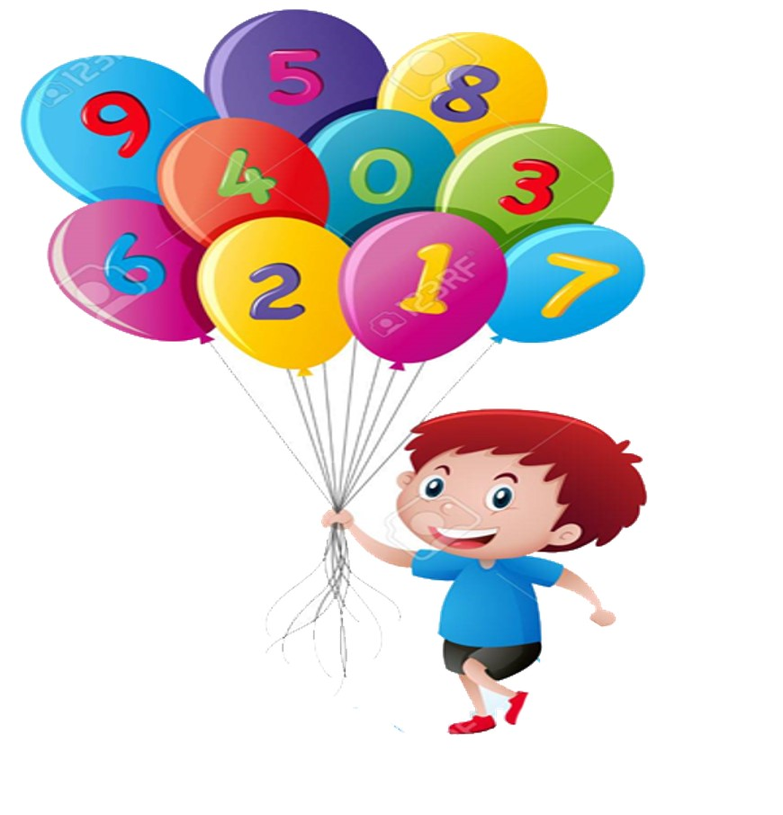


Slide 2
MD. KOWSER ALI
ASISSTANT TEACHER
DURLOVPUR GOVT. PRIMARY SCHOOL
HORINAKUNDU, JHENIDAH.
kowser.gps@gmail.com
Sub: English
Class: Two
Lesson : Colors an numbers
Parts of the lesson: Activity-A
Page No-35

Slide 3

Safety environment by greetings song.
Hello! Hello! How are you?
I’m well, I’m good.
I’m great, I’m wonderful.
Hello! Hello! How are you?
I’m fine! I’m great today.

Slide 4
Checking homework and justify the previous lesson.

Slide 5
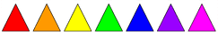
Dear students- How many colors are there?
Now try to say-
What can be the topic of our today’s lesson?

Slide 6
Our today’s lesson is--
Colors and numbers
Activity-A

Slide 7
LEARNING OUTCOMES
By end of the lesson students will be able to-------
Listening: 1.1.1 become familiar with English sounds by listening to
common English words
Speaking: 1.1.2 say simple words and phrases with proper sounds and stress.
Reading: 1.4.1 read words and phrases with the help visual clues and simple
sentences.
2.1.1 recognize and read cardinal numbers up to 30.
Writing: 2.1.1 cardinal numbers up to 30 in figures.

Slide 8
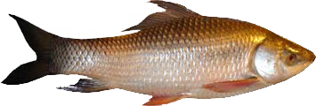
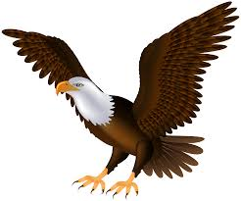

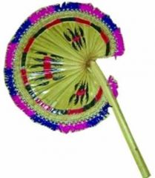
Count and say.
3
5
-------- fishes.
-------- birds
7
6
-------- hand fans.
-------- balls.

Slide 9
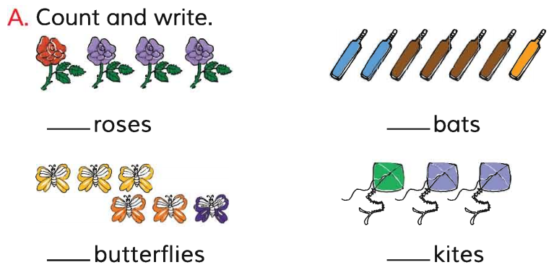
Open your English book at page-35 and see the activity-A.
4
7
6
3
Exchange your book and check the text of other.
Match your answers.

Slide 10

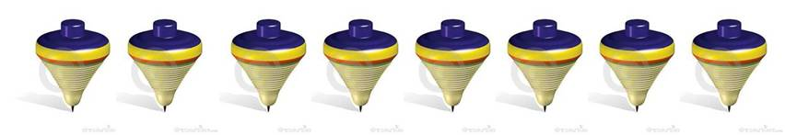
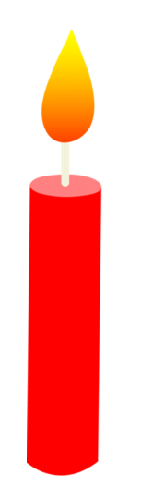
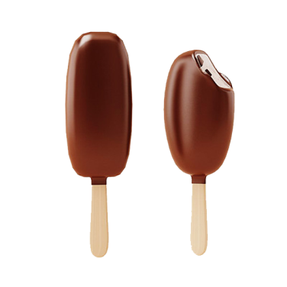
Count and write.
Pair work.
5
9
--------umbrellas.
--------tops
8
13
-------- ice-creams.
-------- candles.
See again

Slide 11
Read and say.
4 roses
7 bats
6 butterflies
3 kites
5 birds
8 balls

Slide 12
One day one word
Read and say.
her
তার
Spell out the word - SGW

Slide 13
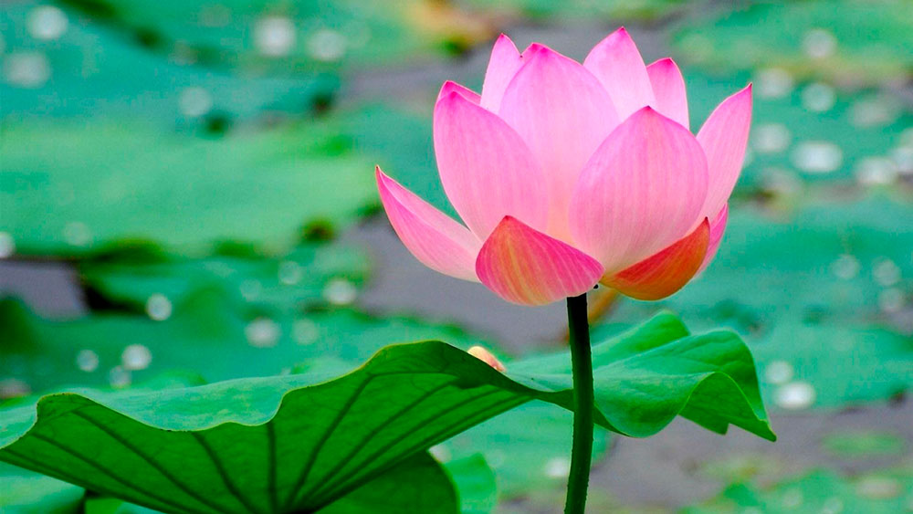
Find out the letters that are made by the word------.
p
h
d
a
e
m
r
k
o
i
Find out the correct word------.
har
hir
her
hare

Slide 14
Say the missing letter.
-er
h-r
he-
Write the word to your notebook.
Date-
/ /20
her
হার
তার

Slide 15
Home work
Page 23 will be well read and written.

Slide 16

That’s all for today. Goodbye. See you tomorrow.

