Slide 1
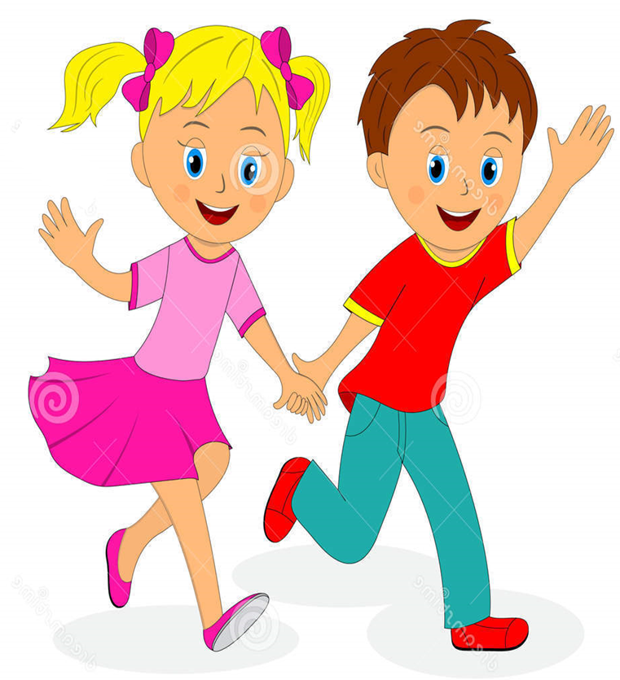


Slide 2
MD. KOWSER ALI
ASISSTANT TEACHER
DURLOVPUR GOVT. PRIMARY SCHOOL
HORINAKUNDU, JHENIDAH.
kowser.gps@gmail.com
Sub: English
Class: Two
Lesson : Numbers-26,27,28
Parts of the lesson: Activity-C
Page No-36

Slide 3
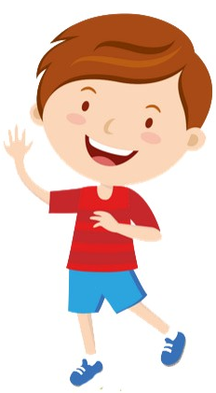
Safety environment by greetings song.
Hello! Hello! How are you?
I’m well, I’m good.
I’m great, I’m wonderful.
Hello! Hello! How are you?
I’m fine! I’m great today.

Slide 4
Checking homework and justify the previous lesson.

Slide 5
Our today’s lesson is too--
Numbers-26,27,28
Activity-C

Slide 6
LEARNING OUTCOMES
By end of the lesson students will be able to-------
Listening: 1.1.1 become familiar with English sounds by listening to
common English words
Speaking: 1.1.1 repeat after the teacher simple words and phrases with
proper sounds and stress.
1.1.2 say simple words and phrases with proper sounds and stress.
Reading: 2.1.1 recognize and read cardinal numbers up to 30.

Slide 7
Look, listen and say.
How many X are there?
How many circles are there?
X
X
X
X
X
X
X
How many A are there?
How many circles are there?
A
A
A
A
A
A
A
A

Slide 8
Look, listen and say.
How many circles are there?
How many circles in box?
Now we will practice on the board.

Slide 9
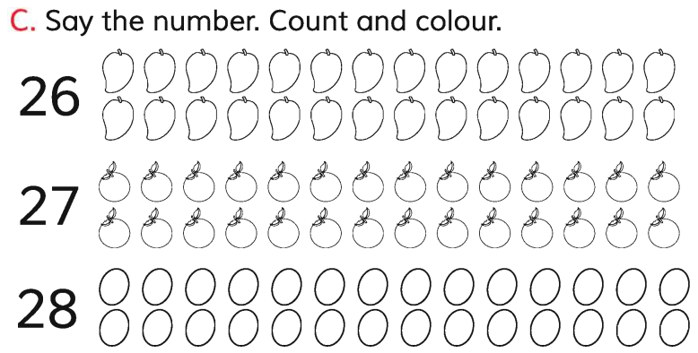
Open your English book at page-36 and see the Activity-C.
SGW
Exchange your books and check the text of other group.

Slide 10
Read and say
18
12
24
6
2
4
9
28
22
15
25
7
14
5
8
11
26
3
13
1
10
19
23
16
21
17
27
20

Slide 11
One day one word
Read and say.
look
দেখা/তাকানো
Spell out the word - SGW

Slide 12
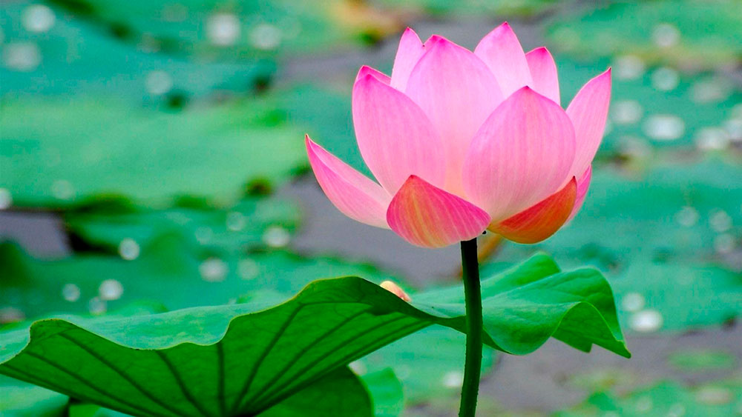
Find out the letters that are made by the word------.
l
w
a
o
s
o
v
k
i
Find out the correct word------.
loke
look
loak
leak

Slide 13
Say the missing letter.
-ook
loo-
l-ok
Write the word to your notebook.
Date-
/ /20
look
লুক
দেখা/তাকানো

Slide 14
Home work
Page 22 will be well read and written.

Slide 15

That’s all for today. Goodbye. See you tomorrow.

