Slide 1
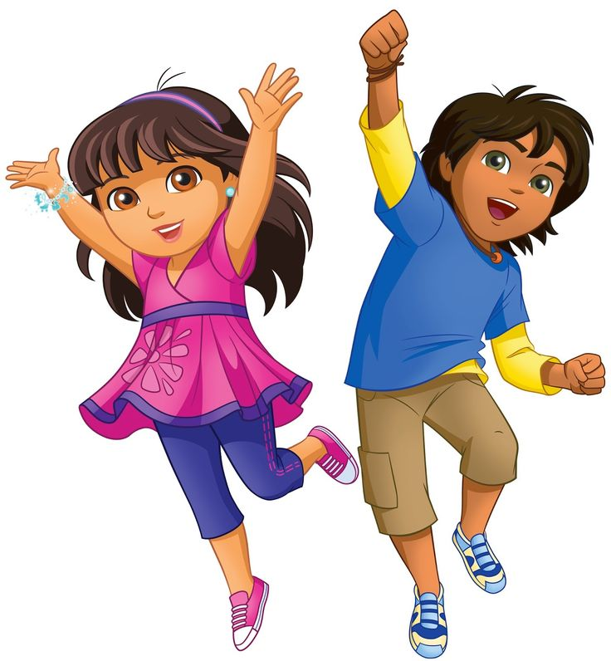


Slide 2
MD. KOWSER ALI
ASISSTANT TEACHER
DURLOVPUR GOVT. PRIMARY SCHOOL
HORINAKUNDU, JHENIDAH.
kowser.gps@gmail.com
Sub: English
Class: Two
Lesson : Numbers-26,27,28
Parts of the lesson: Activity-B
Page No-36

Slide 3

Safety environment by greetings song.
Hello! Hello! How are you?
I’m well, I’m good.
I’m great, I’m wonderful.
Hello! Hello! How are you?
I’m fine! I’m great today.

Slide 4
Checking homework and justify the previous lesson.

Slide 5
Our today’s lesson is too--
Numbers-26,27,28
Activity-B

Slide 6
LEARNING OUTCOMES
By end of the lesson students will be able to-------
Listening: 1.1.1 become familiar with English sounds by listening to
common English words
Speaking: 1.1.1 repeat after the teacher simple words and phrases with
proper sounds and stress.
1.1.2 say simple words and phrases with proper sounds and stress.
Reading: 2.1.1 recognize and read cardinal numbers up to 30.
Writing: 2.1.1 write cardinal numbers up to 30.

Slide 7
Teacher showing real objects.
Look, listen and say.
How many stick?
How many sticks?
Now repeat after me.

Slide 8
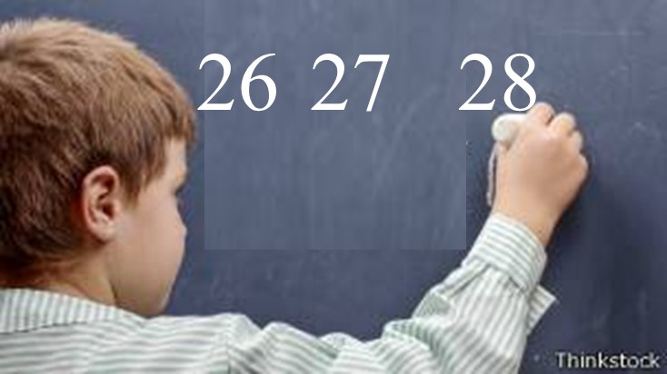
Now we will practice writing the the numbers on the board.

Slide 9
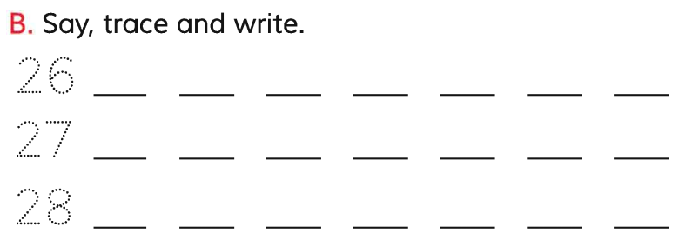
Open your English book at page-36 and see the Activity-B.
Exchange your book and check the text of other.

Slide 10
WCW
Now we will practice writing the numbers in the air.
Identifying weak students and taking to cure.

Slide 11
One day one word
Read and say.
have
আছে
Spell out the word - SGW

Slide 12

Find out the letters that are made by the word------.
p
h
d
c
a
m
v
k
e
x
Find out the correct word------.
have
hav
hev
heve

Slide 13
Say the missing letter.
h-ve
-ave
hav-
Write the word to your notebook.
Date-
/ /20
have
হ্যাভ
আছে

Slide 14
Home work
Page 21 will be well read and written.

Slide 15

That’s all for today. Goodbye. See you tomorrow.

