Slide 1

Welcome to Multimedia Class

Slide 2
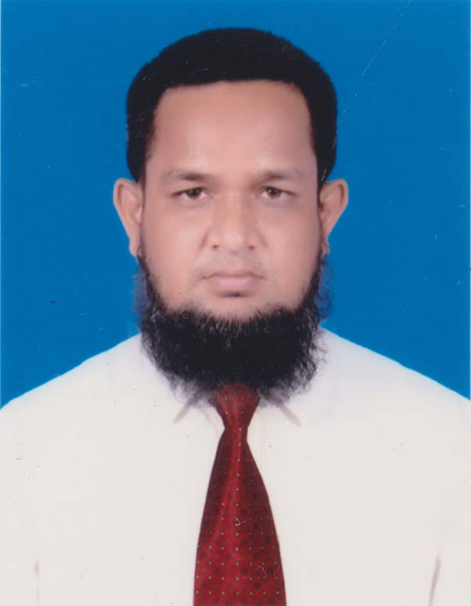

Identity
English 2nd Paper
Class : 11-12
Time : 45min
MD.ABDUR ROUF
Lecturer(English)
Khalna Islamia Fazil(Degree) Madrasah
Patnitala,Naogaon.

Slide 3
Look at the following sentences
If you are confident , --------------- .
If you are confident , you will be successful .
Had I been a rich man , ------------------- .
Had I been a rich man , I could have helped the poor .
In which form the sentences have written ?
INCOMPLETE
&
COMPLETE

Slide 4
Today our topic is
“Completing Sentences”

Slide 5
Learning Outcomes
After we have studied this TEXT , we will be able to
Define the definition of different Sentences ,Clause & Phrase .
Describe the rules of Completing sentences .
Complete the incomplete Sentences .

Slide 6
Definition of sentence
Sentence :
A word or a group of words having a clear
meaning in a given context is called a Sentence .
Example : I am a teacher of English .
Classification of sentence
According to the structures there are three kinds of Sentence :
(i) Simple Sentence .
(ii) Complex Sentence .
(iii) Compound Sentence .

Slide 7
Definition of different sentences
Simple Sentence :
A Simple Sentence is one that contains only one subject &
finite verb . Example : I helped a poor boy .
Complex Sentence :
A Complex sentence is one that contains one principal clause & one or more Subordinate Clause or Clauses .
Example : I have a pen which is very nice .
Compound Sentence:
A Compound sentence is one that contains two or more independent Clauses or Co-ordinating Clauses joined together by Co-ordinating Conjunctions like And , But, Or etc . Example : The man is poor but honest .

Slide 8
Definition of Clause
Clause :
A Clause is a group of words that contains a finite verb expressed or understood .
Example : I can not tell when he will come .
Clause
Classification of Clause
According to the structures there are three kinds of Clause :
(i) Principal Clause .
(ii) Subordinate Clause .
(iii) Co-ordinate clause . .

Slide 9
Definition of Phrase
Phrase :
A Phrase is a group of words which does not contain a finite verb .
Example : He tried heart and soul to pass the exam .
Phrase
Difference of Clause & Phrase
(i) He gave me a gold chain .
(ii) He gave me a chain which was made of gold .
.
Phrase
Clause

Slide 10
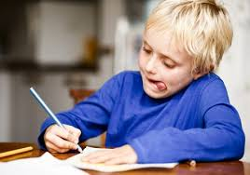
Individual WORK-++
Write down the definition of Sentence , Clause & Phrase .

Slide 11
Structures of Completing Sentence
Key words | Structure & Example
If অর্থ : যদি | If + Sub. + Verb ( Present Form ) + Ext. + (,) + Sub. + Verb ( Future Form ) + Ext. Sub. + Verb ( Future Form ) + Ext. + If + Sub. + Verb ( Present Form ) + Ext. Example : If it rains , we shall not go there . Example : I shall help him If he wants .

Slide 12
Structures of Completing Sentence
Key words | Structure & Example
If অর্থ : যদি | If + Sub. + Verb ( Past Indefinite Form ) + Ext. + (,) + Sub. + Past Conditional Form ( Would , Could , Might , Should ) + Principal Verb + Ext. Sub. + Past Conditional Form ( Would , Could , Might , Should ) + Principal Verb + Ext. + If + Sub. Verb ( Past Indefinite Form ) + Ext. Example : If he came , I would go . Example : We might help them If they wanted .

Slide 13
Structures of Completing Sentence
Key words | Structure & Example
If অর্থ : যদি | If + Sub. + Verb ( Past Perfect Form ) + Ext. + (,) + Sub. + Past Perfect Conditional Form ( Would Have , Could Have , Might Have , Should Have ) + Verb ( Past Participle Form ) + Ext. Sub. + Past Perfect Conditional Form ( Would Have , Could Have , Might Have , Should Have ) + Verb ( Past Participle Form ) + Ext. + If + Sub. + Verb ( Past Perfect Form ) + Ext. Example : If I had seen him, I might have told him this. Example : She would have succeeded If she had tried .

Slide 14
Structures of Completing Sentence
Key words | Structure & Example
If অর্থ : যদি | If + Sub. + Verb ( Were ) + Ext. + (,) + Sub. + Past Conditional Form ( Would , Could , Might , Should ) + Principal Verb + Ext. Sub. + Past Conditional Form ( Would , Could , Might , Should ) + Principal Verb + Ext. + If + Sub. Verb ( Were ) + Ext. Example : If I were a king , I could help the poor . Example : I would play with toys If I were a child .

Slide 15
Structures of Completing Sentence
Key words | Structure & Example
Had অর্থ : যদি | Had + Sub. + Verb ( Past Participle Form ) + Ext. + (,) + Sub. + Past Perfect Conditional Form ( Would Have , Could Have , Might Have , Should Have ) + Verb ( Past Participle Form ) + Ext. Sub. + Past Perfect Conditional Form ( Would Have , Could Have , Might Have , Should Have ) + Verb ( Past Participle Form ) + Ext. + Had + Sub. + Verb ( Past Participle Form ) + Ext. Example : Had I seen him, I might have told him this. Example : She would have succeeded Had she tried .

Slide 16
Structures of Completing Sentence
Key words | Structure & Example
Would That / I Wish অর্থ : অসম্ভব ইচ্ছা / আকাঙ্খা | Sub. + Wish + Ext. + Sub. ( 1-st Sub. ) + Were + Ext. Would That + Sub. + Were + Ext. + In Case + Sub. + Verb ( Present Form ) + Ext. Example : I wish I were a king . Example : Would That he were alive today .

Slide 17
Structures of Completing Sentence
Key words | Structure & Example
In Case অর্থ : যদি | Sub. + Verb ( Present Form ) + Ext. + In Case + Sub. + Verb ( Future Form ) + Ext. Sub. + Verb ( Present Form ) + Ext. + In Case + Sub. + Verb ( Present Form ) + Ext. Sub. + Verb ( Past Form ) + Ext. + In Case + Sub. + Verb ( Past Form ) + Ext. Example : I shall come tomorrow In Case he wants me. Example : I want to stay at home In Case he comes . Example : I carried an umbrella In Case it rained .

Slide 18
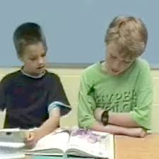
pair WORK
Write down Six structures of Completing Sentence .

Slide 19
Rules of Completing Sentence
Rule-1
If যুক্ত Incomplete Sentence- এর প্রথম অংশ Present Indefinite -এ হলে পরের অংশটি Future Indefinite -এ লিখে Sentence টি Complete করতে হয় ।
If যুক্ত Incomplete Sentence- এর প্রথম অংশ Future Indefinite -এ হলে পরের অংশটি Present Indefinite -এ লিখে Sentence টি Complete করতে হয় ।
Example:
Incomplete : I shall attend the meeting If -------------------- .
Complete : I shall attend the meeting If he invites me .
Rule-2
If যুক্ত Incomplete Sentence- এর প্রথম অংশ Past Indefinite -এ হলে পরের অংশটি Past Conditional + Verb + Ext. লিখে Sentence টি Complete করতে হয় ।
If যুক্ত Incomplete Sentence- এর প্রথম অংশ Past Conditional + Verb + Ext. হলে পরের অংশটি Past Indefinite-এ লিখে Sentence টি Complete করতে হয় ।
Example:
Incomplete : If you called me , --------------------- .
Complete : If you called me , I would help you .

Slide 20
Rules of Completing Sentence
Rule-3
If যুক্ত Incomplete Sentence- এর প্রথম অংশ Past Perfect -এ হলে পরের অংশটি Past Perfect Conditional + Verb ( Past Participle ) + Ext. লিখে Sentence টি Complete করতে হয় ।
If যুক্ত Incomplete Sentence- এর প্রথম অংশ Past Perfect Conditional + Verb ( P. P. ) + Ext. হলে পরের অংশটি Past Perfect-এ লিখে Sentence টি Complete করতে হয় ।
Example:
Incomplete : I had finished the work If -------------------- .
Complete : I had finished the work If you could have helped me .
Rule-4
If যুক্ত Incomplete Sentence- এর Clause-এ Subject-এর পরে Were থাকলে Principal Clause -এ Subject –এর পর Past Conditional + Verb + Ext. লিখে Sentence টি Complete করতে হয় ।
Example:
Incomplete : If I were a bird , --------------------- .
Complete : If I were a bird , I could fly in the sky .

Slide 21
Rules of Completing Sentence
Rule-5
Had যুক্ত Incomplete Sentence- এর Subordinate Clause -এ Had + Sub. + Verb ( Past Participle ) + Ext. থাকলে Principle Clause টি Sub. + Perfect Conditional + Verb ( Past Participle ) + Ext. লিখে Sentence টি Complete করতে হয় ।
Example:
Incomplete : Had I finished the work , -------------------- .
Complete : Had I finished the work , you could have helped me .
Rule-6
Would That / I Wish দ্বারা অসম্ভব ইচ্ছা , আকাঙ্খা ইত্যাদি প্রকাশ করা হয় ।Would That / I Wish যুক্ত Incomplete Sentence-এ Subject-এর পরে Were + Ext. লিখে Sentence টি Complete করতে হয় ।
Example:
Incomplete : Would That / I wish , --------------------- .
Complete : Would That / I Wish , I could fly in the sky .

Slide 22
Rules of Completing Sentence
Rule-7
In Case যুক্ত Subordinate Clause টি Principle Clause-এর কাজের কারণ নির্দেশ করে । In Case যুক্ত Incomplete Sentence-কে Complete করার সময় In Case-এর পর Principle Clause-এর কারণের সাথে সম্পর্কযুক্ত একটি Subordinate Clause ( Present Form ) গঠন করে Sentence টি Complete করতে হয় ।
কোন কাজ সংঘটিত হয়েছে এরূপ বুঝাতে In Case যুক্ত Sentence –এর উভয় Clause-এ Past Tense ব্যবহৃত হয় ।
In Case যুক্ত Clause সাধারণতঃ Principle Clause-এর পরে বসে । তবে In Case Of + Noun যদি If there is a/an + Noun অর্থ প্রকাশ করে তবে তা Principle Clause-এর পূর্বে বসে ।
Example:
Incomplete : I shall attend the meeting In Case -------------------- .
Complete : I shall attend the meeting In Case he invites me .
2. Incomplete : You called me , --------------------- .
Complete : You called me In Case , you wanted .
3. Incomplete : In Case the shortage of money , --------------------- .
Complete : In Case the shortage of money , phone me .

Slide 23
Complete the following sentences (In group)
1. Incomplete : If I were a nutritionist ----------------- .
1. Complete : If I were a nutritionist ----------------------------------------- .
I would teach them nutrition
2. Incomplete : Would That -------------------- .
2. Complete : Would That --------------------------.
I were a writer
3. Incomplete : Had Kashem been my brother -------------------- .
3. Complete : Had Kashem been my brother ------------------------------------.
I would have helped him
4. Incomplete : You will success in life If -------------------------- .
4. Complete : You will success in life If --------------------------- .
You work hard

Slide 24
Evaluation
1. Incomplete : I would not come to disturb you If ------------------- .
1. Complete : I would not come to disturb you If ---------------------------- .
I knew the matter
2. Incomplete : Had I possessed vast property, ------------------- .
2. Complete : Had I possessed vast property ,
----------------------------------------------.
I would have established a college
3. Incomplete : I waited at the station In Case ------------------- .
3. Complete : I waited at the station In Case --------------------------------- .
he came
4. Incomplete : I could have joined the party If ------------------- .
4. Complete : I could have the party If ----------------------------------------- .
I had not busy with my exam

Slide 25

Home work
Write down only six sentences according to the rules of Completing Sentence.

Slide 26

No more today
See you tomorrow

