Slide 1

WELCOME

Slide 2
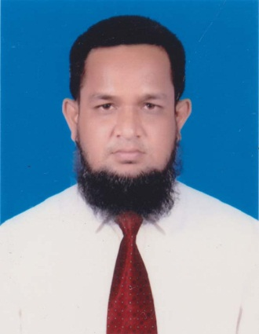
Identification
Teacher Identification.
Md. Abdur Rouf
rouf301285@gmail.com
Lecturer(English)
Khalna Islamia Fazil(Degree) Madrasah.
Patnitala,Naogaon.

Slide 3


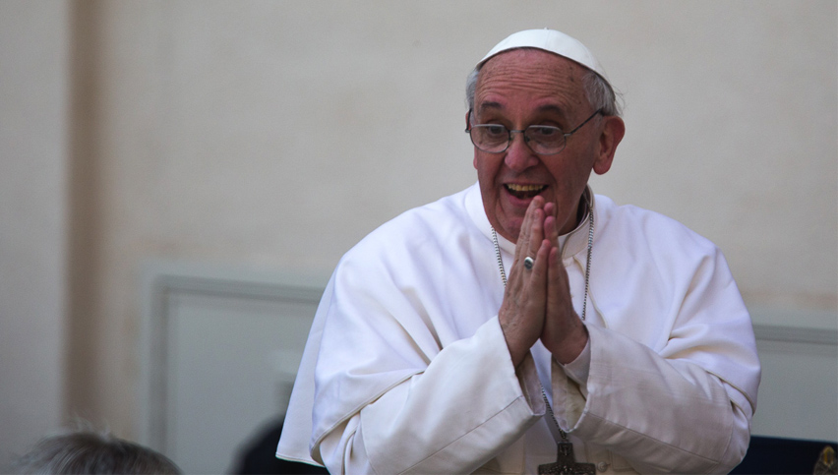
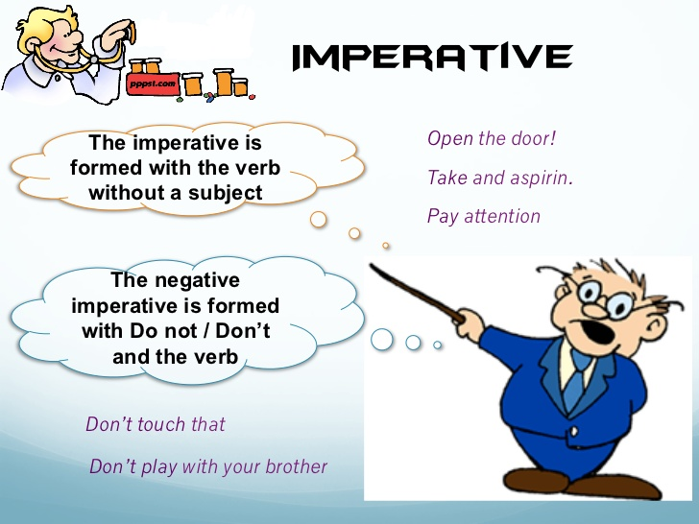

Look at the picture

Slide 4

Look at the sentences below.
1.Kamal is going to School.
2.Is Kamal going to School?
3.What a slim Kamal is!
4.May Bangladesh live long.
5.Go to School.
Notes:
How many sentences are there? What is the name of these sentence?What is sentence and its classification?

Slide 5

Today’s Lesson is-
Transformation of Sentences

Slide 6
After finishing this lesson students will be able to…
1.Say the definition of sentence.
2.Say kinds of sentences.
3.Say the rules of changing from affirmative to negative.

Slide 7
How to convert from affirmative to negative.
None but(person)/Nothing but(things)Not more than/Not less than(Number/Age)
Only/alone/merely
Replaced by
Affirmative: Only Allah can help us.
Negative: None but Allah can help us.

Slide 8
Can not but/Can not help(V+ing)
Must
Replaced by
Affirmative: We must obey our parents.
Negative: We can not but obey our parents.

Slide 9
Notonly……but also
Both…………and
Replaced by
Affirmative: Both Hira and Mira were excited.
Negative: Not only Hira but also Mira were excited.

Slide 10
No sooner had..(v3)….than
As soon as
Replaced by
Affirmative: As soon as the man saw the police he ran away.
Negative: No sooner had the man seen the police than he ran away.

Slide 11
No other+rest part of superlative degree+so+positive deg.+as+sub.
Absolute superlative degree
Replaced by
Affirmative: Dhaka is the biggest city in Bangladesh.
Negative: No other city in Bangladesh is as good as Dhaka.

Slide 12
Notonly.......but also
And(If join two words)
Replaced by
Affirmative:He was obedient and gentle.
Negative: He was not only obedient but also gentle.

Slide 13
Always
Never+opposite word
Replaced by
Affirmative: Rony always attends the class.
Negative: Rony never misses the class.

Slide 14
Every one/Every body/Every person/Every mother/Every+Common noun/All
There is no+attached word+but+rest part
Replaced by
Affirmative: Every mother loves her child.
Negative:There is no mother but loves her child.

Slide 15
Sometimes affirmative sentences are
Using opposite word(before the word) “not” is used
Replaced by
Affirmative: I shall remember you.
Negative:I shall not forget you.

Slide 16
As……..as
Not less……than
Replaced by
Affirmative: Shimi is as wise as Rimi.
Negative:Shimi is notless wise than Rimi.

Slide 17
Too……….to
So……..that+sub+can not/could not+verb
Replaced by
Affirmative: He is too weak to walk.
Negative:He is so weak that he can not walk.

Slide 18
Universal truths are
making them negative and interrogative
Replaced by
Affirmative: The sun sets in the west.
Negative:Does not the sun set in the west?

Slide 19
Sometimes
Not always
Replaced by
Affirmative: Rahim sometimes visits me.
Negative:Rahim doesnot always visit me.

Slide 20
Many
Not afew
Replaced by
Affirmative: I have many friends.
Negative:I have not a few friends.

Slide 21
A few
Not many
Replaced by
Affirmative: Bangladesh has a few scholars.
Negative:Bangladesh has not many scholars.

Slide 22
Much
A little
Replaced by
Affirmative: He belongs much mony.
Negative:He does not belong a little money.

Slide 23
A little
Not much
Replaced by
Affirmative: Dolon has a little riches.
Negative:Dolon does not have much riches.

Slide 24
Group Work
Write five rules of changing from affirmative to negative.

Slide 25

HOME WORK
What kind of sentences are according to meaning?

Slide 26
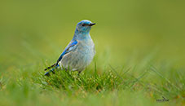
Thank you

