Slide 1

WELCOME

Slide 2
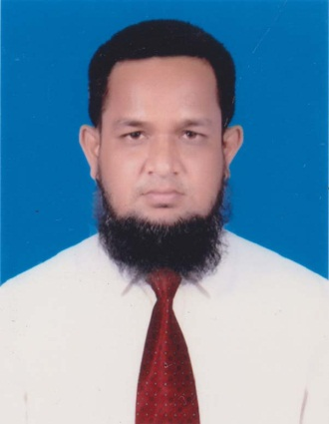
Identity
TEACHER`S IDENTITY
MD.ABDUR ROUF LECTURER IN ENGLISH KHALNA ISLAMIA FAZIL(DEGREE) MADRASHA
PATNITALA,NAOGAON.

Slide 3
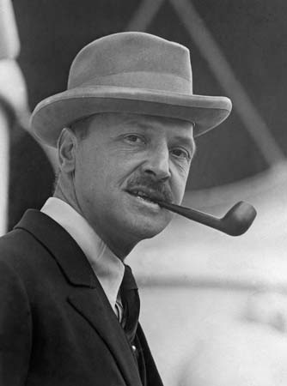
Writer`s identity
Name: William Somerset Maugham(1874-1965)
Birth place:Paris
Character: British novelist,playwright and short story writer.
Important works:Liza of lambet,Of human bondage,The merry-go-round etc.

Slide 4
Lesson Declaration
Class : Alim(HSC)
Unit 3 ,Lesson 2
Title : EATING HABIT AND HAZARDS
Reference: Short Story `THE LUNCHEON`

Slide 5
LEARNING OUTCOME
          The students will be able to say:
1 What a short story is.
2 The bad effect of overeating.
3 A profound understanding of human nature.

Slide 6
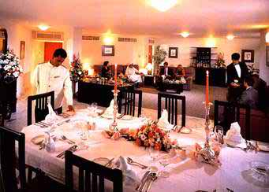
PRESENTATION

Slide 7
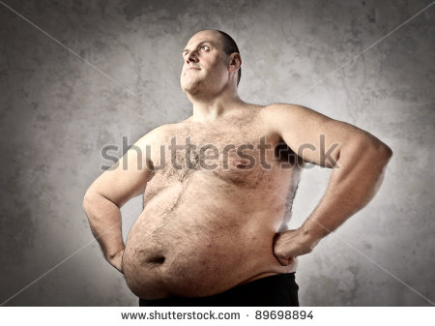
What do you watch in the picture?

Slide 8
Find out the answer from 4 alternatives through listening
1.To lead the life the writer was earning ……..
a)Much b) little c) few d) a little
2.The writer received …….letters
One b) two c) three d) none
3.Foyot`s is a/an……restaurant.
Rich b) expensive c)good d)French
4.The luncheon finally cost ……a) 15 franks b)80
Franks c) 95 franks d) more than his thinking.
Ans: 1.d) 2.b) 3.b) 4.d)

Slide 9
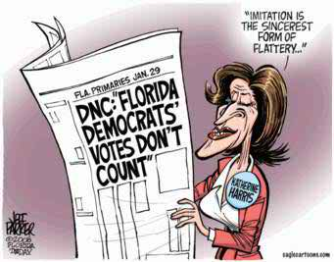
Flattery
praising

Slide 10
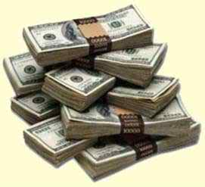
WORD MEANING
Expensive
      Costly, valuable.

Slide 11
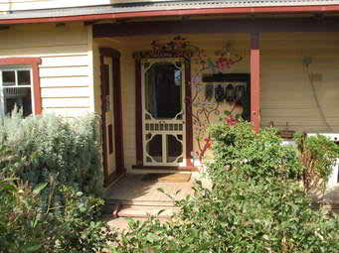

Hospitable Splendid
Welcoming
Gorgeous,Magnificient

Slide 12
Group Work
1.What are the items the lady ate?
2.What is irony?
3. What examples of irony we find in the text?

Slide 13
Home Work
1.What are the bad effects of overeating?
2.How much successful is the writer?
3.Have you cheated anywhere in your life? How did you react then?

Slide 14

THANK YOU VERY MUCH

