Slide 1
RED ROSE WELCOME

Slide 2
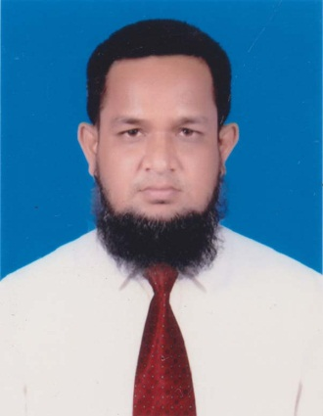
TEACHER’S IDENTITY
Md. Abdur Rouf
Lecturer in English
Khalna Islamia Fazil(Degree) Madrasah,Patnitala,Naogaon.
Cell Phone: 01767650169

Slide 3
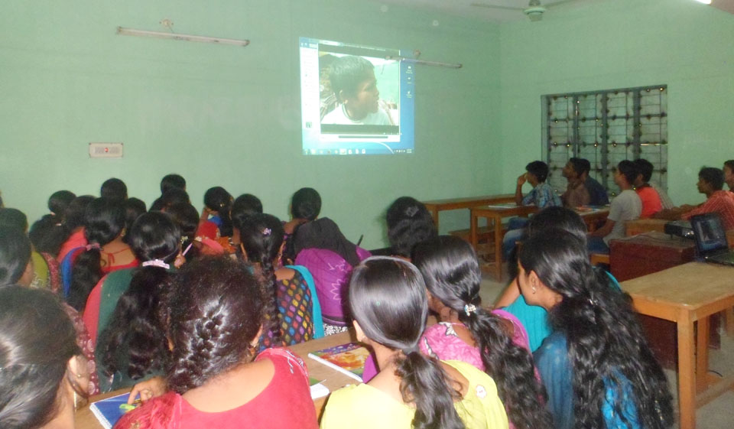
Introduction to Session
Sub: English 1st Paper
Class- xi
Unit- Eight, Lesson- 04
Students: 40
Time: 50 minutes

Slide 4
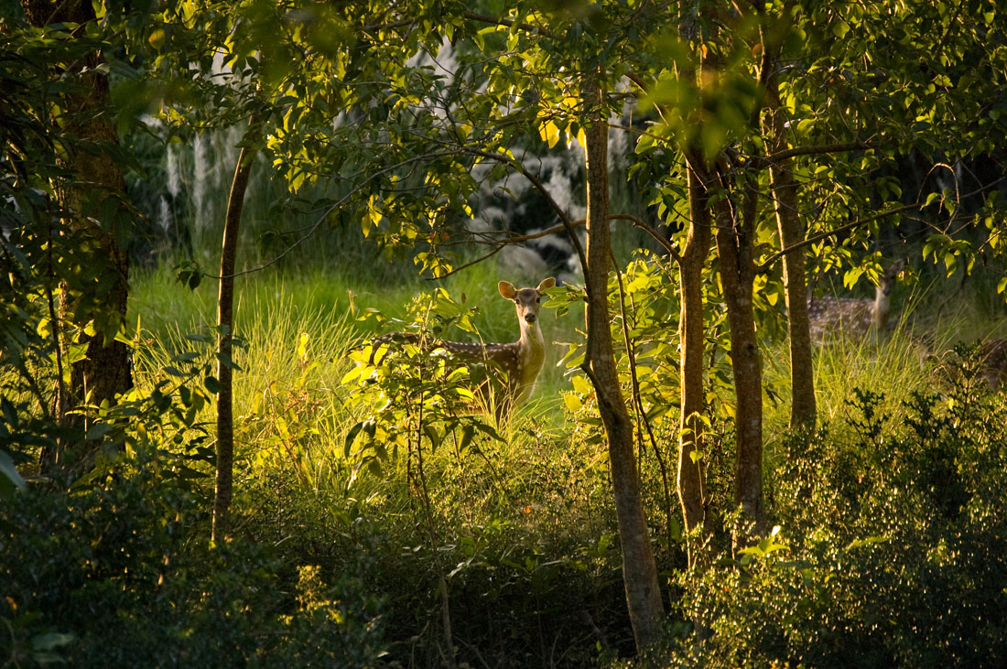
The Sundarbans

Slide 5
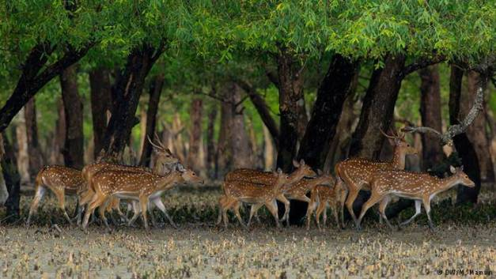
We can see

Slide 6
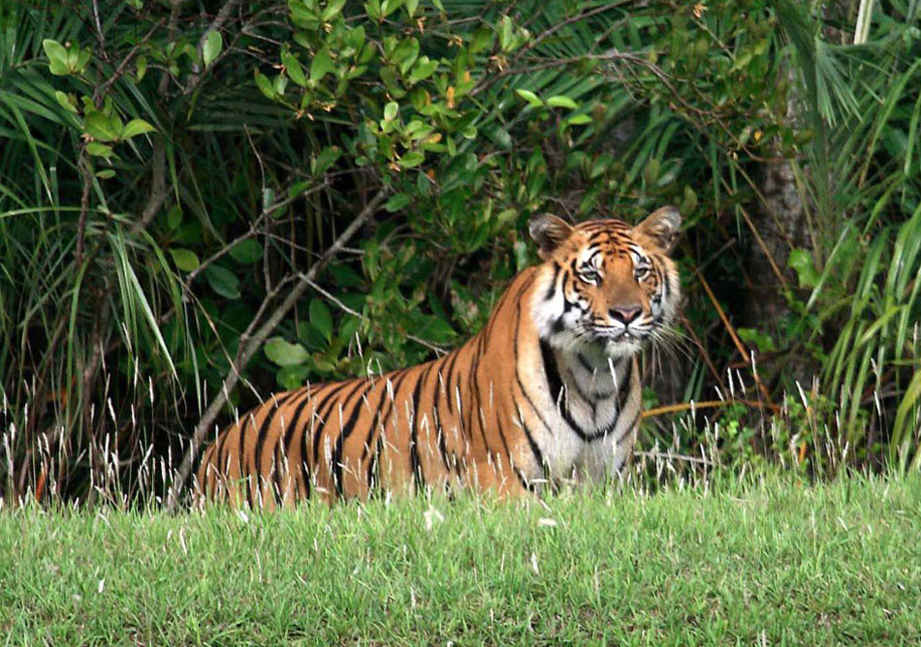
Our lesson today
Threats to Tigers of Mangrove Forest

Slide 7
LEARNING OUTCOMES
By the end of the lesson students will
► mention the causes of extinction of The Royal Bengal Tiger
► answer some questions
► learn some new words
► develop listening, reading & writing skills

Slide 8
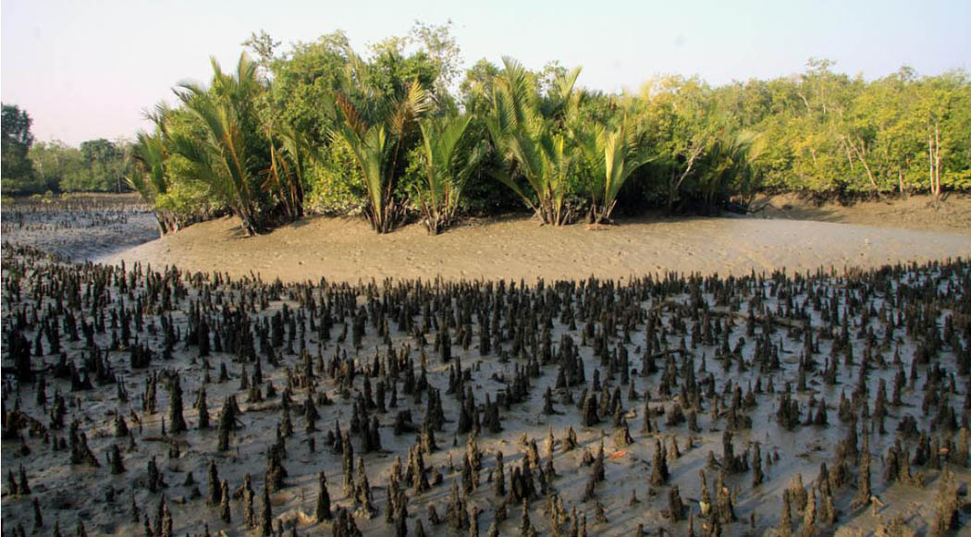
The difficult words you may face
Mangrove
A tropical tree that grows in swamps or shallow salt water

Slide 9
Now read the passage silently and in group point out the different causes of the decrease in the numbers of tigers in the Sundarbans

Slide 10
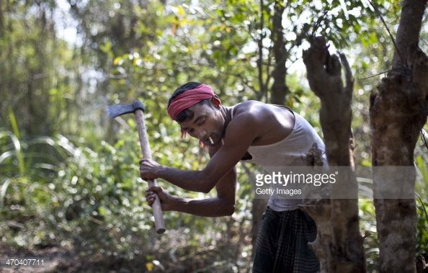
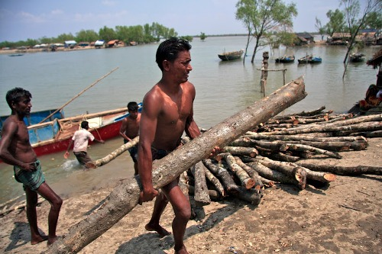
Cutting down trees indiscriminately

Slide 11
Other reasons

Slide 12
Individual work
Answer the following questions
►How many tigers live in the Sundarbans
►When did super cyclone sidr hit the Sundarbans
►Why is the sundarbans famous for
►Who is Sarah Christie
►What will happen if we loss the Sundarbans

Slide 13
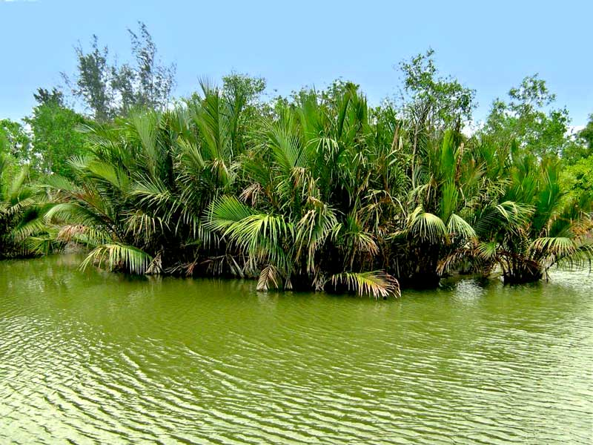
HOME WORK
Write a paragraph on the Sundarbans

