Slide 1
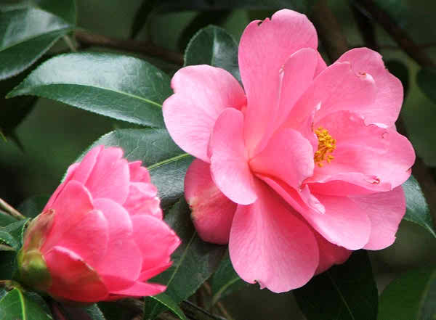
WELCOME

Slide 2
Teacher’s Identity
Name: MD.ABDUR ROUF
Lecturer( English)
Khalna Islamia Fazil(Degree) Madrasah,Patnitala,Naogaon.

Slide 3
Introduction of the lesson
English For Today
Class: xi
Unit: one ,Lesson:3
Time: one hour
Students: 4o

Slide 4
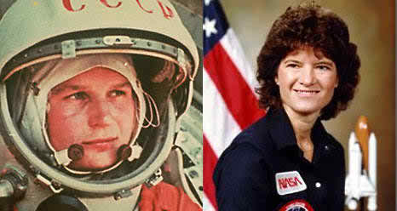
Mention the name of the 1st woman travelled in space
Valentina Tereshcova

Slide 5
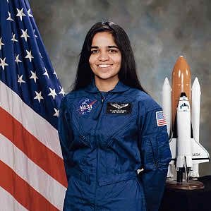
Mention the name of the 1st Indian born woman travelled in space
Kalpana Chawla

Slide 6
Announcement of the lesson
Two Women

Slide 7
Learning Outcomes
Students will be able to……..
1.Tell the meaning of some words.
2. Answer some questions on Valentina and Kalpana Chawla.
3.Tell the biography of two famous women.
4.Write paragraph on Valentina Tereshcova and Kalpana Chawla.

Slide 8
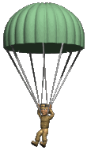
Difficult words analyze
Parachuting
Jumping with Parachute
The pilot is practicing parachuting

Slide 9
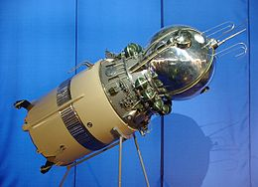
Vostok
The space craft that carried Valentina
Valentina used Vostok-5 to travel in space

Slide 10
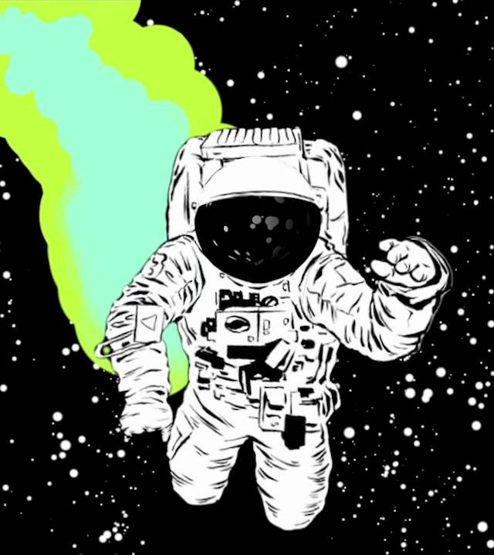
Space walk
Walking in space
Walking in space is not an easy work

Slide 11
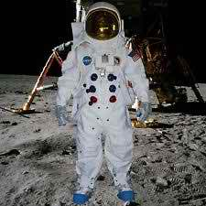
Spacesuit
Special dress or suit wear by cosmonaut
Spacesuit is needed to go to space

Slide 12
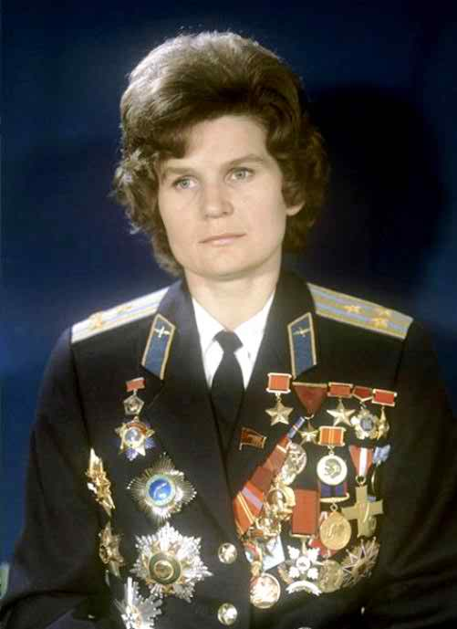
Answer
# Spacesuit
# By bus
#Orange

Slide 13
Biography of Valentina Tereshkova
Was born in 6 March 1937
Father was a tractor driver
Mother was textile plant worker
Went to school at the age of eight in 1945
Left school in 1953

Slide 14
Left school in 1953
Continued education through distance learning
Doctorate in Engineering 1977 from Zhukovsky Air Force Academy
Interested in parachuting and skydiving
First jumped at 22, on 21 May 1959

Slide 15
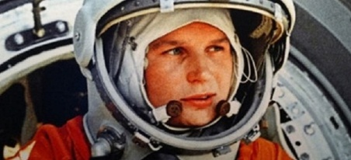
Training
Weightless flight
Isolation tests
Centrifuge tests
Rocket theory
Spacecraft engineering
120 Parachute jumps
Pilot training

Slide 16
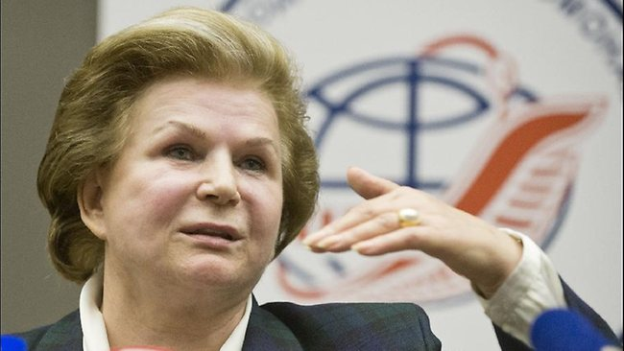
Career
Lunched Vostok-6 on 16 June 1963
Orbited the earth 48 times
Spent about 3 days in space
Became the presidium members of the Supreme Soviet after 1977
Now a member in the Lower house of the Russian Legislature

Slide 17
Read the passage silently and Fill the flow chat in group
Make short notes in the each of the boxes in the flow chart showing information about Valentina Tereshkova
Was born in 1937 in a village of Tutayvsky

Slide 18
Was born in 1937
Went to school in 1945
Left school in 1953
Completed education through distance learning
First jump in 1959
In 1977 earned doctorate

Slide 19
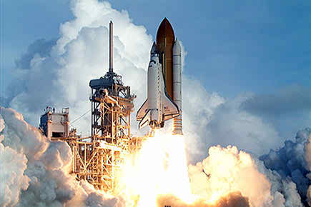
Answers:
1 Feb. 2003
At 8.40 AM
At 8.44 Am

Slide 20
Biography of Kalpana Chawla
Birth & Education
Was born on 17 March 1962
Graduated from Panjab Engineering College, India in 1982
Obtained Master’s Degree from University of Texas in 1984, USA
Ph.D. from University to Colorado, USA in 1988

Slide 21
Career & Death
Joined NASA as vice president in 1988
Worked as CFD (Computational Fluid Dynamic)
Became citizen of the USA in 1991
Started her career as NASA astronaut in 1995.
Selected for first flight in 1996.

Slide 22
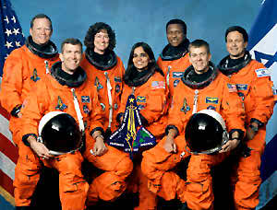
Travelled 10.67 million miles in space
First mission began 19 November, 1997
In 2002 selected for the 2nd mission
2nd mission started on 16 January, 2003
Died in 1 February, 2003

Slide 23
The sentences below are true about either Tereshkovs or Chawla. Find out which applies to whom
She was an engineer.
She came from an ordinary family.
# She is one of the victims of a spacecraft disaster
She earned a ph.D degree.
She was selected from among 400 competitors
*Involved in politics.

Slide 24
Write a paragraph on Valentina Tereshcova and Kalpana Chawla based on the informations provided in the text.

Slide 25
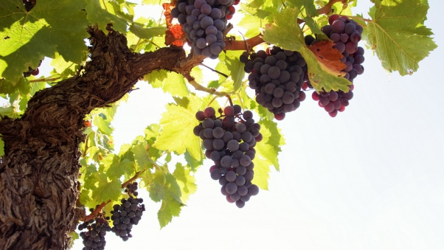
Thank you so much

