Slide 1
WELCOME

Slide 2
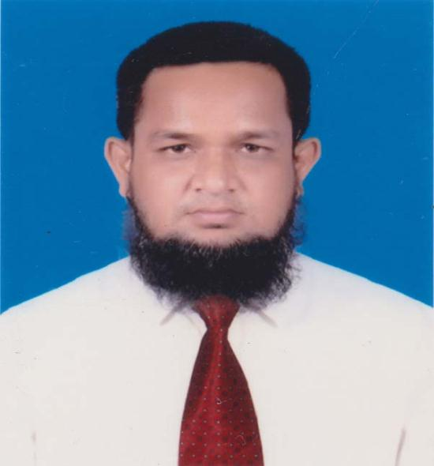
Presented By-
MD.ABDUR ROUF

Slide 3
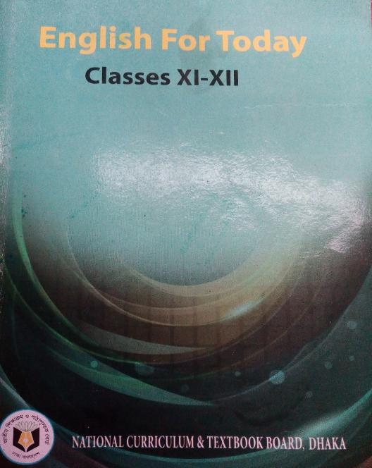
Subject Introduction
Subject : English 1st paper
Unit : 14
Lesson : 01(What is Beauty)
Time : 45 Minutes
Date : 26/08/2019
Click to see the Text

Slide 4
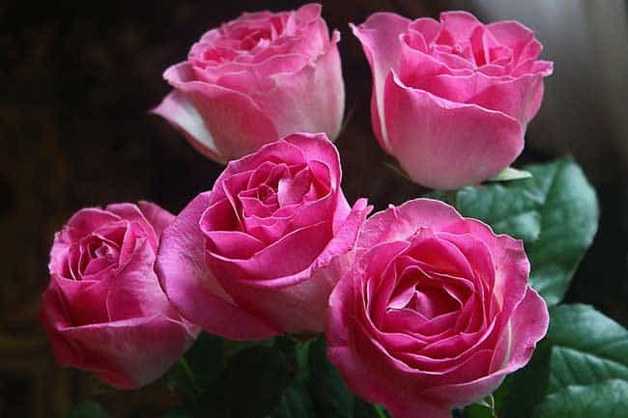
How to look?

Slide 6
Today’s Lesson?
What is Beauty?

Slide 7
Learning Outcomes-
At the end of the lesson, Ss will be able to -
Learn some new words.
Say about the real beauty of life.
Be introduced with some romantic poets.

Slide 8
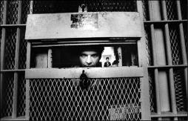
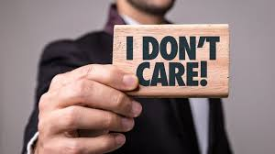
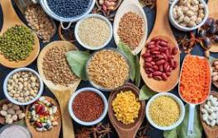
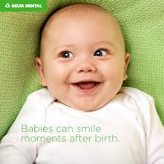
Individual Work (3 minutes)
Learning New Words
Put up hand and say the meaning-
Ignore
Confine
Ingredient
Mortality

Slide 9
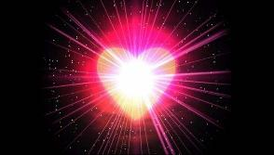
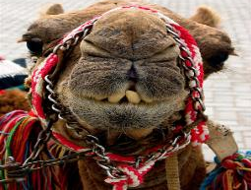
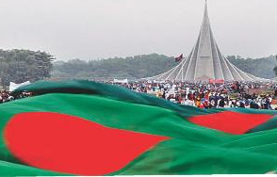
Individual Work (3 minutes)
Learning New Words
Put up hand and say the meaning-
Romantic
Appreciate
Ugly
Independent

Slide 10
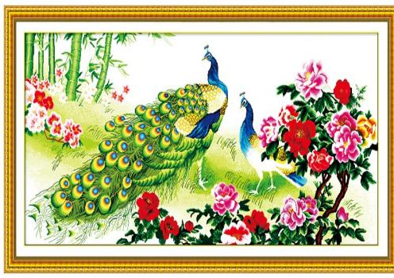
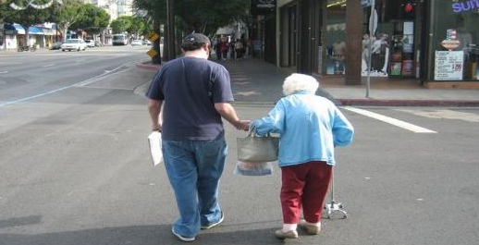
Real Beauty of life
We discover beauty in pleasurable objects and sights-

Slide 11
Real Beauty of life

Slide 12
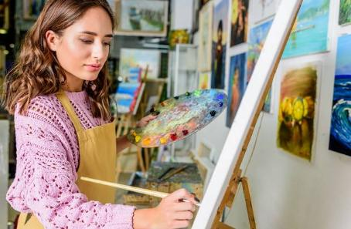
Real Beauty of life
Poets and artists have provided an answer by incorporating beauty and truth---

Slide 13
Real Beauty of life
Pair Work (5 minutes)
Make a flow chart showing the perception
of beauty.

Slide 14
Real Beauty of life
1.
Beauty being easy to appreciate
2.Beuty being difficult to define
6.Beauty being an important part of life.
3.
Beauty being discovered in pleasurable objects
4.
Beauty prevailing in the laughter of children
5.
Beauty having an independent objective identity
# Now match the answer:

Slide 15
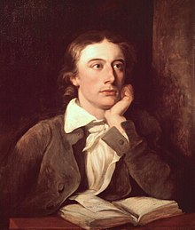
Romantic Poet
Born in 1795
London, UK
Died in 1821 in Rome, Italy
An English Romantic poet
"Ode on a Grecian Urn”, a famous poem
John Keats

Slide 16
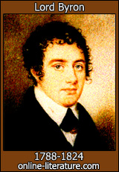
Romantic Poet
Born in 1788
Birth Place-London
Died in 1824 (36 years old)
Romantic Poet & politician
She Walks in Beauty, a famous poem
Lord Byron

Slide 17
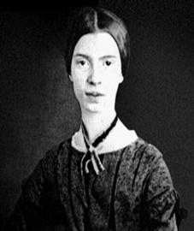
Romantic Poet
Born in 1830
Massachusetts, United States
Died in 1886
an American poet of Romantic Tradition
I Died For Beauty, a famous poem
Emily Dickinson

Slide 18
Lesson Evaluation
Which products are commonly adulterated
‘Beauty is truth, truth beauty’- who comments it

Slide 19
Lesson Evaluation
Which products are commonly adulterated
What’s the vital part of life

Slide 20
Lesson Evaluation
Which products are commonly adulterated
“Beauty is a complex word”-do you agree
Yes, I agree to the statement. As beauty is easy to appreciate but difficult to define. We can discover beauty in all kinds of pleasurable objects and things but we can’t define it because it’s absolutely dependent on sense of perception.

Slide 21
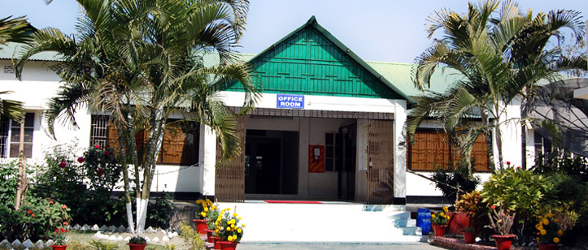
HOME WORK
Write a paragraph on Beauty.

