Slide 1
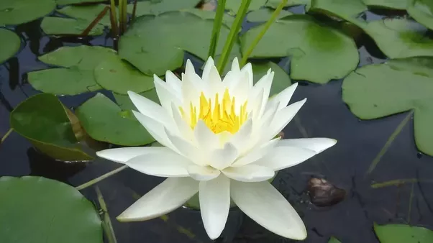
Welcome

Slide 2
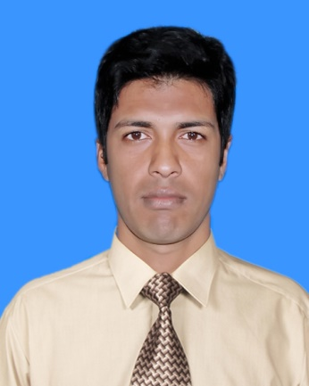
Introduction
Md. Magzumi
Assistant Teacher
Kutubpur Hat GPS
Shibchar, Madaripur.
Mob: 01720647519 Emailtmagzumi1985@gmail.com

Slide 3
Class : Two
Subject : English
Time : 45 minute

Slide 4
Learning Outcome
1.1.1 : become familiar with English sounds by listening to common English word.
1.2.1 : recognize and read the Alphabet both small and Capital. (Non cursive)

Slide 5
Let’s we sing a song.
We shall overcome
We shall overcome
We shall overcome someday
Oh deep in my heart, I do believe,
………………………………..

Slide 6
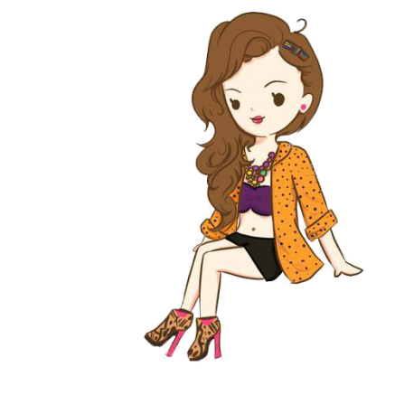
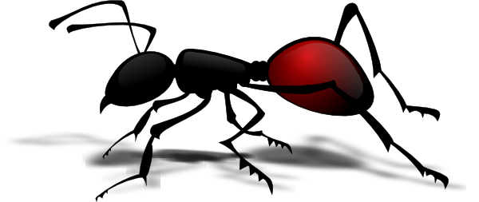
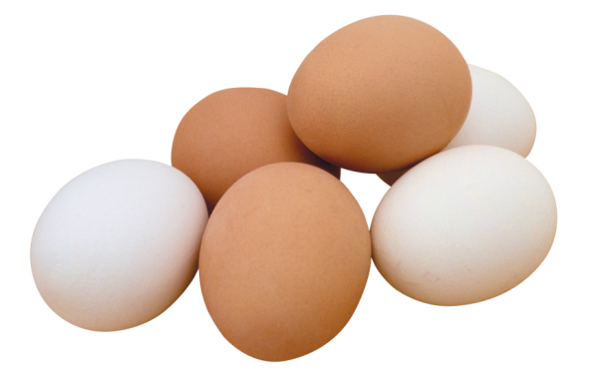
What can you see in this pictures?
Ant
Ball
Cup
Doll
Egg

Slide 7
Today’s Lesson
Alphabet: Aa-Ee
Unit: 1
Lesson-4
Page: 3

Slide 8
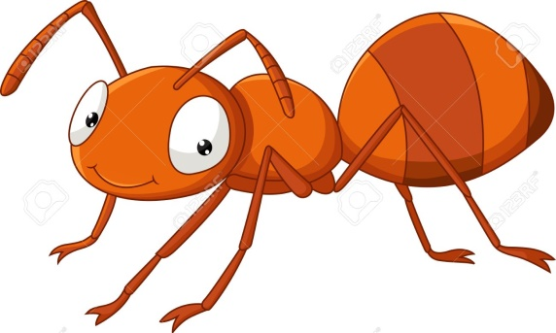
Look listen and say-
Aa
Ant

Slide 9
Look listen and say-
Bb
Ball

Slide 10
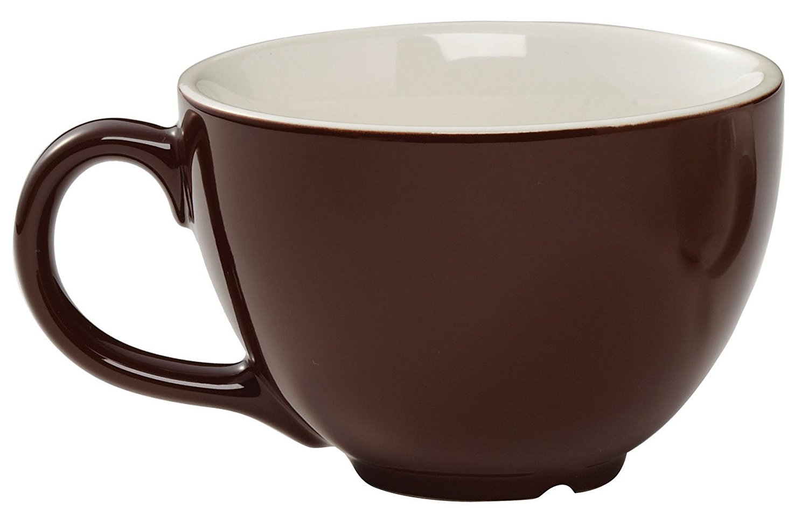
Look listen and say-
Cc
Cup

Slide 11
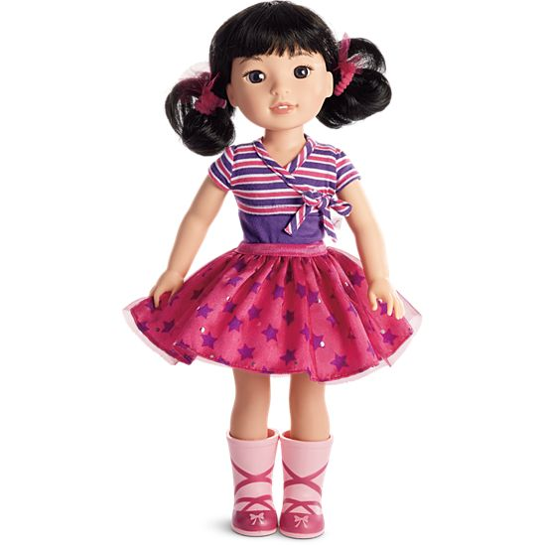
Look listen and say-
Dd
Doll

Slide 12
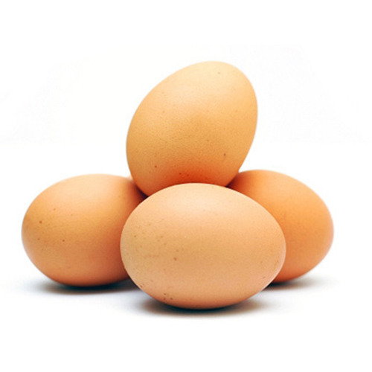
Look listen and say-
Ee
Egg

Slide 13
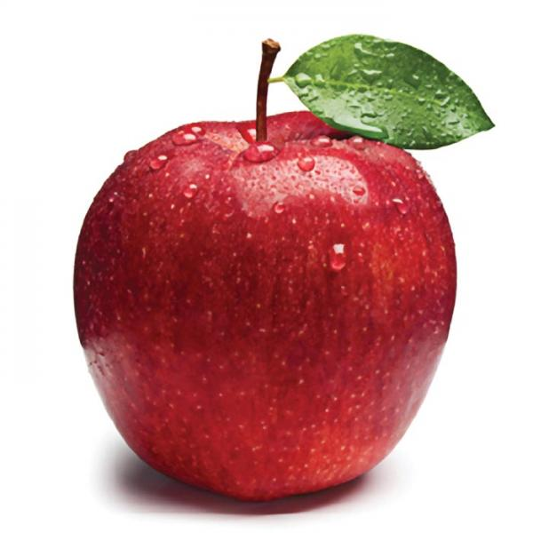
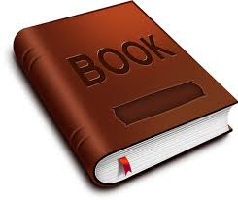
Individual work
a=
apple
b=
book

Slide 14
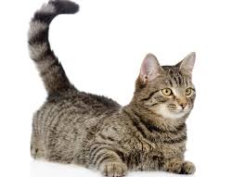
Individual work
c=
cat
d=
door

Slide 15
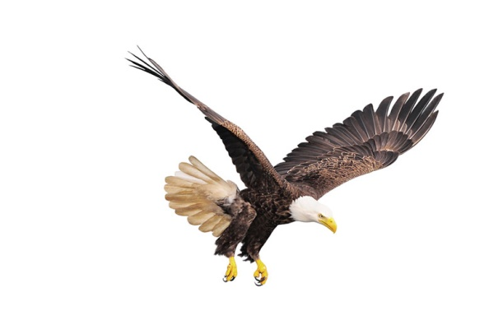
e=
eagle

Slide 16
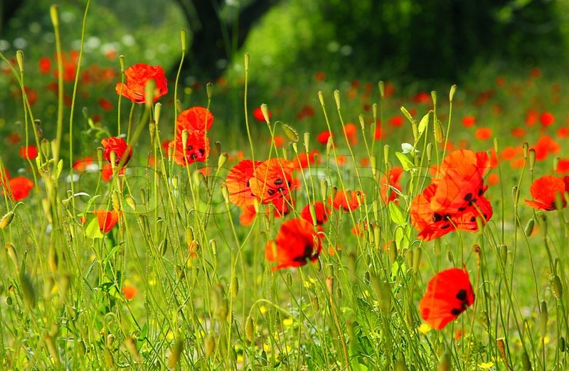
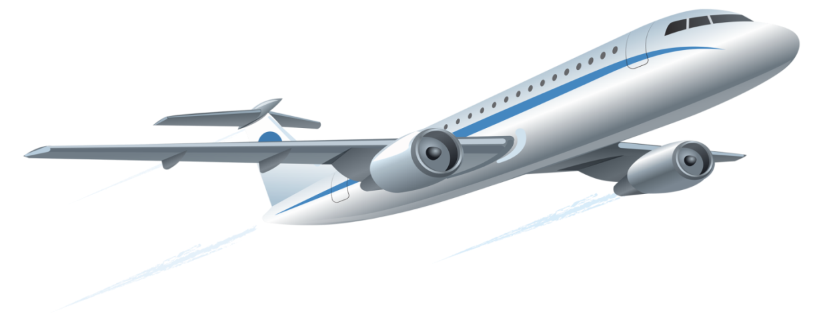
Bye bye

