Slide 1
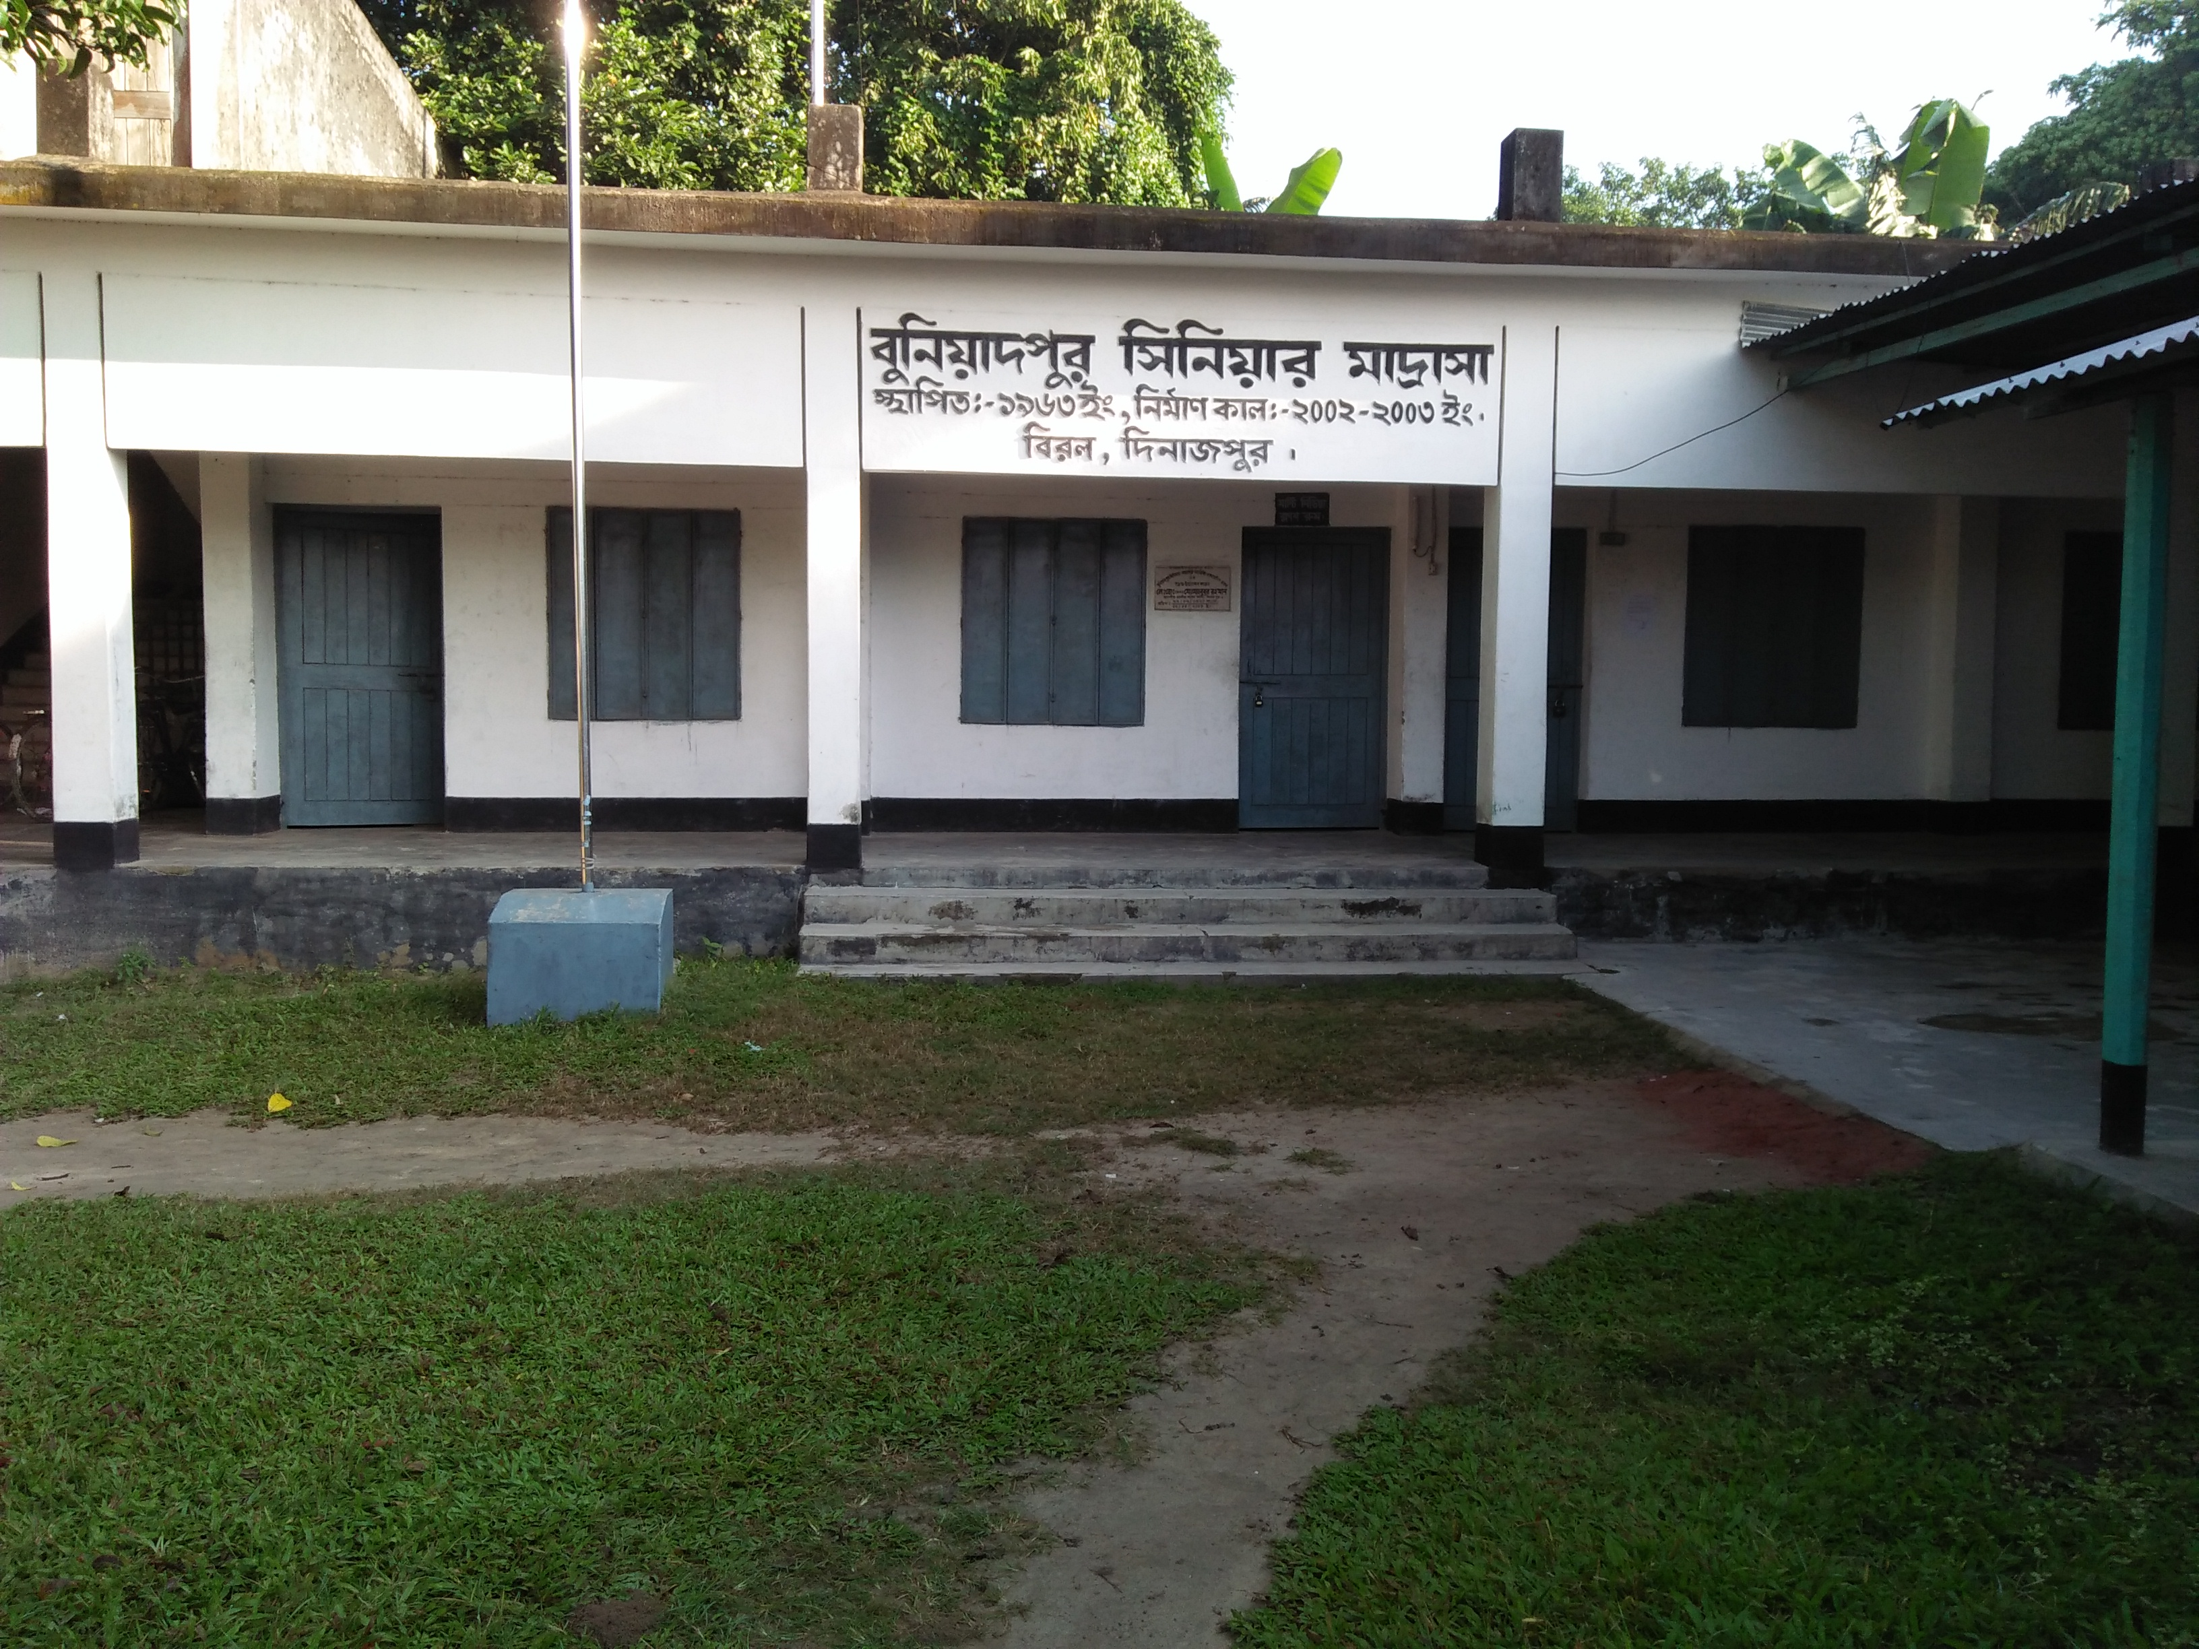
WELCOME

Slide 2
INTRODUCTION
Md. Moshiur Rahman
Lecturer English
Buniadpur Senior Alim Madrasah
Phone: 01701910333
Class : Ten
Subject: English
Chapter : 4

Slide 3
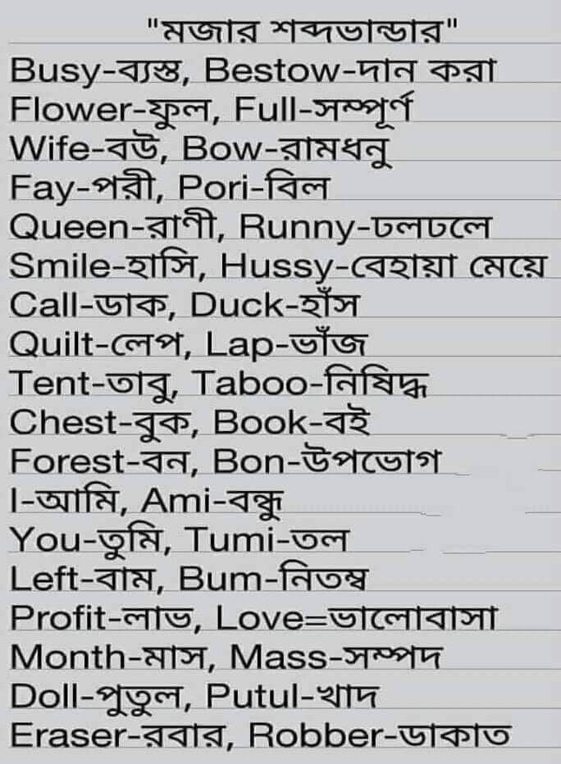

Slide 4
TENSE

Slide 5
Learning Outcome
After the chapter students have to learn…
You will learn about tense
You will know kinds of tense
You can learn structures of present tense

Slide 6
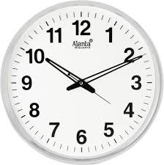
◆ Meaning of tense
Tense means time.
Tense means time of verbs.
Tense means a time of doing any work.

Slide 7
Give answers of the questions
What do you know about tense?
Tense means___.
a) verb b) time c) school d) sentence
3. How many letters are in the word “Tense”?
4. How many vowels are in the word “Tense”?

Slide 8
❖ Kinds of tense
PRESENT
PAST
FUTURE
TENSE

Slide 9
PRESENT
CONTINUOUS
PERFECT
PERFECT CONTINOUOS
INDEFINITE

Slide 10
PAST
CONTINUOUS
PERFECT
PERFECT CONTINUOUS
INDEFINITE

Slide 11
FUTURE
CONTINUOUS
PERFECT
PERFECT CONTINUOUS
INDEFINITE

Slide 12
Give answers of the questions
How many kinds of tense and what?
How many kinds of present tense and what?
How many kinds of past tense and what?
How many kinds of future tense and what?

Slide 13
⬥ Structures of present tense
Present Indefinite Tense
(এ,য়,ই অ)
Structure: subject + v¹+ ext.
example:(Affirmative) Riya eats rice.
(Negative) Riya doesn’t eat rice.
(Interrogative) Does Riya eat rice?
(Interrogative & negative) Doesn’t Riya eat rice?

Slide 14
Present Continuous Tense
তেছি,তেছ,তেছেন)
Structure: subject + am/is/are+ p .verb+ ing + ext.
example:(Affirmative) Sanjida is reading a book.
(Negative) Sanjida isn’t reading a book.
(Interrogative) Is Sanjida reading a book?
(Interrogative & negative) Isn’t Sanjida reading a book?

Slide 15
Present Perfect tense
(য়াছ,য়াছি,য়াছেন)
Structure: subject +has/have+ v³ + ext.
Example: (Affirmative) Lima has done the work.
(Negative) Lima hasn’t done the work.
(Interrogative) Has Lima done the work?
(Interrogative & negative) Hasn’t Lima done the work?
Present Perfect Continuous Tense
(নির্দিষ্ট সময় ধরে কোন কাজ বর্তমানে চলতেছে)
Structure : subject+have/has+been+p .verb+ing+ext.+for/since+time
Example : Afrina has been reading a book for two hours

Slide 16
Write the translations into English
১। আমি বই পড়ি।
২। সে ভাত খাইতেছে।
৩। আমি কাজটি করিয়াছি।
৪। সকাল হইতে বৃষ্টি হইতেছে।
I eat rice.(make continuous)
 Say the structures orally

Slide 17
HOME WORK
Write the name of twelve tense & structures with examples of present tense.

Slide 18
TAHANKS

