Slide 1
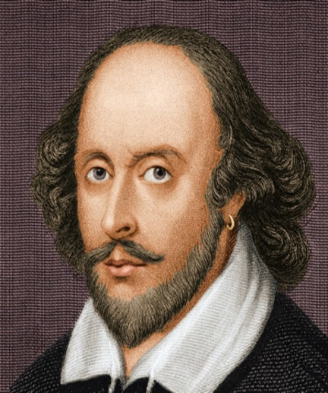
In Shakespeare's ‘Hamlet’ ‘The Ghost of King Hamlet’
Extended Character Analysis.
Wel Come
Khandoker Mufakkher Hossain
William Shakespeare

Slide 2
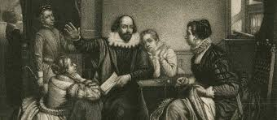
‘Hamlet’
By
William Shakespeare

Slide 3
‘Hamlet’

Slide 4
In Shakespeare's ‘Hamlet’ ‘The Ghost of King Hamlet’
Extended Character Analysis.

Slide 5
The Ghost of King Hamlet
The ghost tells Hamlet that he cannot move on to heaven until his “foul and most unnatural murder” is avenged.

Slide 6
The Ghost of King Hamlet
Hamlet is skeptical of the ghost at first, wondering whether it is truly the ghost of his father or an instrument of evil that has come to tempt him to commit sin.

Slide 7
The Ghost of King Hamlet
However, Hamlet already loathes Claudius, so when he uncovers evidence of Claudius’s guilt, Hamlet believes the ghost and embarks on the course of revenge.

Slide 8
The Ghost of King Hamlet
The nature of the ghost remains vague throughout the play, with different characters proposing different theories.

Slide 9
The Ghost of King Hamlet
Marcellus, Bernardo, and Horatio initially assume that, due to its armored guise, the ghost has appeared to warn them about an impending threat to Denmark.

Slide 10
The Ghost of King Hamlet
They clearly doubt its intentions, only reluctantly allowing Hamlet to be alone with it. Hamlet is also initially unsure whether the ghost is truly his father or a devil in disguise.

Slide 11
The Ghost of King Hamlet
A significant aspect of Hamlet’s indecision to immediately kill Claudius is his uncertainty about the ghost’s nature.

Slide 12
The Ghost of King Hamlet
Several different theories have been proposed regarding the ghost. By one reading, the ghost can be read as the literal manifestation...

Slide 13
The Ghost of King Hamlet
The End

