Slide 1
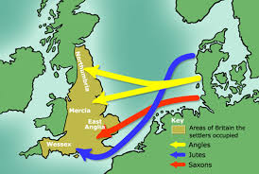

Slide 2
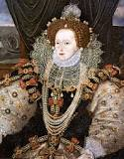
Everybody
wel
come
in
my
Presentation

Slide 3
Presented by
Md. Belal Hossan
Roll: 24
EMA 6th Intake
Sub: History of English Literature
Subject Code: EMA-003
Renaissance-Elizabethan Literature

Slide 4
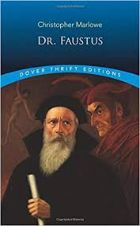
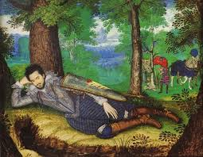
Presentation topics
English Renaissance period
Elizabethan Literature

Slide 5
In this presentation I will try to discuss....
1. Literary Features of the Period.
2. Major Writers and Their Works.
3. Major Historical Facts and the Society.
4. Dr. Faustus as a Renaissance Play.

Slide 6
Literary Features of the Period
Elizabethan age is known as the Golden Age in the history of English literature.
The spirit of renaissance brought classical (Greek & Roman) elements in literature.
The literature was also marked by strong national spirit, religious broad-mindedness, scientific curiosity, intellectual progress, and unlimited enthusiasm.
Love and romance are idealized in poetry.

Slide 7
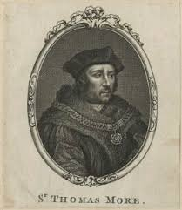
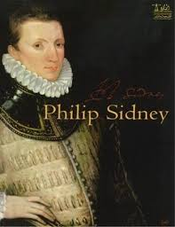
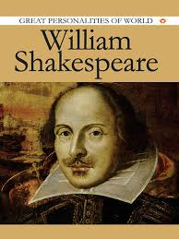
Major Writers

Slide 8
Major Writers and Their Works
Thomas More (1478-1535)– Utopia (1516)
Norton and Sackville (1536-1608)—Gorboduc (1562), the first English Tragedy
Thomas Kyd (1557-1595)—The Spanish Tragedy (1585)
Sir Philip Sidney (1554-86)—An Apologie for Poetrie (1595), Arcadia (1590) Christopher Marlowe (1564-93)--Dr. Faustus (1592), The Jew of Malta (1589),
William Shakespeare (1564-1616)—37 plays and 154 sonnets
Ben Jonson (1573-1637)—Every Man in His Homour (1599), Volpone (1605)

Slide 9
Major Historical Facts and the Society
The age is named after Queen Elizabeth who reigned over England from 1558-1603.
The ongoing political chaos comes to an end in the period.
The autocracy and the corruption of Pope reduces with the religious settlement of Anglicanism.
Geographical and astronomical discoveries brings unlimited fortunes for England.
The spirit of Renaissance is strongly felt .

Slide 10
Dr. Faustus as a Renaissance Play
The Renaissance man was fascinated by new learning and knowledge. He regarded knowledge to be power. He developed an insatiable thirst for further curiosity, knowledge, power, beauty, riches, worldly pleasures and the like. The writer of this age represented their age in their work. Marlowe is the greatest and truest representative of his age. So the Renaissance influence is seen in every one of his plays. Dr. Faustus represents the Renaissance spirit in various ways.

Slide 11
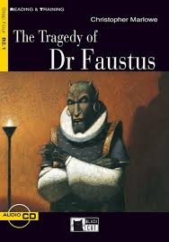
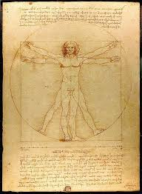
see you again
Thanks

