Slide 1

Welcome to Multimedia Class

Slide 2
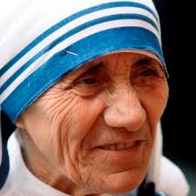
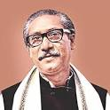
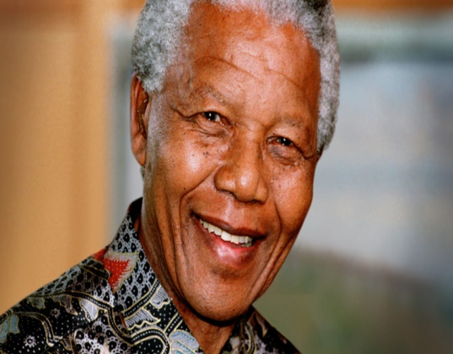
Look at the following pictures
Sheikh Mojibur Rahman
Nelson Mandela
Mother Teresa
Why are they famous for ?
Who is an Apartheid Fighter out of them ?

Slide 3
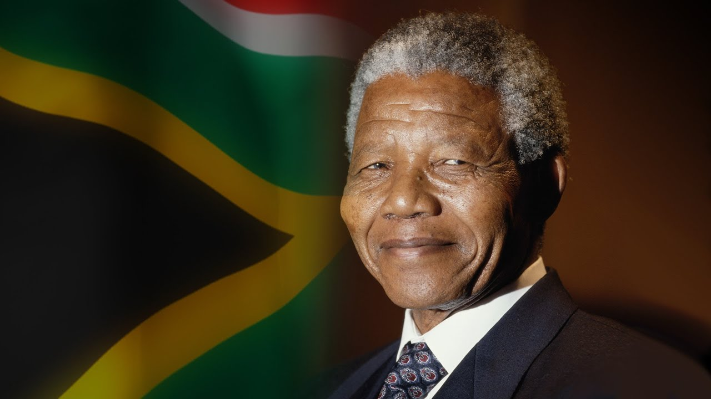
Today our topic is
“ Nelson Mandela, from Apartheid Fighter to President”
Unit : 1
Lesson : 2
Page no : 07-08
Time :50 mins.

Slide 4
Learning Outcomes
After we have studied this TEXT , we will be able to
Infer meanings from the context
Answer the questions
Complete the flow-chart
Choose the best answer
Write a paragraph on “The Contribution of a Great Leader

Slide 5
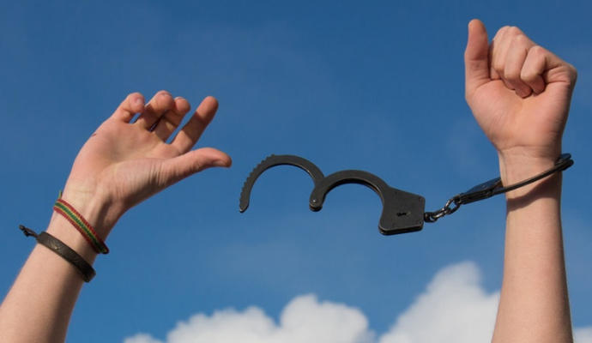
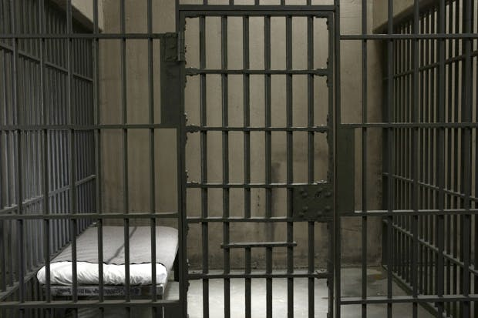
Key Words
Emancipation (N.)
Freedom
Imprisoned (Adj.)
Jailed

Slide 6


Negotiate (V.)
Talk
Sparkle (V.)
Flash

Slide 7
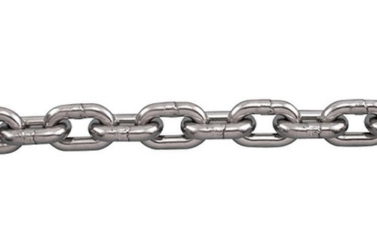
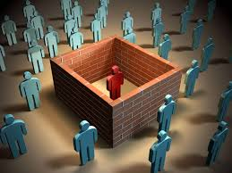
Key Words
Shackle (N.)
Chain
Apartheid (N.)
Injustice

Slide 8
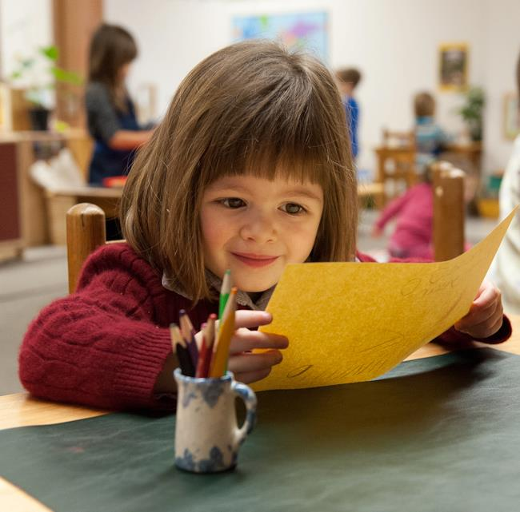
Individual Work
Read the text silently & answer the questions that follow

Slide 9
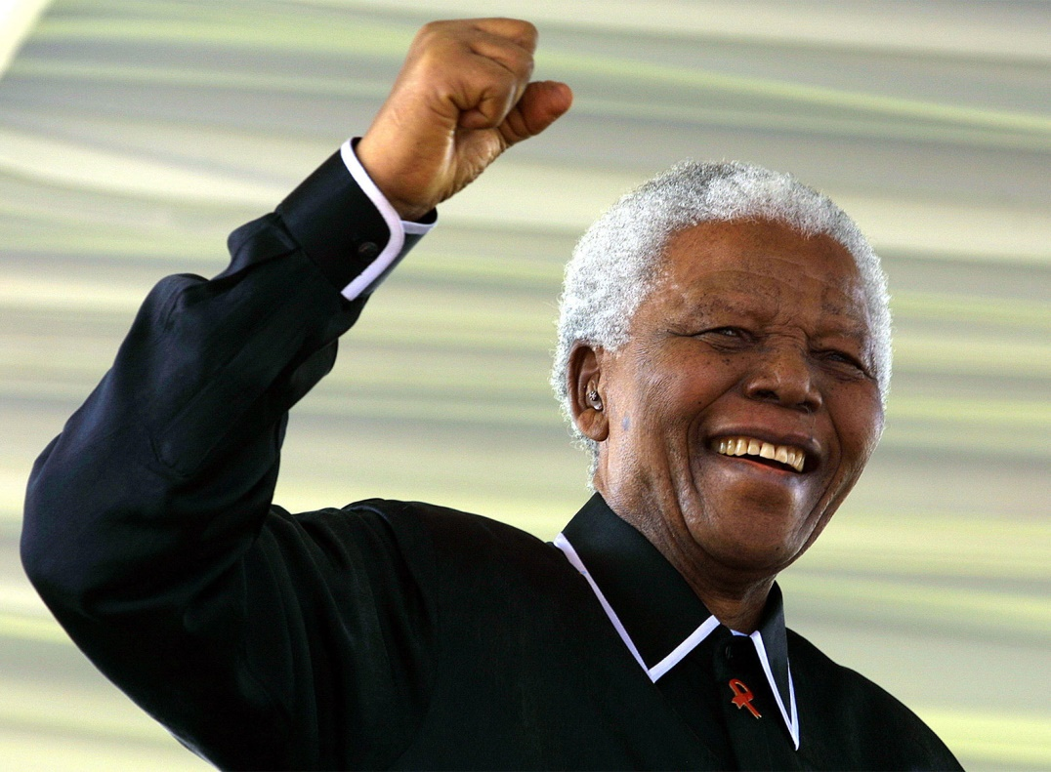
Nelson Mandela
Mandela was guided South Africa from the shackles of apartheid to a multi-racial democracy , as an icon of peace & reconciliation who came to embody the struggle for justice around the world

Slide 10
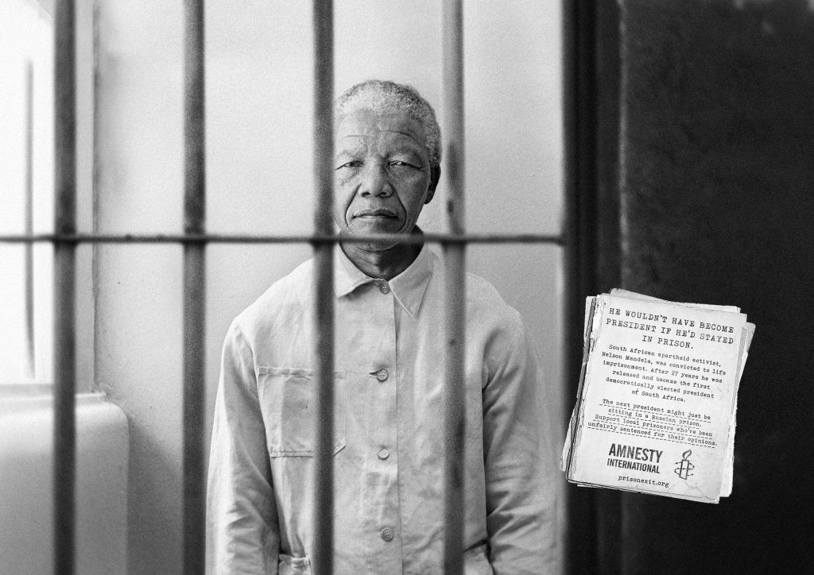
Imprisoned of Nelson Mandela
Imprisoned for nearly three decades for his fight against white minority rule , Mandela never lost his resolve to fight for his people’s emancipation

Slide 11
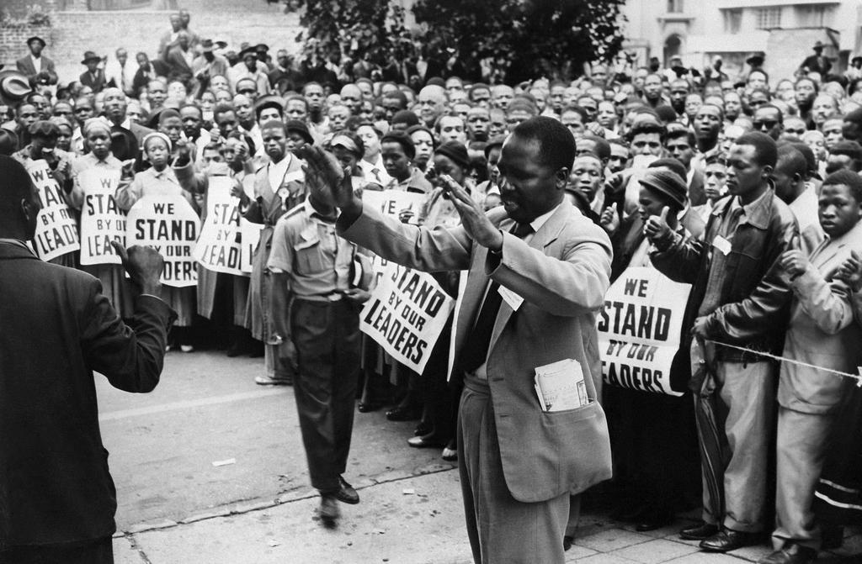
Determination of nelson mandela
Mandela was determined to bring down Apartheid in South Africa without creating a civil war

Slide 12
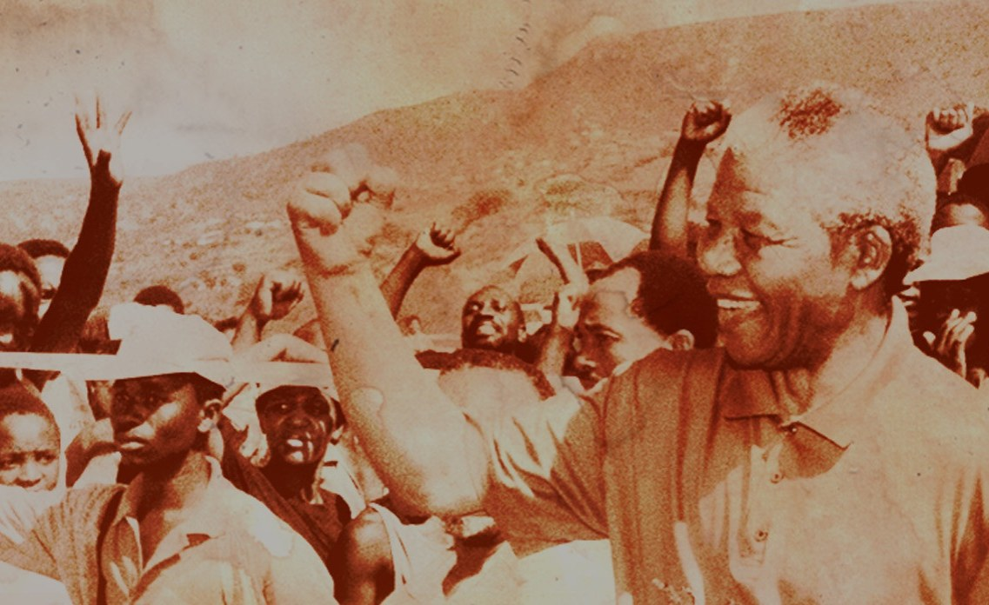
Freedom of Nelson Mandela
Mandela was freed from prison in 1990

Slide 13
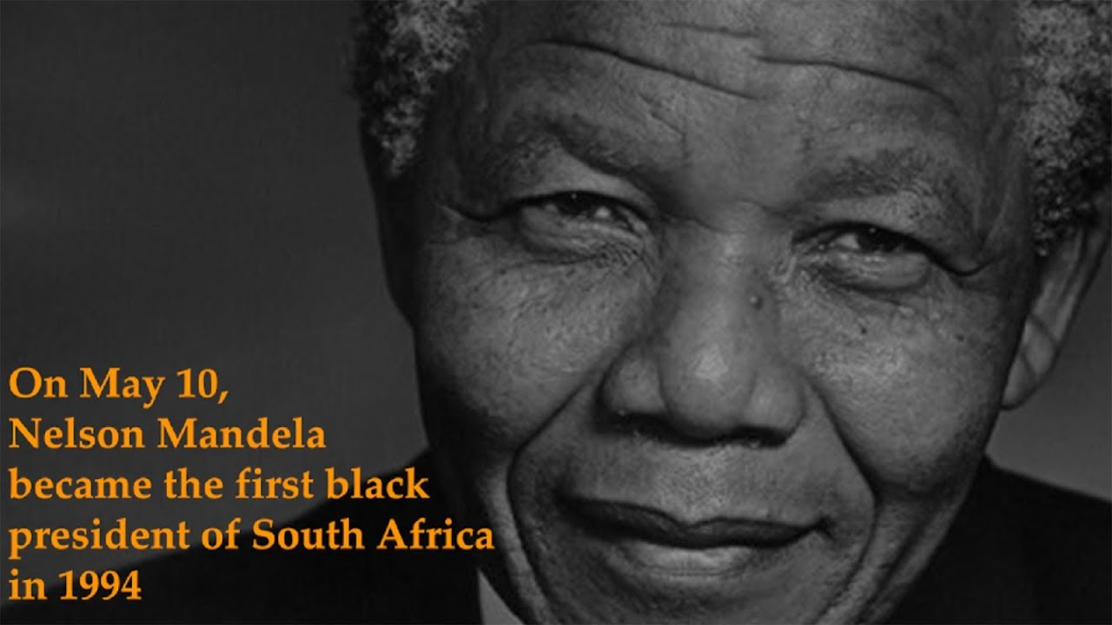
First Black President of South Africa
Mandela became South Africa’s first Black President in 1994.

Slide 14
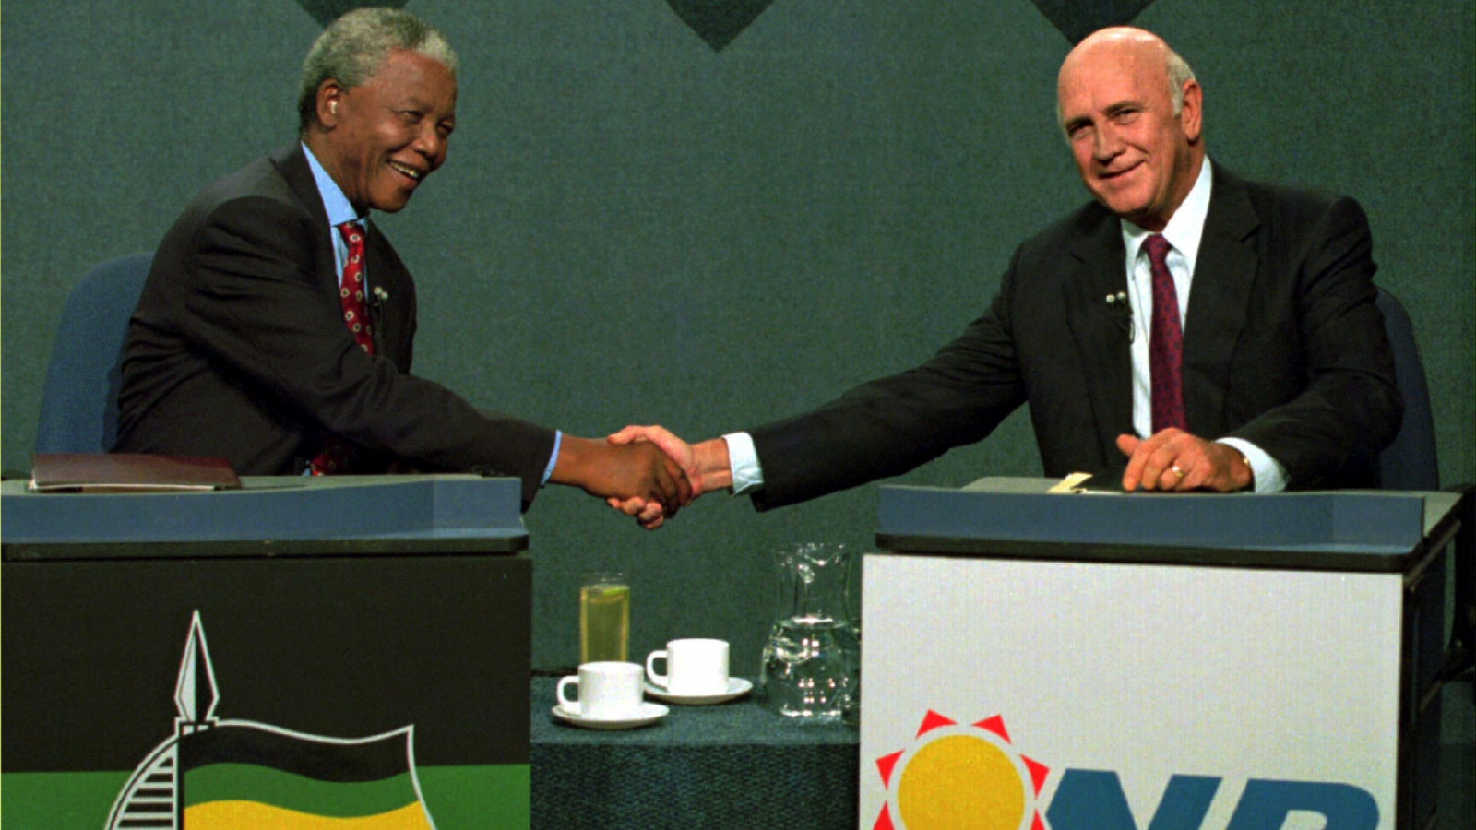
Leaving public life
Mandela formally left public life in June 2004

Slide 15
Group Work
Read the text silently & make short notes in each of the boxes in the flow-chart showing the life history of Nelson Mandela .
1.stood against Apartheid
2. Imprisoned for nearly three decades
3. Freed from prison in 1990
4. Awarded the Nobel Peace Prize in 1993
5. Became South Africa’s first Black President in 1994
6. Formally left public life in June 2004

Slide 16
Evaluation
1. Mandela wanted to ----- . (a) eliminate race disparity (b) establish race discrimination (c) healing of the wounds (d) mend the chasms that divided them
2. Mandela was awarded Nobel Peace Prize because he played prominent role (a) to establish black domination in South Africa (b) to become the first black president in Africa (c) as an advocate of humanity (d) to remove White domination in South Africa
3. Nelson Mandela is considered as a------ (a) emblem of peace & harmony (b) symbol of destruction (c) icon of love (d) epitome of democracy
4. What does the word Apartheid in the passage refer to ? (a) stratification (b) socialization (c) dissatisfaction (d) discrimination

Slide 17
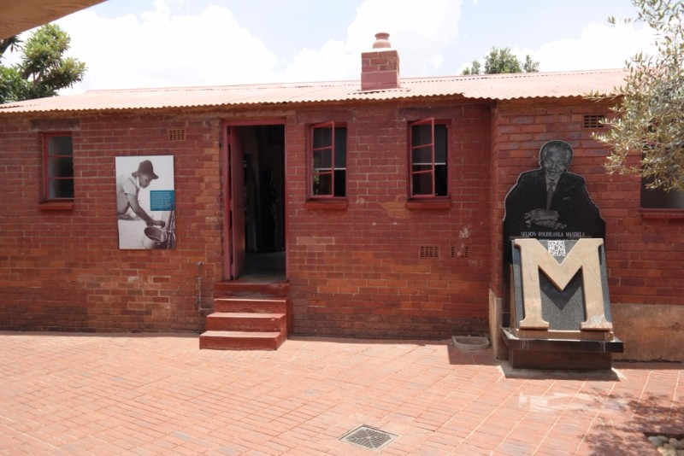
Home work
Write a paragraph on “ The Contribution of a Great Leader

Slide 18
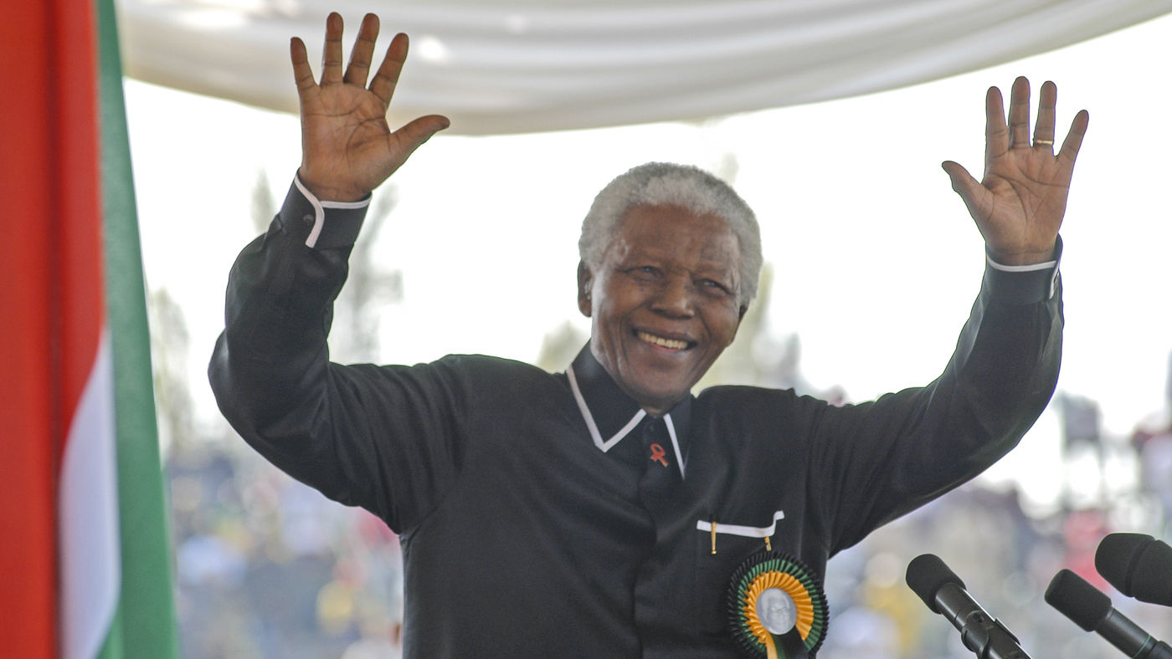
No more today
See you tomorrow

