Slide 2
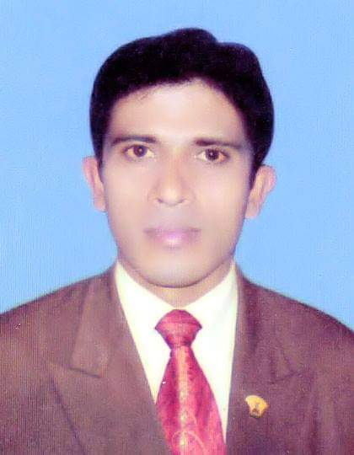
Md. Mominul Islam
M.A (English) B.ed
Dattagati Girls High School
Abhaynagar, Jashore.
Presented by

Slide 3
Class introduction
Class : Eight
Subject : English 1st paper
Unit : 01
Lesson : 09
Time : 40 Minutes

Slide 4
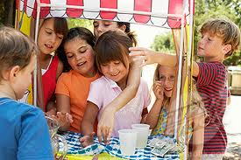
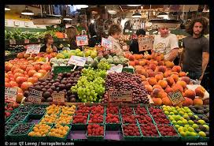
Pre –Knowledge Verification
What are they doing in the pictures?
They are selling and buying.

Slide 5
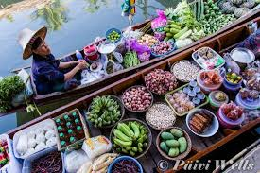
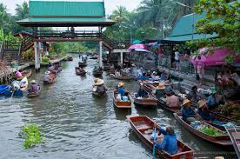
Today ,s Lesson
THA KHA FLOATING MARKET IN BANGKOK

Slide 6
*By the end of the lesson the learners will be able to listen about Tha Kha Market
*Read and understand texts.
*Ask and answer questions
*Write the main ideas.
Learning outcomes

Slide 7
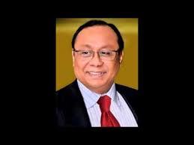
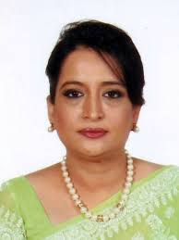
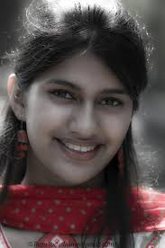
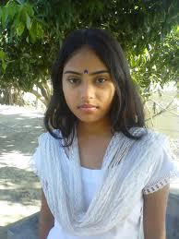
market
Who are they in the pictures?
Mazharul Islam
Jhuma Islam
Mita
Zara
*They are Bangladeshi. They visited The Tha Kha Market. They hired a
boat to see the market.

Slide 8
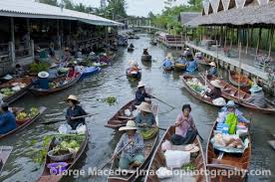
What can you see in the picture?
*There were boats every where. The sellers were mainly elderly Thi women. Their small boats were laden with bundles of lotus flowers, coconuts fruits ,vegetables, local food and sweets. They displayed their goods.

Slide 9
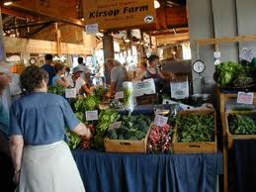
Vocabulary
Exhibition
Display
Sentence
The sellers displayed their goods.

Slide 10
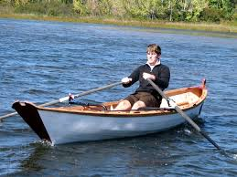
ROW
PULL
The boatman started to row.

Slide 11
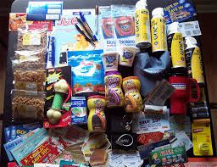
Goods
Wealth
There are many goods in the boats.

Slide 12
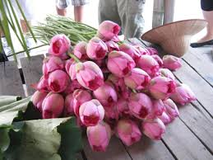
Bundle
Bunch
There is a bundle of lotus

Slide 13
Individual work
Write the meaning of the following words.
1, Display
2. Goods
3.Lotus
4. Bundle

Slide 14
GROUP WORK
Look at the picture and write 5 sentences.
GROUP-A

Slide 15
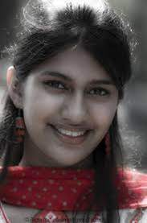
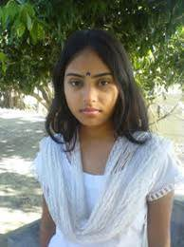
GROUP -B
Look at the pictures and describe them.

Slide 16
Evaluation
*Where is Tha kha market?.
*What kind of market was it?
*What were they selling?
*Who were selling goods?

Slide 17
Homework
Write a short paragraph on “Tha Kha Market”.

