Slide 1
WELCOME

Slide 2
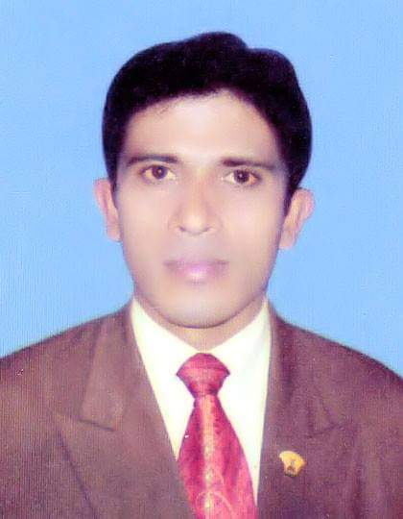
PRESENTED BY
MD. MOMINUL ISLAM
ASSISTANT TEACHER
DATTAGATI SECONDARY GIRLS SCHOOL,
ABHAYNAGAR, JASHORE.

Slide 3
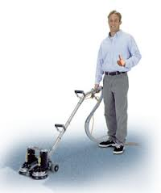
Simple Man

Slide 4
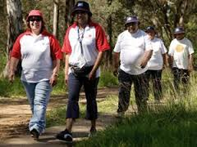
Healthy Man

Slide 5
So Todays our topics
Is………………………?
HYGIENCE

Slide 6
Lesson Introduced
Class-Eight
Subject- English
Unit-Three
Lesson-Three

Slide 7
OBJECTIVES
By the end of the lesson students will have
1) asked and answered question about hygience
2) Guessed the meaning of the following word
and choose the correct meaning
3) Summarized the passage

Slide 8
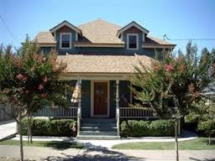
Vocabulary
Hygiene: Neatness and cleanliness

Slide 9
Clean
Free from dirt

Slide 10
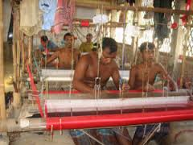
Work place
Place where people work

Slide 11
Dirt
filth

Slide 12
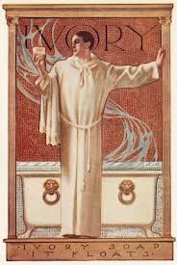
godliness

Slide 13
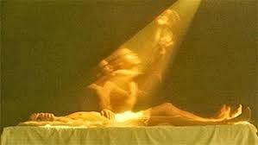
soul
The spiritual element

Slide 14
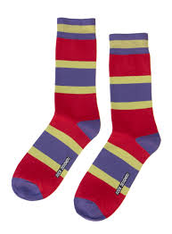
socks

Slide 15
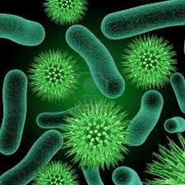
Bacteria
Germ of disease

Slide 16
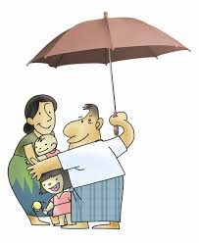
protect
Keep safe

Slide 17
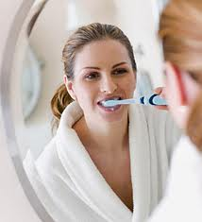
The word hygiene means the practice of keeping ourselves clean

Slide 18
It also means to keep our home and work place clean

Slide 19
First we must keep our body clean

Slide 20
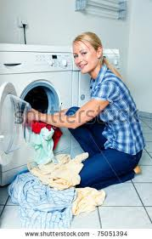
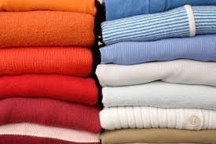
We should wash our cloth regularly

Slide 21
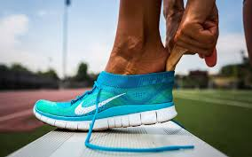
We should wear socks and shoes when we go out to protect our feet from dust and germs

Slide 22
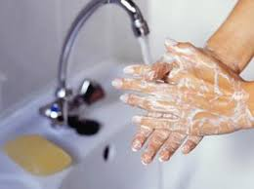
It is also important to wash our hands before meals and after using the toilet.

Slide 23
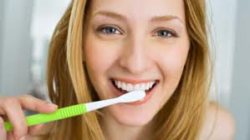
We should brush our teeth twice a day after breakfast

Slide 24
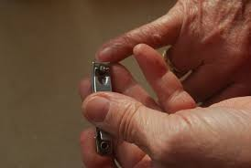
We also cut our nails regularly

Slide 25
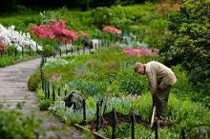
Finally we should keep our surroundings and environment clean

Slide 26
Guess the meaning of the following words and close the correct meaning closest to the text.

Slide 27
Dirt
(1) Fume (2)smoke (3) fire (4) filth

Slide 28
What does hygiene mean?
Why should we need our hair clean?
What should we do to keep our body clean?
What kind of water should we drink?

Slide 29
Summarize the above passage in around 70 words

Slide 30
Thank

