Slide 2
Teacher Introduction
md. Mominul islam
ASSISTANT TEACHER
dattagati GIRL’S HIGH SCHOOL, jashore.

Slide 3
Class : Seven
Sub : English 2nd paper
Unit : Three
Lesson : two
Time : 45 minutes
Date : 20/8/2019

Slide 4
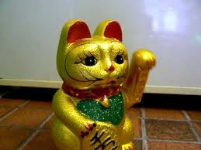
.
*The cat is on the car
The cat is in the car.
The cat is under the car.

Slide 5
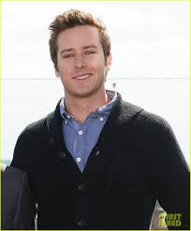
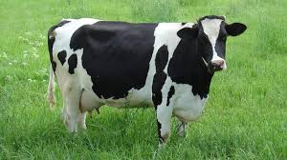
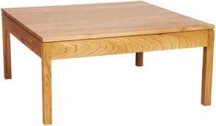
There is a man in the picture.
The re a cow looking at me
The flowers are on the table.

Slide 6
Today , s Lesson
preposition

Slide 7
LEARNING OUTCOMES
*By the end of the lesson the learners will be able to
Learn definition of preposition.
Learn kinds of preposition.
*use of preposition.
Fill in the gaps with preposition.

Slide 8
The butterfly is above the table.
The cat is in front of the chair.

Slide 9
Definition of preposition
*A Preposition is acompound word means before and position means situation.
*A preposition is a word placed before a noun or a pronoun or a noun equivalent to show its relation to any other word of sentence.

Slide 10
Kinds of preposition
Simple preposition
Detached
Double preposition
Disguised
Compound
Participle
Phrase

Slide 11
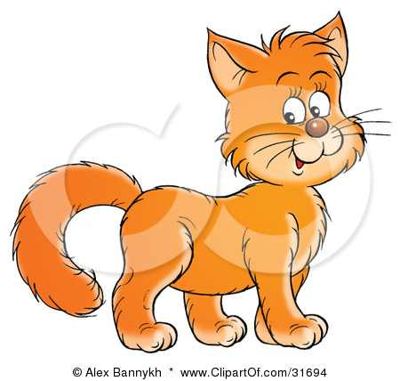
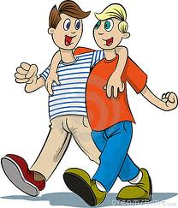
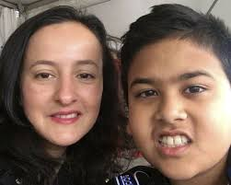
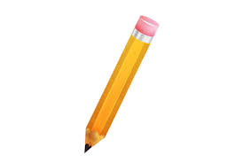
Example of preposition
Simple
The cat is on the table.
Double
Two boy s are entering into the room
Compound
The boy sat beside his mother.
Please give me a pen a instead of pencil.
Phrase

Slide 12
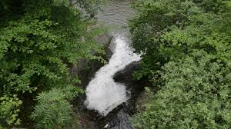
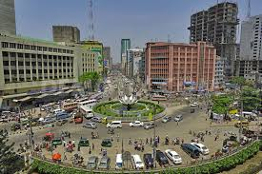
participle
The river flows past the village.
Disguised
It is 12 O, clock
Detached
What is Dhaka famous for?

Slide 13
*Fill in the gaps with preposition from the box.
with—for—to—with—out—of Man has an unquenchable thirst (a) — knowledge. He is never satisfied (b) — what he has known and learnt. The curiosity (c) — knowing.
coupled (d) — the indomitable spirit (e) — adventure has inspired him to undertake and carry (f) — dangerous tasks.
Pair work

Slide 14
Group work
Find out the preposition from the sentences
Education is the back bone of a nation. No progress can be made without education . Ignorance is similar to darkness.

Slide 15
Evaluation
*What is preposition?
*How many kinds of preposition are there ?

Slide 16
Home work
Make five sentences with following preposition.
On , to, behind, of with

Slide 17
THANKS TO ALL

