Slide 1
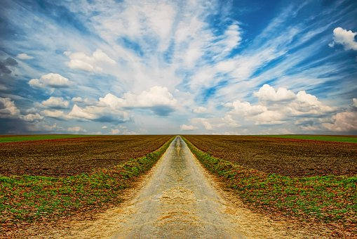

Slide 2
WELCOME TO MALTIMEDIA CLASS
WELCOME TO MULTIMEDIA CLASS

Slide 3
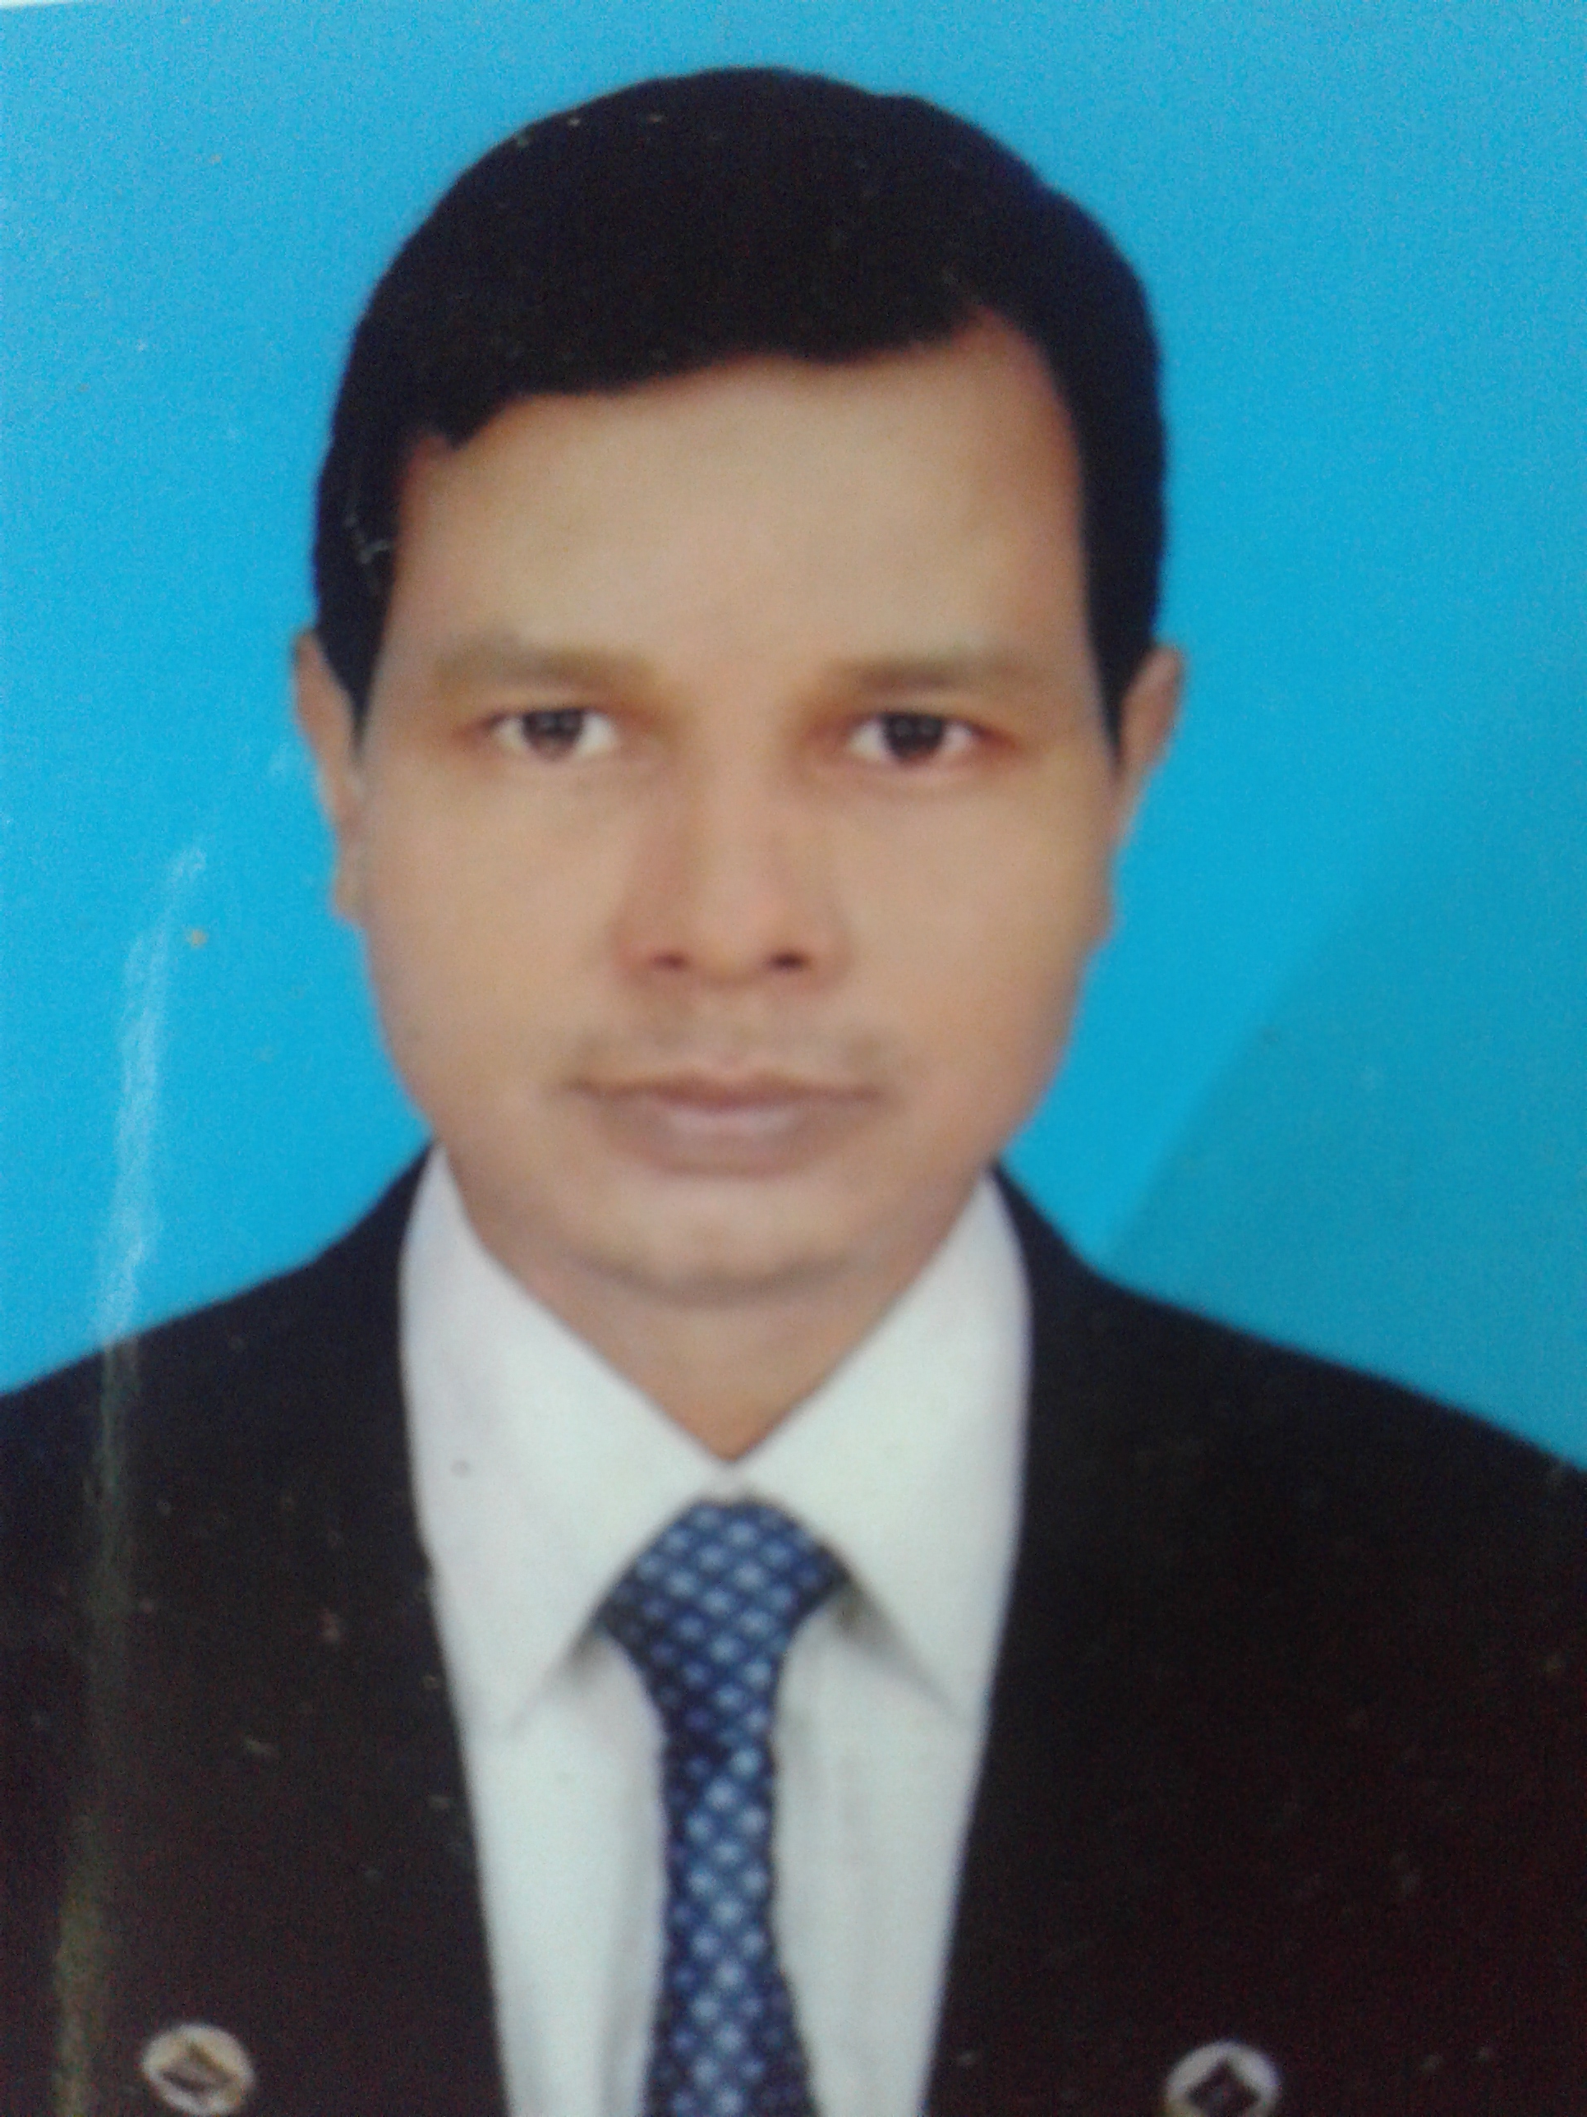
INTRODUCTION
Md.Arifur Rahman
Assit. Teacher
Muraripur Govt. Primary School
Bochagonj, Dinajpur.
Class: One
Subject: English
Lesson Unit: 1-3
Lesson:In the village (Cow…..kitten.)

Slide 4
Learning Outcomes
Learning Outcomes
Learning Outcomes
Learning Outcomes
Learning Outcomes
Students will be able to…
1.1.1 become familiar with English sounds by listening
to common English words.
1.1.1 repeat after the teacher simple words and phrases.
1.1.2 say simple words and phrases.
Students will be able to…
1.1.1 become familiar with English sounds by listening
to common English words.
1.1.1 repeat after the teacher simple words and phrases.
1.1.2 say simple words and phrases.
Students will be able to…
1.1.1 become familiar with English sounds by listening
to common English words.
1.1.1 repeat after the teacher simple words and phrases.
1.1.2 say simple words and phrases.
Students will be able to…
1.1.1 become familiar with English sounds by listening
to common English words.
1.1.1 repeat after the teacher simple words and phrases.
1.1.2 say simple words and phrases.
Students will be able to…
1.1.1 become familiar with English sounds by listening
to common English words.
1.1.1 repeat after the teacher simple words and phrases.
1.1.2 say simple words and phrases.

Slide 5
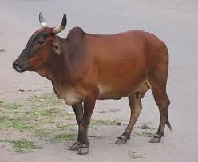
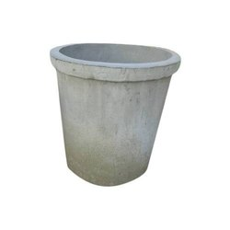
Let`s see some picture
cow
tub

Slide 6
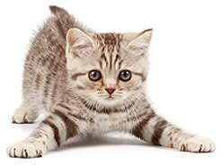
Let`s see some picture
kitten
tubewell

Slide 7
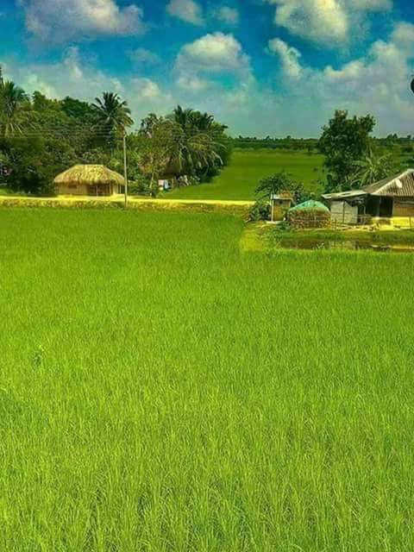
TODAYS LESSON
In the village
Open at page 44

Slide 8
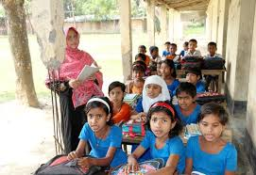
Teachers reading

Slide 9
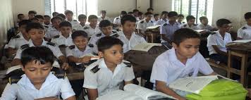
Students reading

Slide 10
Word Meaning
One kind of animal
cow
A pot of plant of flower
tub

Slide 11
Word Meaning
Mini cat
kitten
The source of drinking water
Tubewell

Slide 12
Matching
kitten
Tubewell
tub
cow

Slide 13
Fill in the gaps
u
c__w.
Tu__.
Kitt__n.
t__bewell.
e
o
b

Slide 14
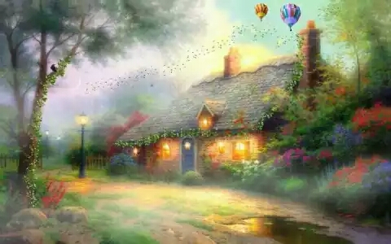
Home work
Trace the words in home
cow tub kitten tubewell

Slide 15
Evaluation
Write this pictures name

Slide 16
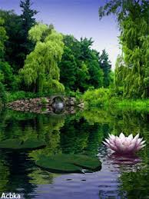
THANK YOU

