Slide 1
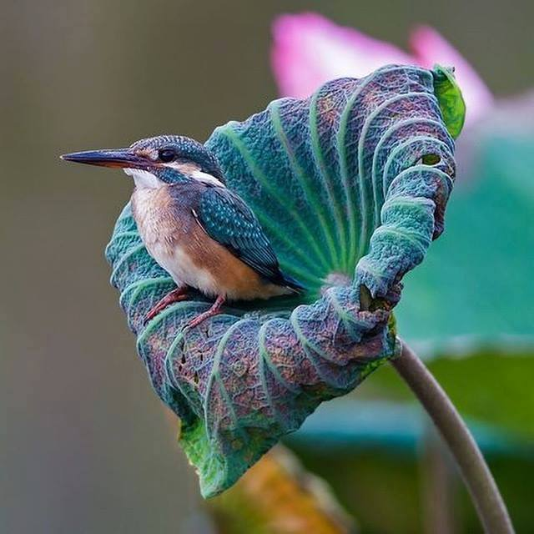
Welcome to all
.
Notes:
No need to click.

Slide 2
Introduction
Emdadul Haque Milon
B.A hons in English M.A,B.ed Assistant Teacher in English Sonapur SESDP Model High School Dowarabazar,Sunamganj | Class-8 English First Paper
Notes:
Introduction of teacher & class.

Slide 3
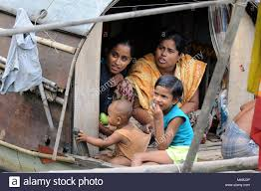

Slide 4
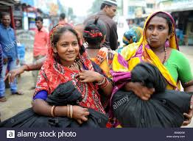

Slide 5
Gypsy
Notes:
Teacher may click accordingly to conduct this page.

Slide 6
Our Today’s Lesson is-
River Gypsies in Bangladesh
Unit-7, Lesson-3
Notes:
Lesson declaration

Slide 7
Learning Outcome
After we have studied this lesson. we will be able to---
ask and answer questions
read and understand the text
participate them in a short paragraph
Notes:
This will cover both speaking, listening, reading & writing skills.

Slide 8
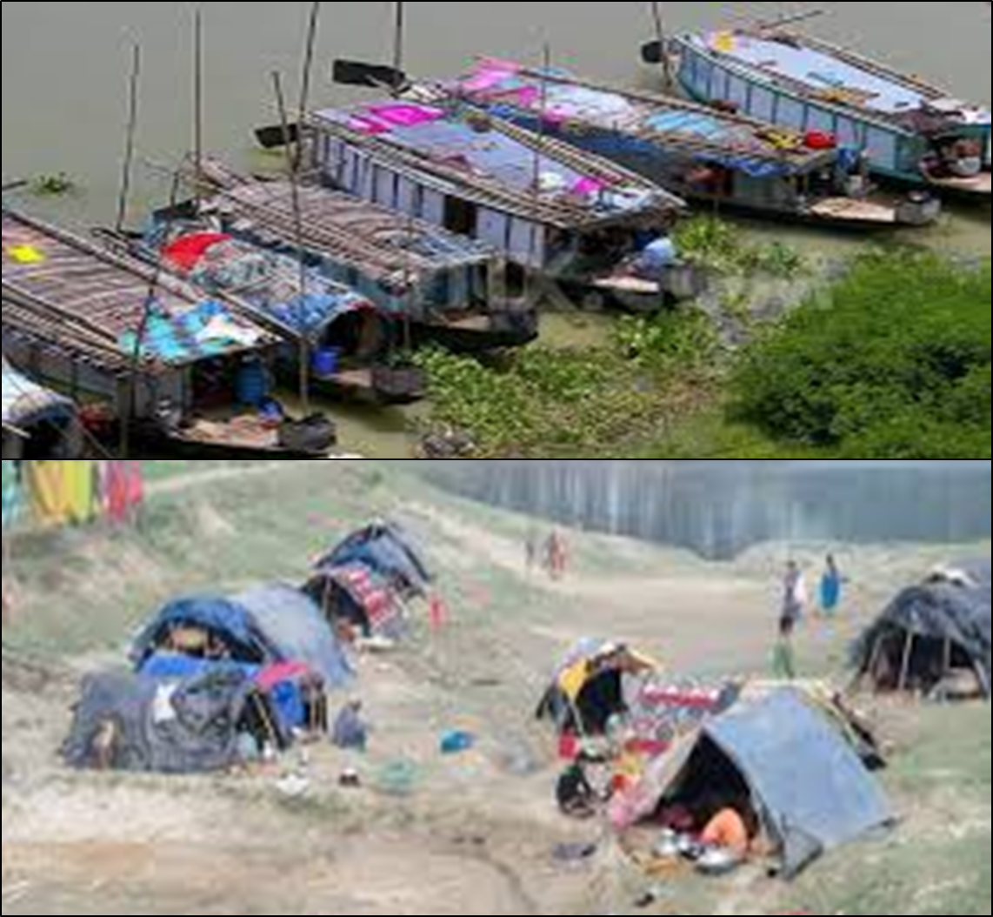
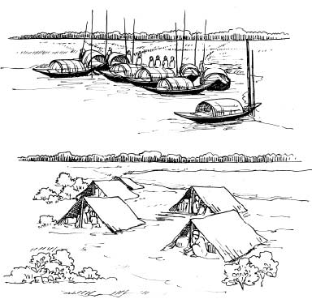
A Look at the pictures and discuss with your partner what you see.
Notes:
Teacher may ask the students to talk about the pictures with their partners. To go to text directly click right arrow.

Slide 9
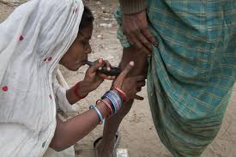
They also try to heal pains of old people often by sucking out blood from their body.
Notes:
Teacher may ask about the pictures and then read out the text to the students and explain.

Slide 10
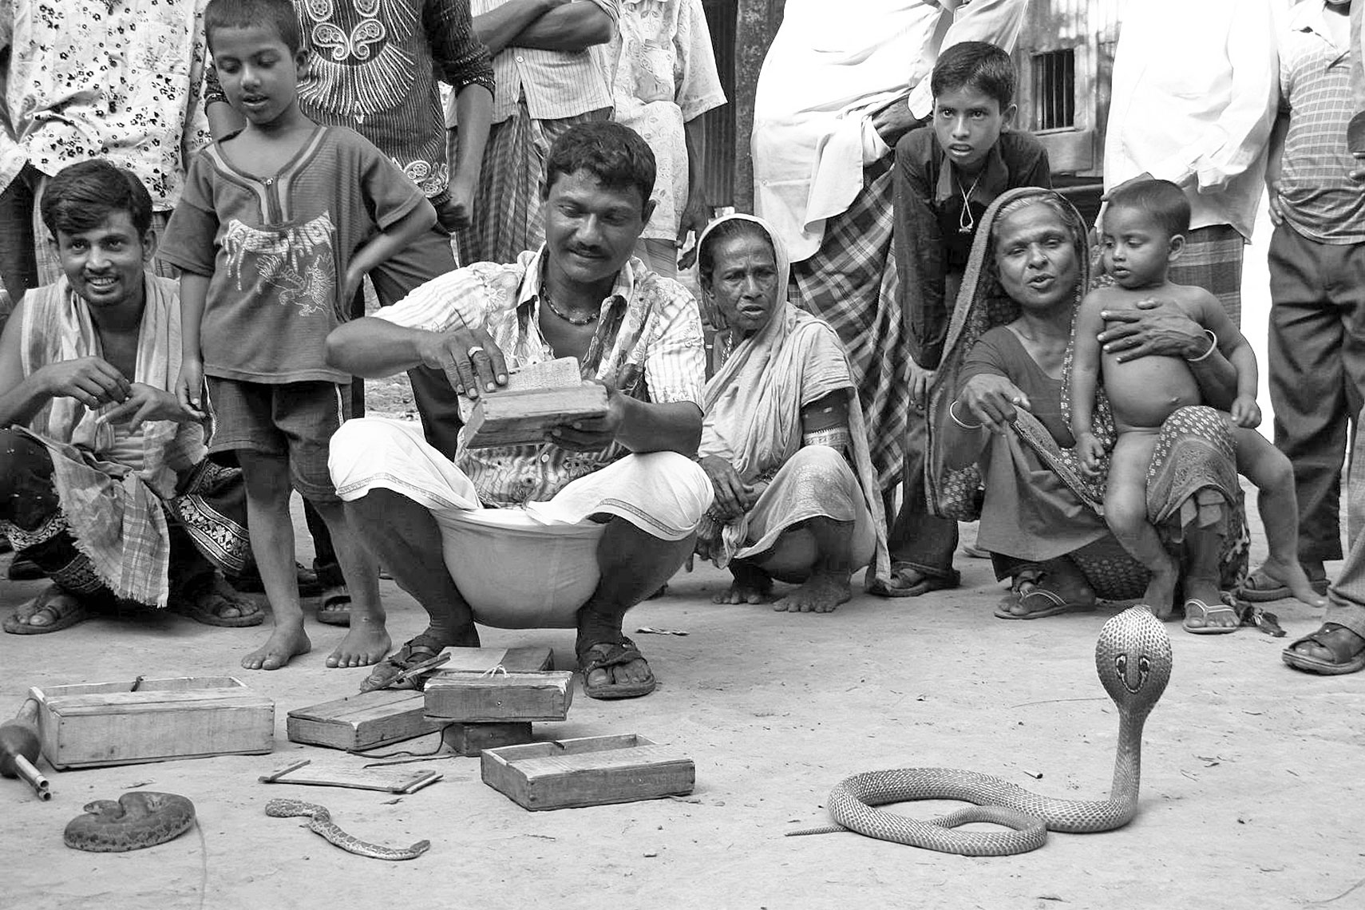

Slide 11
Key words : gypsy ethnic nomadic roam tarpaulin tents remedy vend heal talisman A Look at the pictures and discuss with your partner what you see. B Read the text and answer the following questions.
River gypsies are an ethnic group in Bangladesh. They are known as bedey to local people. The gypsies have their own lifestyle and culture. They live in groups and do not own any land. Therefore, they live a nomadic life travelling from one place to another. These people roam across our rivers and waters from May to December in small country boats. These boats are their houses and these people are a part of our waters. In winter, many water bodies dry up. At that time they return to the mainland and live in make-shift tarpaulin tents on open river banks. You can see their men relaxing in the tents. Toddlers play with dogs or other pets in the dust. Women often idle away time by hair doing, picking off lice in twos or threes sitting in a row. 80 English For Today Throughout the monsoon, they remain busy with fishing. They also dive for natural pearls in waters. Sometimes, they camp for a couple of weeks. Men catch snakes and entertain people with snake charming and sell herbal cures. Women go from door to door to sell bangles, cosmetics and other things. They also try to heal pains of old people often by sucking out blood from their body. Many villagers believe in the magical power of the gypsies . They can an evil spirit leave someone’s body by magic or special Powers.

Slide 12
Answer the following questions
1 Who are river gypsies?
2 How do they live?
3 What do river gypsies do in winter?
4 What do river gypsy men do for a living?
5 What do river gypsy women do for a living?
Notes:
This option may be conducted orally.

Slide 13
Home Work
write your experience about river
gypsy within 70 words.
Notes:
Task for the next class.

Slide 14
Allah Hafez

