Slide 1
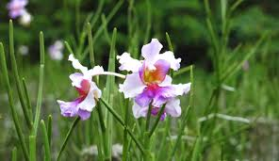
Welcome

Slide 2
Introduction
Teachers Info
Abul kucher
Assistant Teacher, ICT
Bishowanathpur Salameia
Hossaina Dhakil Madrasha
Class Info
Class : Six
Subject: English 1st Paper
Lesson: ?
Time: 50 minutes

Slide 3
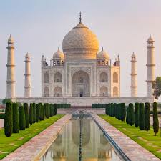
Let’s see the picture
What are you see in this picture?

Slide 4
Let’s see a video
https://www.youtube.com/watch?v=49HTIoCccDY
Are you know about this?
Notes:
Elicitation

Slide 5
Lesson Title
Wonders of the world-1
Notes:
Title of the lesson: Nakshi Kantha

Slide 6
After this lesson, student will be able to :
Describe about theTaj Mahal .
Understand text by silent reading.
Participate in short dialogues and conversations on Taj Mahal.
Notes:
Title of the lesson: Nakshi Kantha

Slide 7
Read the passage silently

Slide 8
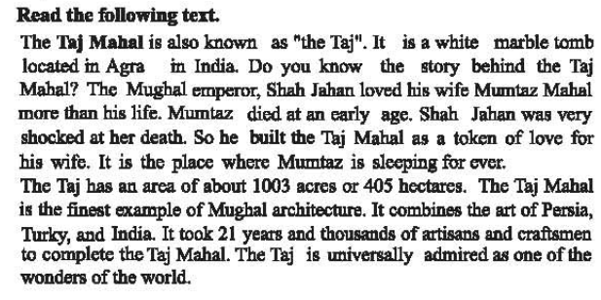
Silent Reading
Notes:
Title of the lesson: Nakshi Kantha

Slide 9
Let’s see the key words of the passage

Slide 10
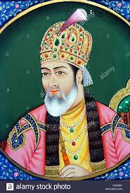
Key Words
Emperor
The word emperor is a general word for a ruler having total control of a country or region..
Notes:
Title of the lesson: Nakshi Kantha

Slide 11
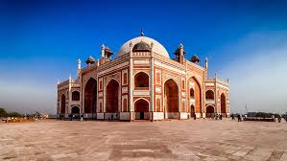
Key Words
Architecture
the art or practice of designing and constructing buildings.
Notes:
Title of the lesson: Nakshi Kantha

Slide 12
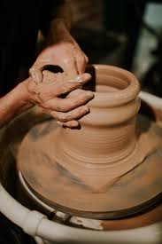
Key Words
Artisans
a worker in a skilled trade, especially one that involves making things by hand.
Notes:
Title of the lesson: Nakshi Kantha

Slide 13
Individual Work
Complete the following sentences with the clues given.
agra
shocked
universally
The taj
1003
1 The Taj mahal is also know as ----------------
2 it is a white marble tomb located in ----------
3 Shah Jahan was very ----------- at her death.
4 the Taj has an area of about ---------- acres.
5 The Taj is -------------- admired as one of the wonders of the world.
Notes:
Title of the lesson: Nakshi Kantha

Slide 14
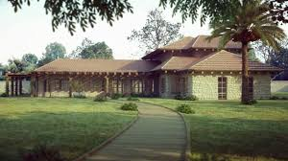
Home Work
Write 5 sentence
“About The Taj Mahal”.
Notes:
Title of the lesson: Nakshi Kantha

Slide 15
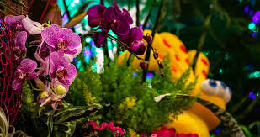
Thank you
Notes:
Title of the lesson: Nakshi Kantha

