Slide 1
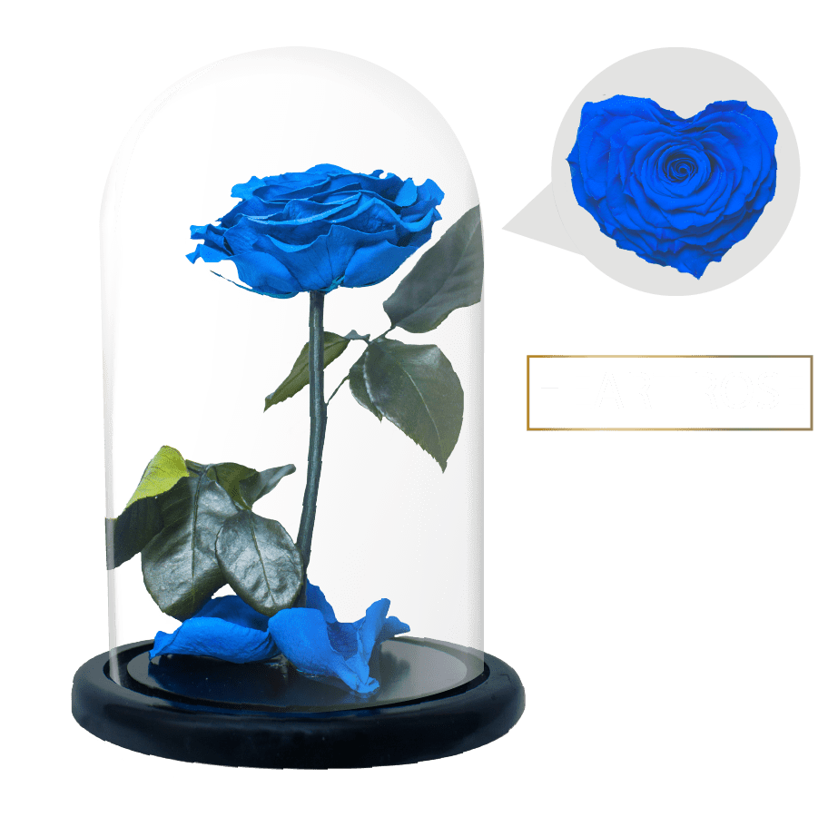
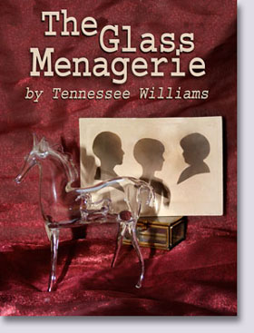
Wel Come
Khandoker Mufakkher Hossain
In Tennessee Williams's ‘"The Glass Menagerie", ‘The final scene depicts Laura as "she blows the candle out."

Slide 3
In Tennessee Williams's ‘"The Glass Menagerie", ’ ‘The final scene depicts Laura as "she blows the candle out." What does this act represent and what message is it sending?

Slide 5
In the final scene of "The Glass Menagerie", Tom's monologue synchronizes directorially with Laura blowing out the candles of the candelabra.

Slide 6
It was the candelabra that Amanda had given Jim (the gentleman caller) to take and go talk to Laura who felt sick and left the room when she discovered that the gentleman caller was the boy she had a crush on in high school.

Slide 7
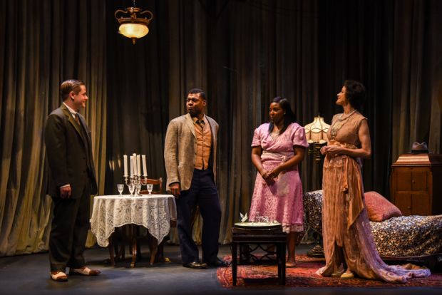

Slide 8
Tom leaves the house forever after he is berated by Amanda for bringing home a gentleman caller for Laura who (unbeknownst to Tom) was already engaged.

Slide 9
Tom leaves St. Louis and "descended the steps of this fire escape for the last time and followed from then on, in my father's footsteps, attempting to find in motion what was lost in space . Perhaps it was a familiar bit of music.

Slide 10
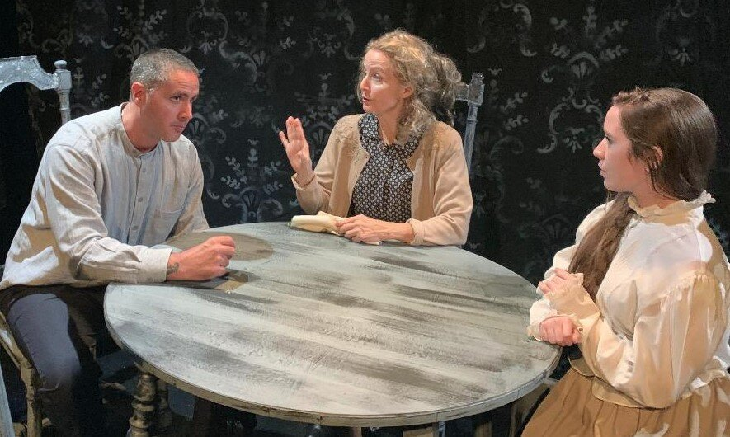

Slide 11
Perhaps it was only a piece of transparent glass. (referring to Laura's glass menagerie). Perhaps I am walking along a street at night, in some strange city, before I have found companions. I pass the lighted window of a shop where perfume is sold.

Slide 12
The window is filled with pieces of colored glass, tiny transparent bottles in delicate colors, like bits of a shattered rainbow. Then all at once my sister touches my shoulder.

Slide 13
I turn around and look into her eyes. Oh, Laura, Laura, I tried to leave you behind me, but I am more faithful than I intended to be! I reach for a cigarette, I cross the street, I run into the movies or a bar, I buy a drink, I speak to the nearest stranger--anything that can blow your candles out!

Slide 14
(The following passage synchronizes with Laura blowing out the candles). For nowadays the world is lit by lightning! Blow out your candles, Laura---and so goodbye. "(She blows the candles out.)

Slide 16
Tom is troubled by how he deserted Laura. He tried to help her and his mother, but he could not live with them any longer--the guilt is overwhelming and he finds no peace.

Slide 17
He wants the interminable reminder of what he has done to end. and thus asks Laura to forgive him and to forget about him. This is the symbolism in the passage of asking her to blow out the candles.

Slide 18
Laura and Amanda are destined to continue living their lives with little income and no husband to take care of Laura. Tom is asking her forgiveness and she grants his request by blowing out the candles.

Slide 19
In real life, Tennessee Williams' sister's bedroom was next to an alley where she could hear cats fighting and screaming at night as she went to sleep.

Slide 20
So Tennessee painted her room white and brought home little pieces of colored glass for her to collect in order to brighten her room as well as her spirits.

Slide 21
The END

