Slide 1
Welcome

Slide 2
Teachers Information
Mazada Akter
Lecturer (English)
BaraborAlim Madrasha
Subject : English 1st paper
Class IX-X

Slide 3
Can you tell the name of some sources of water?
 Pond
 River
 Sea / Ocean
 Lake
 Waterfall
 Rain

Slide 4
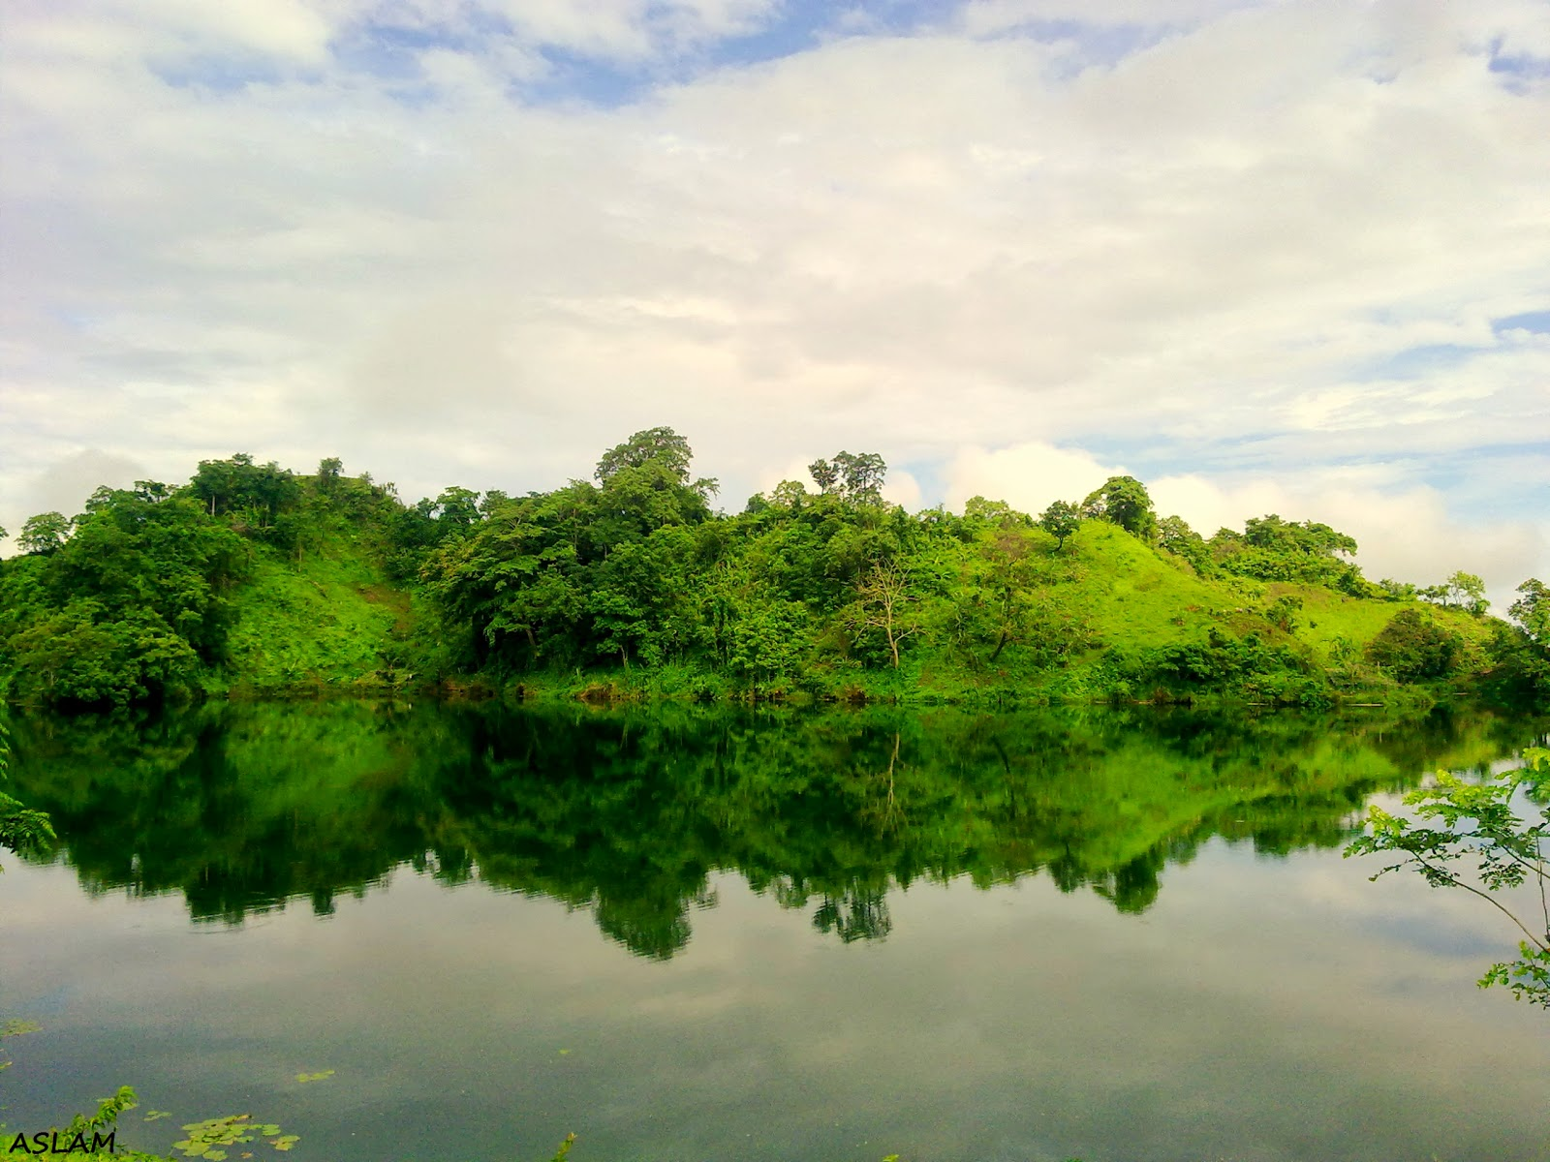
What do you mean by ‘Lake’?
A large body of water within land

Slide 5
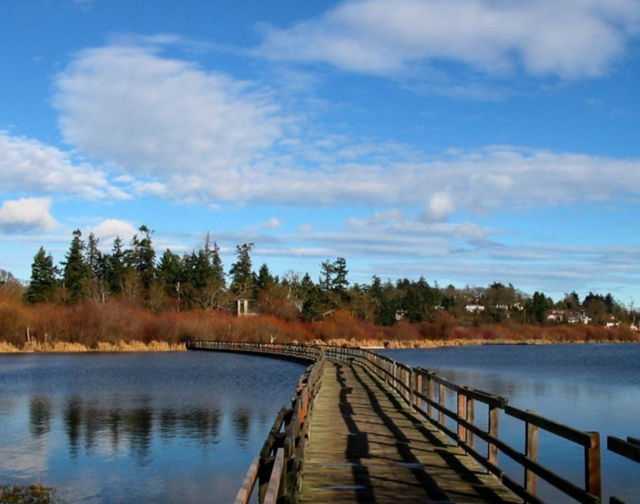
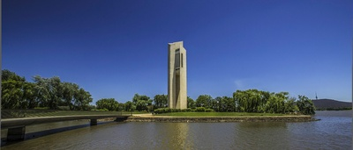
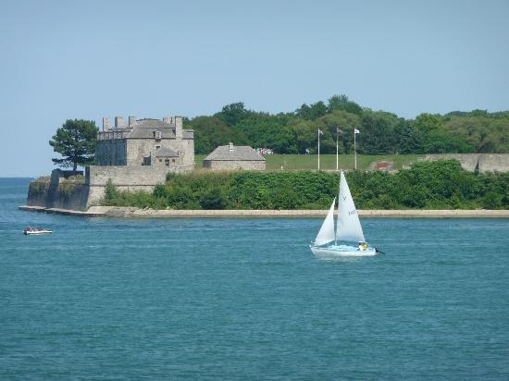
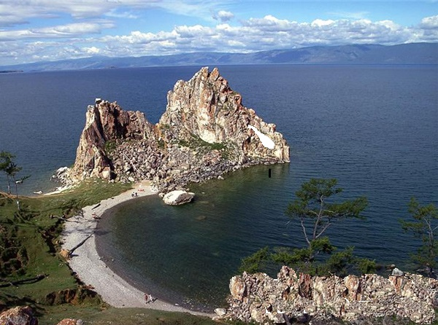
Victoria Lake
Aspen Lake
Niagara Lake
Baikal Lake

Slide 6
Our Today’s Topic
Unit-8; lesson-4

Slide 7
Learning outcomes
By the end of the lesson students will be able to-
❖ talk about Lake Baikal and it’s attractive features.
❖ practise the following new words: brook, crest, basin and miracle.
❖ read for specific information.
❖ describe a place.

Slide 8
Now enjoy a video on
top 10 most amazing lakes of the world

Slide 9
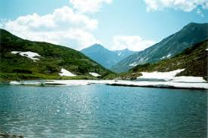
Pair work
 What do you think it is?
 Where is this situated?
 Are you familiar with something
like this?

Slide 10
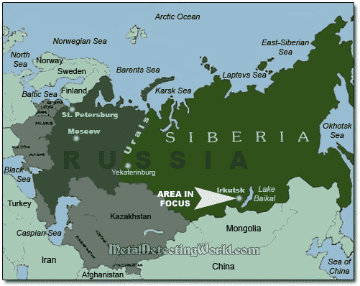
Location of Lake Baikal in the map

Slide 11
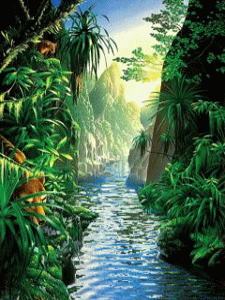
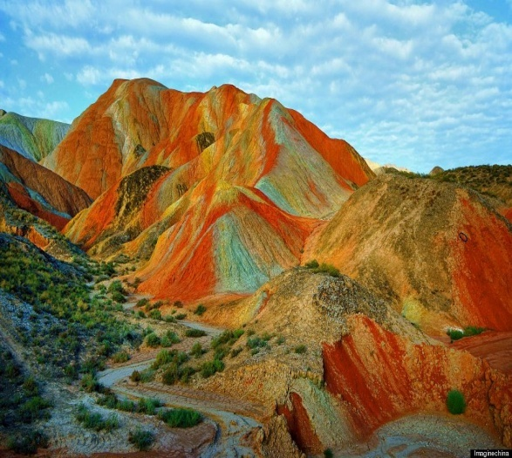
Vocabulary
small stream/river
Brook
Crest
top/summit

Slide 12
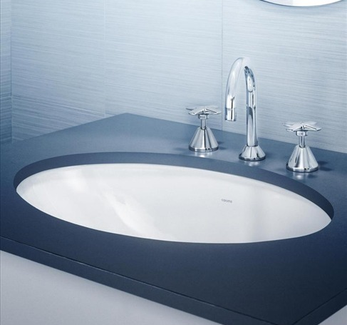
Basin
round open vessel for holding liquids or food
Miracle
mystery

Slide 13
Now read the text silently and carefully
Silent Reading

Slide 14
At a glance
Lake Baikal
Located -Siberia in Russia.
636 km long
Reserves of fresh surface water
Maximum depth is 1620 m
48 km wide
The deepest and one the biggest in the world

Slide 15
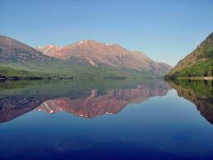
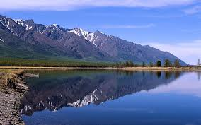
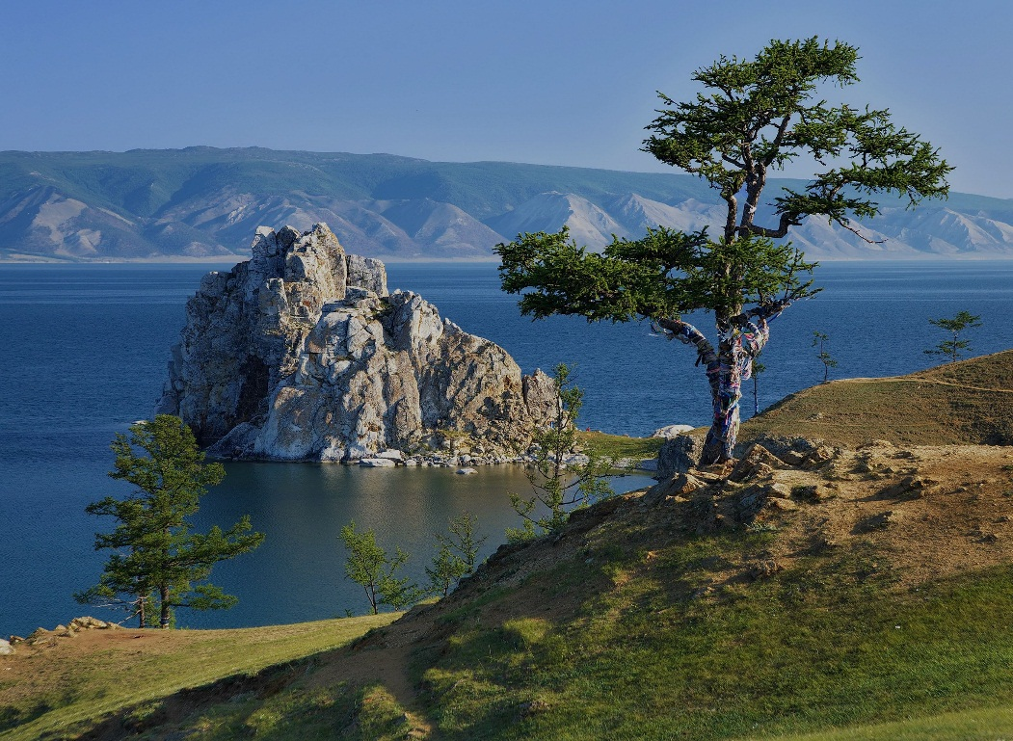
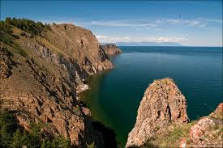
Scenic view

Slide 16
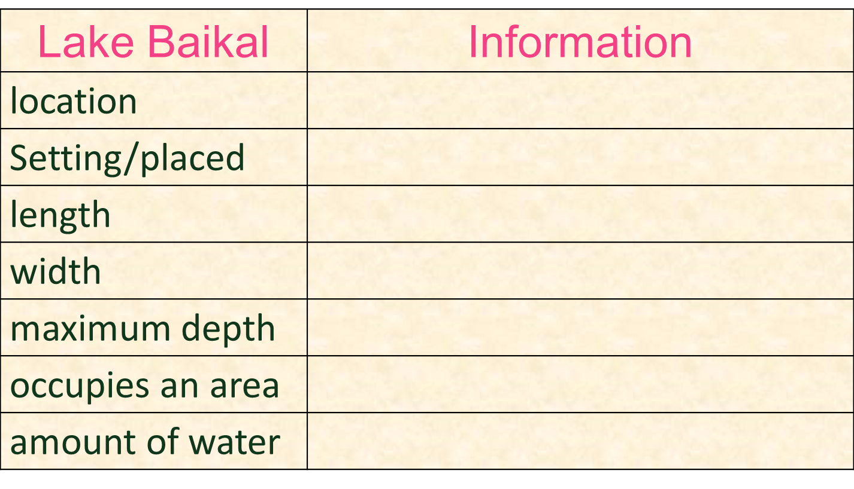
Read The text in A again and complete the chart individually:
in the south of Eastern Siberia
in the centre of Asia
636 km.
48 km.
1620 m.
31500 sq.km.
23000 cu.km.

Slide 17
◆ Where do we get one-fifth of the world’s reserves of fres
surface water?

Slide 18
Home Work
Suppose you have visited a lake & you have been charmed by the aspects of the lake. Now write a paragraph what aspects of the lake appealed to you.

Slide 19
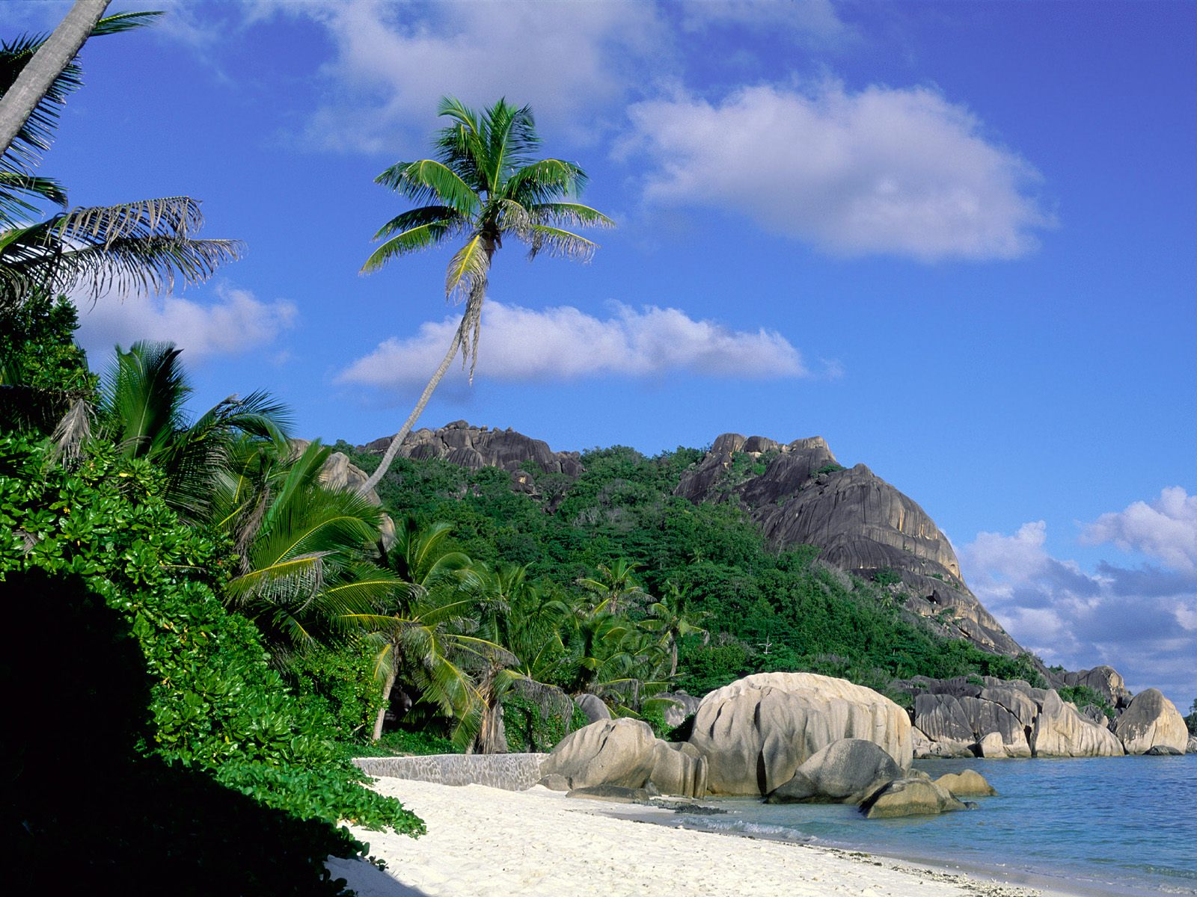
Thank you all

