Slide 1
Good morning

Slide 2
Class:3
Subject:English
Duration:40 minutes

Slide 3
Mental Preparation

Slide 4
Have you take your breakfast today?
What do you take ?
What is your fovourite item of breakfast?
Ackowledge

Slide 5
Unit:37
Lesson:1-3
Page no:74
Declaration of lesson

Slide 6
At the end of the lesson,the students will be able to
1.read the text
2.tell about what food we should eat.
Learning outcomes

Slide 7
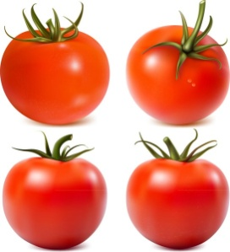
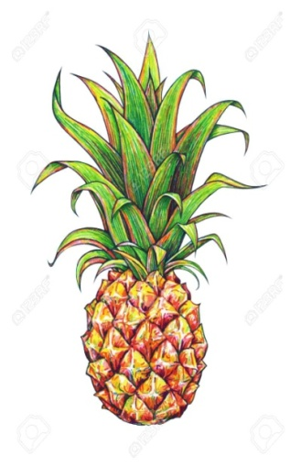
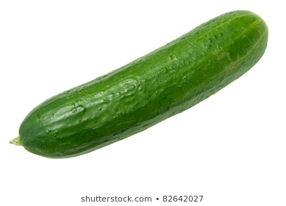
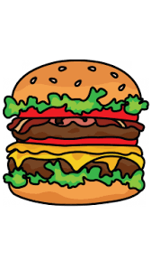
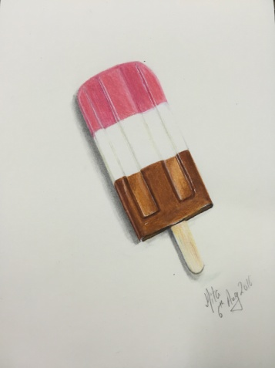
Look at the following pictures.
tomato
cucumber
pineapple
lettuce
Listen to me
chips
chocolate
ice-cream
burger

Slide 8
Listen to me and read after me.
We should eat healthy food.Healthy foods are fruits,like pineapples and papayas.Vegetables,like carrots ,lettuce and tomatos are also healthy .
We shouldn’t eat too much unhealthy food.
Unhealthy foods are ice-cream,chocolate,chips and burgers.Burgers are meat,but they aren’t very healthy.We shouldn’t eat too many of them.

Slide 9
New words:Healthy,Unhealthy, Pineapples,Papayas,Carrots, Lettuce,Burgers,Meat.

Slide 10
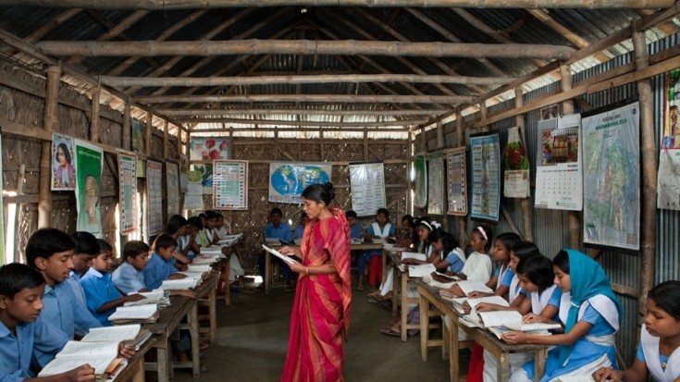
Whole class reading

Slide 11
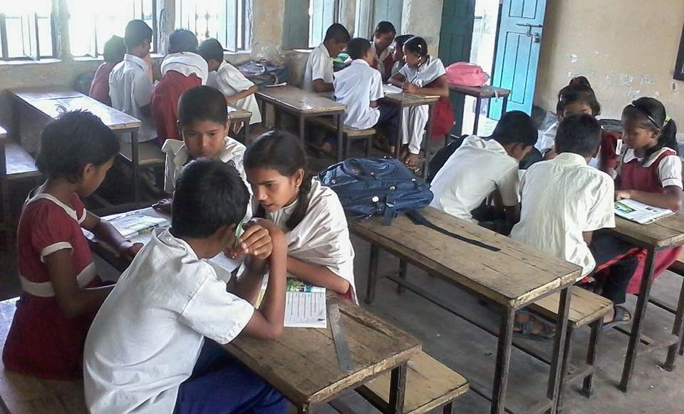
Group reading

Slide 12
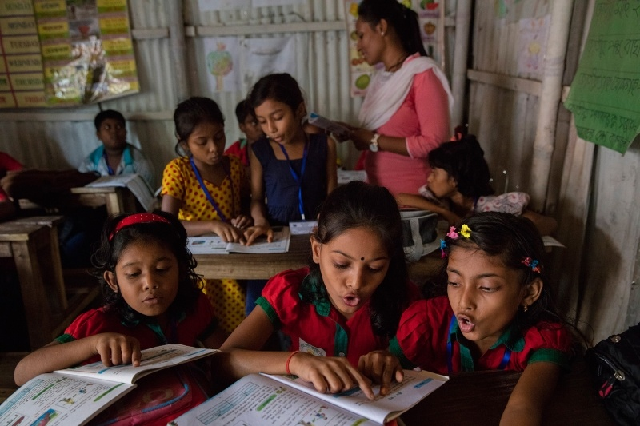
Pair reading

Slide 13
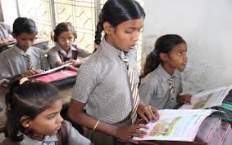
Individual reading

Slide 14
Underline foods in Activity B. Write them in correct lists in your excecise books.
Healthy food | Unhealthy food
Evulation

Slide 16
Prepared by
Muhammad Jane alam
Assistant teacher
West Rashidabad Government primary school.patiya,chittagong.

