Slide 1
DIGITAL BANGLADEAH

Slide 3
INTRODUCING
TEACHER
CLASS
CLASS: TEN
PERIOD: FIRST
SUB: ENGLISH 1ST PAPER
TIME:50M. STU: 59 (M+F)
DATE: 25-09-2016
BIDHAN SEN
ASSISTANT TEACHER
BAGER HAT HIGH SCHOOL

Slide 4
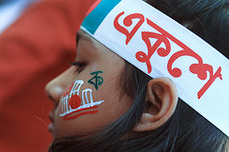
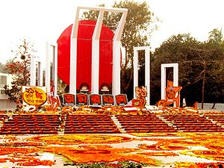
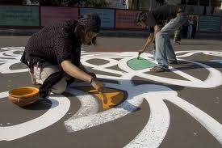

Slide 5
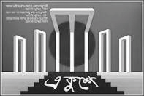
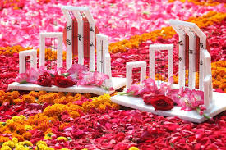
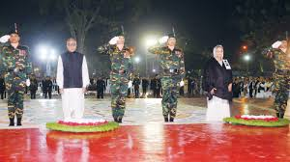
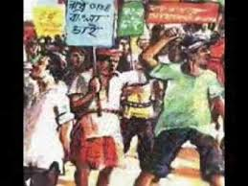
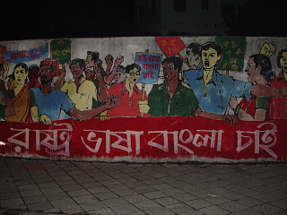
A. Look at the picture and talk about it.
1. What’s the picture about?
2. Where do you think it is?
3. Why was it built?
21 February is a memorable day in our national history. We observe the day every year as International Mother Language Day. The day is a national holiday.
On this day, we pay tribute to the martyrs who laid down their lives to establish Bangla as a state language in undivided Pakistan in 1952. This is known as the Language Movement.

Slide 6
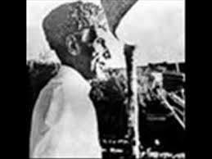
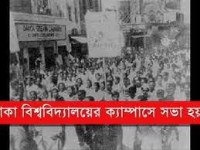
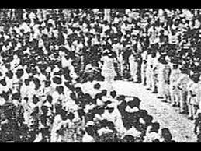
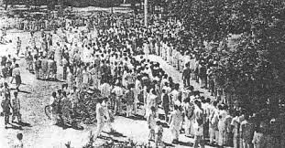
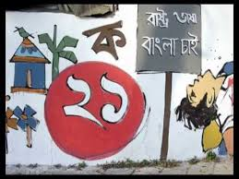
The seed of the Language Movement was Sown on 21 March 1948 when
Mohammad Ali Zinnah, the then Governor General of Pakistan, at a public meeting
in Dhaka declared that Urdu would be the only official language of Pakistan. The
declaration raised a storm of protest in the eastern part of the country. The protest
continued non-stop, gathering momentum day by day. It turned into a movement and
reached its climax in 1952. The government outlawed all sorts of public meetings and
rallies to prevent it.

Slide 7
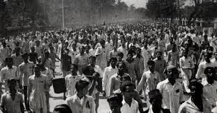
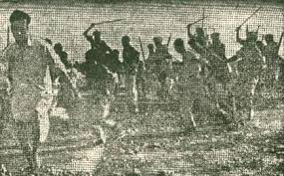
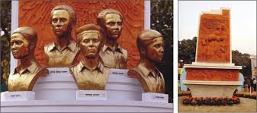
The students of Dhaka University defied the law and they brought out a peaceful
protest procession on 21 February 1952. When the procession reached near Dhaka
Medical College, the police opened fire on the students, killing Salam, Rafiq, Barkat
and Jabbar. This enkindled the sparks of independent movement of Bangladesh.
C. Complete the chart.
Time | What happened
1947
1948
1952

Slide 8
D. Match the words with their meanings.
Words | Meanings
tribute | to have a particular effect
climax | to refuse to obey
outlaw | to give in
defy | the ability to keep increasing or developing
provoke | an act to show respect or admiration
relent | the most exciting point in time
momentum | to ban
E. Answer these questions.
1 Why do we observe 21 February as the International Mother Language Day?
2 What happened when Urdu was declared as the only official language of Pakistan?
3 “The seed of independence was sown in 21 February 1952”. Do you agree with the comment? Why?
F. Write briefly how you observed this year’s 21 February at your school.

Slide 9
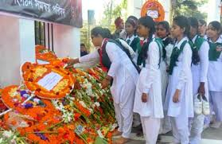
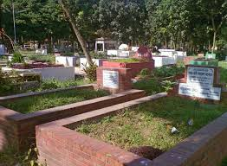
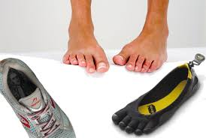
A. Talk about these questions.
1. When does the International Mother Language Day celebration begin?
2. What does the abbreviation UNESCO stand for?
3. What is the other name of 21 February?
B. Read more about International Mother Language Day.
21 February has been observed as Shaheed Dibosh every year throughout the country
in remembrance of the martyrs of language movement of 1952. The occasion begins
at the early hours of the day with mourning songs that recall the supreme sacrifices of
our language martyrs. People wear black badges and go to the Shaheed Minar barefoot in procession, singing mourning songs. They place wreaths at the Minar. Many of them visit the graves of the martyrs at Azimpur graveyard and pray for
them. They also attend various programmes organised in remembrance of the
language martyrs.

Slide 10
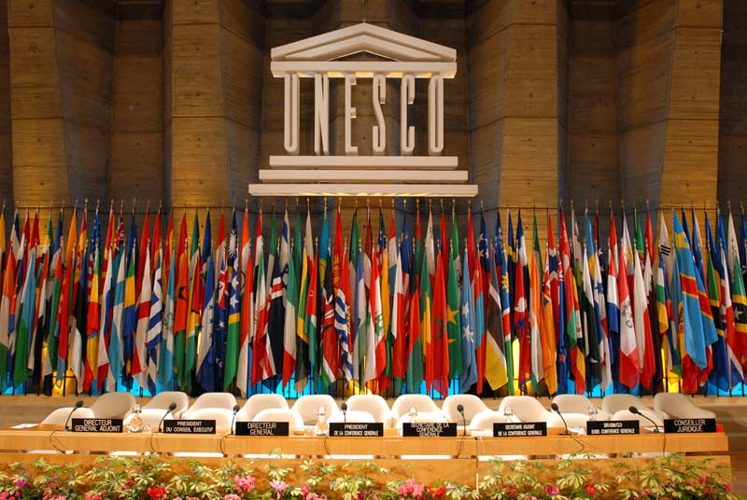
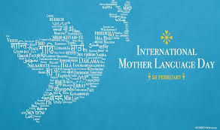
The UNESCO (United Nations Educational, Scientific and Cultural Organisation) on
17 November in 1999 proclaimed February 21 as the International Mother Language
Day in recognition of the sacrifices of the martyrs for the rightful place of Bangla.
The day is now annually observed worldwide to promote awareness of linguistic and
cultural diversity and multilingualism.

Slide 11
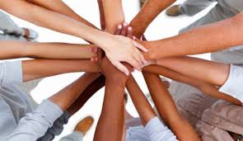
C. Match the words/phrases in the table with their meanings.
Words/phrases | Meanings
wreath in remembrance of proclaim promote diversity multilingualism in recognition of | encourage in appreciation of practice of using several languages an arrangement of flowers in the shape of a circle declare in memory of variety

Slide 12
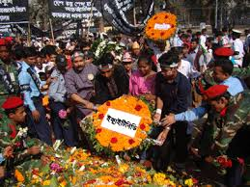
D. Read the text in B again and answer these questions.
1. Why is 21 February called Shaheed Dibosh?
2. Why do people go to the Shaheed Minar? How do they go there?
3. Why is 21 February now observed throughout the world every year?
E. Complete the passage with suitable words.
On 21 February 1952 _______ was shed at a place between Dhaka Medical
College and Dhaka University _______ to establish Bangla as a state ______
of Pakistan.
All subsequent movements _______ the struggles for independence had their
origin from the historic language _________. Shaheed Minar is the ______ of
the supreme sacrifice _______ the mother tongue.

Slide 13
Home Work Write a paragraph within 100-120 words on What people do on ‘The International Mother Language Day’.

Slide 14
Evaluation

