Slide 1
Good Morning
Students
How are you?

Slide 2
Lesson’s introduction
Subject :English 1st paper
Class :Eight
Unit :seven
Lesson :three
Duration :45 minutes
Date :16/08/2019

Slide 3
Shahera Banu
Assistant teacher
Sutarpara Abdul Hamed High School
Dohar Dhaka

Slide 4
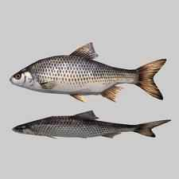
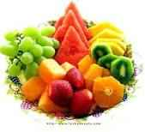
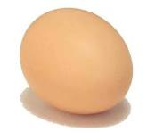
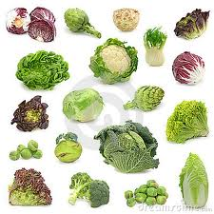
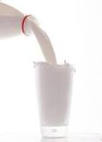
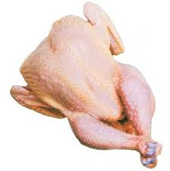
Look at the pictures
Fruits
Egg
Fish
Milk
Vegetable
Chicken
Find out the right food for our health

Slide 5
Our daily diet
Unit: two
Lesson: one

Slide 6
After studding this lesson the students will be able to…
How much food does a person need to eat a day
Why do we eat food?
What is meant by ‘nutritious food?

Slide 7
Open the textbook
& read with me:

Slide 8
Individual work
Why do we eat food?

Slide 9
Pair Works :
Give another 3 example of good food without following pictures?
Fish
Fruits
Egg
Give 3 example of cheap food.

Slide 10
Group Works :
Write down the three rules for good health?
The first one is done for you:
We must cut our nails every week.

Slide 11
Evaluations
What is good health?
What is the good food for our health?
What are the main rules for our health?

Slide 12
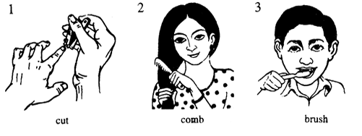
Home Works :
Why is it important for health to do these things?

Slide 13
Thanks all of you,
Student

