Slide 1
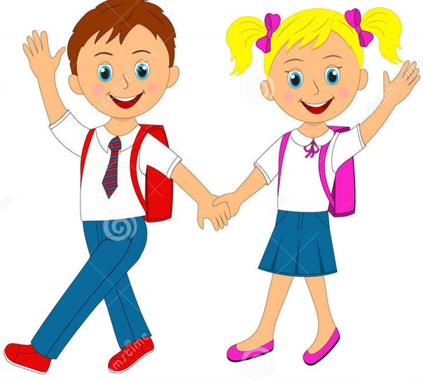

Slide 2
MD. KOWSER ALI
ASISSTANT TEACHER
DURLOVPUR GOVT. PRIMARY SCHOOL
HORINAKUNDU, JHENIDAH.
kowser.gps@gmail.com
Sub: English
Class: Two
Lesson : The Golden Goose
Parts of the lesson: Activity-A
Page No-59

Slide 3
Safety environment by greetings song.
Hello! Hello! How are you?
I’m well, I’m good.
I’m great, I’m wonderful.
Hello! Hello! How are you?
I’m fine! I’m great today.

Slide 4
Checking homework and justify the previous lesson.

Slide 5
Dear students-
Name a valuable thing.
gold
Now try to say-
What can be the topic of our today’s lesson?

Slide 6
Our today’s lesson is--
Today we will read the 1st part of the story.

Slide 7
LEARNING OUTCOMES
By end of the lesson students will be able to-------
Listening: 1.1.1 become familiar with English sounds by listening to common
English words.
4.2.1 enjoy simple stories
Speaking: 1.1.1 repeat after the teacher simple words and phrases with
proper sounds and stress.
1.1.2 say simple words and phrases with proper sounds and stress.

Slide 8
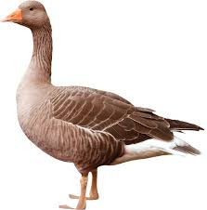
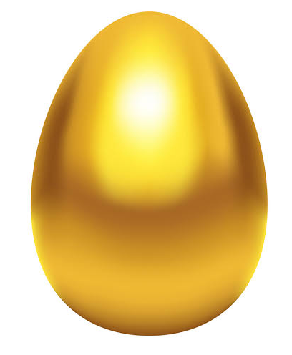
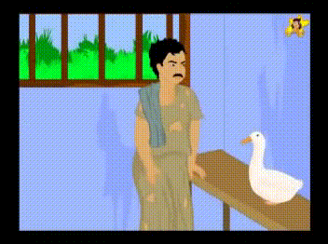
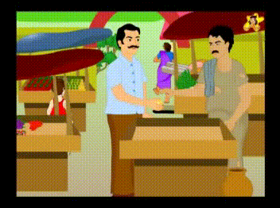
Look, listen and say.
What’s this?
goose
Golden egg
lay
sell

Slide 9
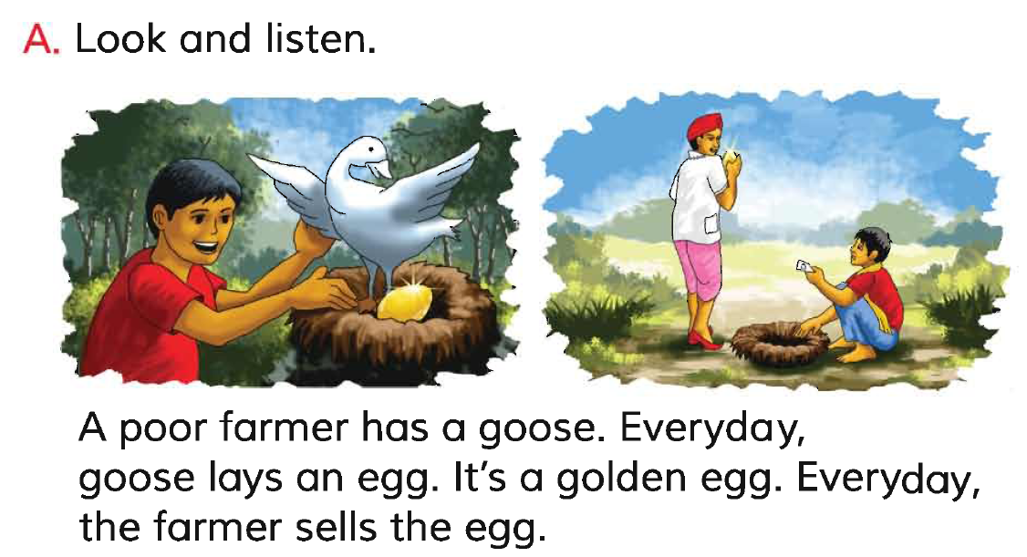
Open your English book at page-59 and see the Activity-A
What can you see in the picture?
Repeat after me.
Reading - SGW

Slide 10
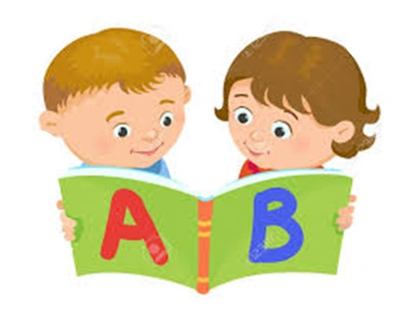
Reading in pair.
I reading.

Slide 11
Read and say.
Everyday the goose lays an egg.
It’s a golden egg.
Everyday the farmer sells the egg.
The poor farmer has a goose.
Identifying weak students and taking to cure.

Slide 12
One day one word
What is this?
goose
রাজ হংসী
Spell out the word - SGW

Slide 13
Find out the letters that are made by the word--------.
g
h
o
o
c
r
s
b
e
n
Find out the correct word-------.
gose
goose
gooce
goese

Slide 14
Say the missing letter.
go-se
g-ose
goo-e
goos-
Write the word to your notebook.
তারিখঃ ০০/০০/০০
goose
গুজ
রাজ হংসী

Slide 15
Homework
Page 54 will be well read and written.

Slide 16
That’s all for today. Goodbye. See you tomorrow.

