Slide 2
Identity
Shaheara Banu
Assistant Teacher
Sutarpara Abdul Hamed High School
Dohar-Dhaka
email: sbanuspahs@gmail.com
Class : Six
Lesson :03
Time: 45mins

Slide 3
LESSON INTRODUCTION
ENGLISH 1ST PAPER
CLASS: SIX
LESSON: THREE
TIME: 40 MINUTES

Slide 4
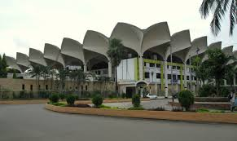
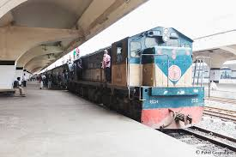
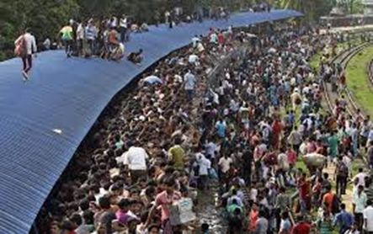
SOME PICTURES OF RAILWAY STATION

Slide 5
TITLE NAME
A railway station
Lesson- 3

Slide 6
STUDENTS WILL BE ABLE TO:-
READ AND UNDERSTAND THE TEXT
UNDERSTAND THE VOCABULARARY
ASK AND ANSWER QUESTIONS
WRITE A SHORT PARAGRAPH
FILL THE BLANKS

Slide 7
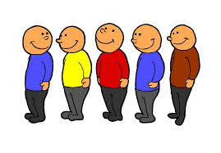
VOCABULARY
A line of waiting people or vehicles
QUEUE
QUIET
Silence

Slide 8
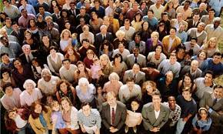
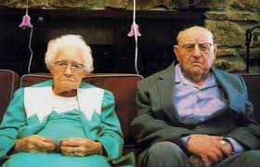
CROWD
A small and definable group of people
Two items of a type
COUPLE

Slide 9
Match a word from Column A with Column B that has an opposite meaning. One is done for you.
Column A | Column B
See off Long Quiet Heavy Pick up | Light Busy Receive Drop Short

Slide 10
See off-Receive
Long-Short
Quiet-Busy
Heavy-Light
Pick up-Drop

Slide 11
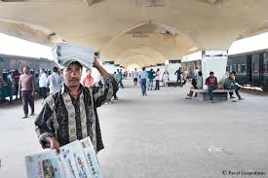
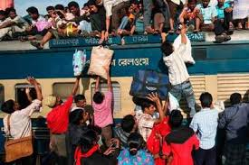
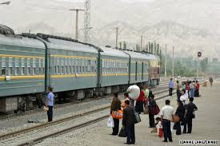
Look at the picture below. Talk about what things you see and what are happening.
Some general pictures of a railway station.

Slide 12
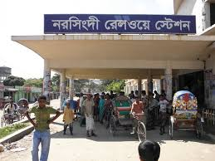
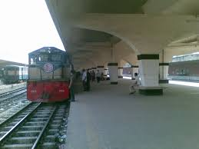
DEFINITION OF A RAILWAY STATION:
A train station, railway station, railroad station (see below) is a railway facility where trains regularly stop to load or unload passengers or freight.
TWO PICTURES OF A RAILWAY STATION

Slide 13
Now read the text individually and complete the sentences with given clues…
(Quiet, crowded, queue, picked up, carry)
A railway station is a… ..place.
A woman standing in the…..was holding a child tightly.
The man was trying to…..three heavy suitcases.
As the train whistled, the woman …..her suitcase.
Ans: Crowded, queue, carry, picked up.

Slide 14
GROUP WORK
Find out what people do in a railway station

Slide 15
EVALUATION
Where was Sajjad going?
What does the old couple do?
How was the environment of the railway station?

Slide 16
HOMEWORK
Write a short paragraph on a railway station.

