Slide 1
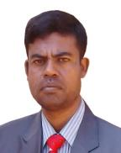
IDENTITY
MD. ABDUR RAZZAK
HEAD TEACHER
DHALAHARA WESTPARA
SECONDARY GIRLS’ SCHOOL
E-mail: abdurrazzakmt@gmail.com
Phone number: 01721588402

Slide 2
TOPIC
DIALOGUE WRITING
TITLE : Environment Pollution
CLASS : ix & x
Time : 50 minutes

Slide 3
Acknowledgement
Muktopaath, NCTB , A2I respective officials & Prof. S. Yoffie
Note for the teachers:
Implementation of such model content depends on the class room situation and skills of the teachers. If the situation demands please edit it according to Ss’ demands.

Slide 4
LEARNING OUTCOMES
After the end of the lesson the Ss will be able to –
say the causes of Environment Pollution.
explain solution of Environment Pollution.
Write a dialogue on Environment Pollution.

Slide 5
Warm up
5 min.
Dhalahara Westpara Secondary Girls’ School
WELCOME TO MULTIMEDIA CLASS
ENGLISH

Slide 6
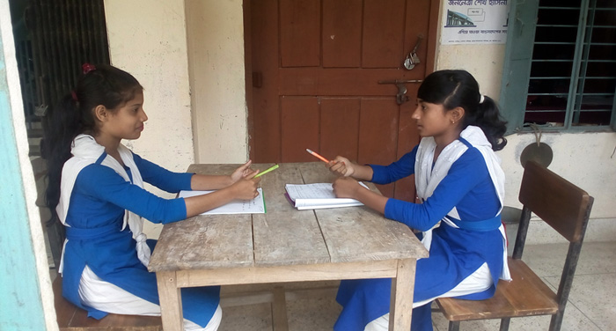
What are they doing?
Look at the picture.
They are making a dialogue.

Slide 7
Let’s see a video clip.

Slide 8
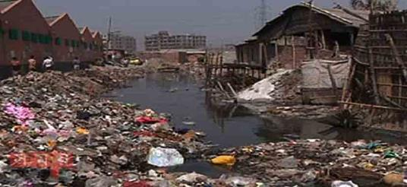
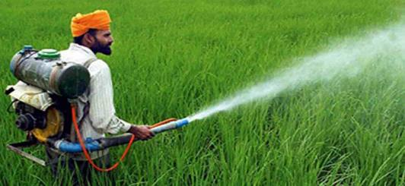
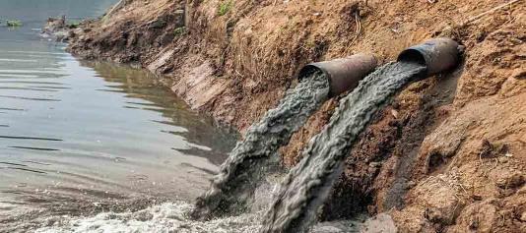
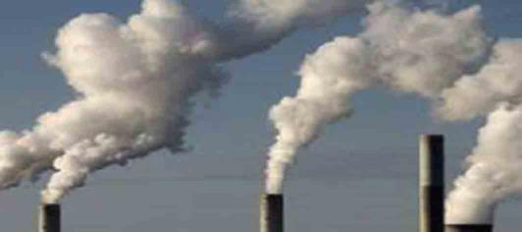
A. Look at the pictures .
garbage
pesticide
Khasias
Toxic chemical
Black smoke

Slide 9
So , What is today’s lesson?
WRITING DIALOGUE ABOUT Environment Pollution

Slide 10
Could you remind what is dialogue?
Dialogue is a written or spoken conversation between two or more persons.

Slide 11
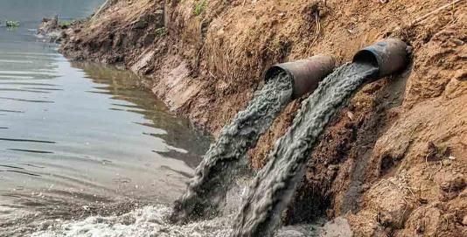
INDIVIDUAL WORK 10MINUTES
by answering question
Causes of water pollution

Slide 12
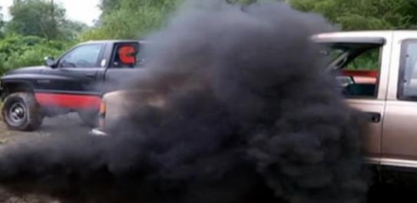
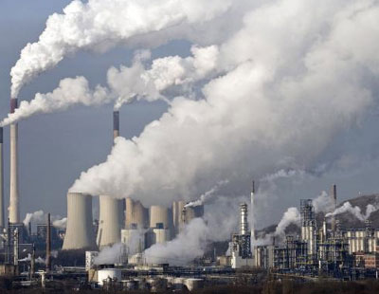
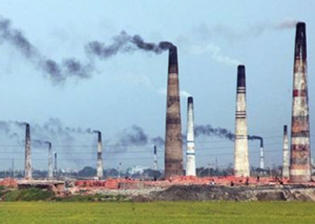
Causes of air pollution

Slide 13
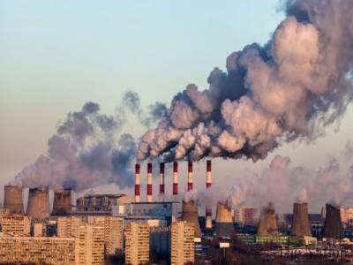
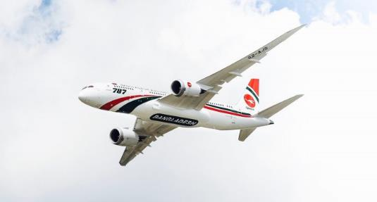
Causes of sound pollution
Loud sound of mills and factories
Loud sound of airplanes

Slide 14
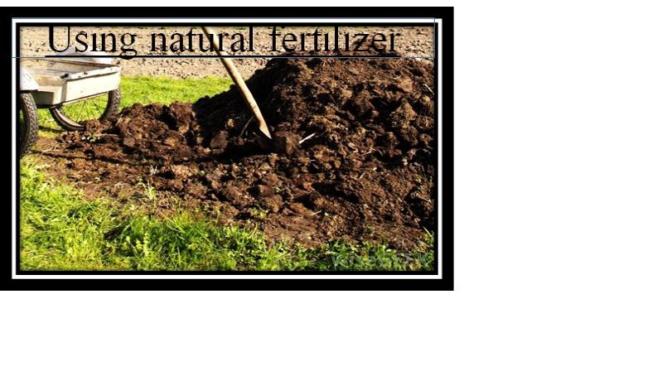
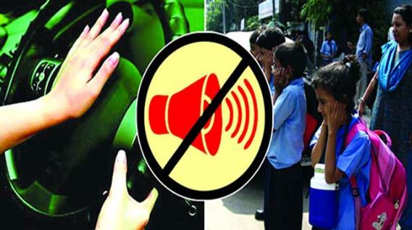
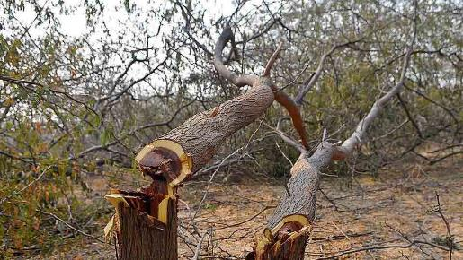
Loud sound of mills and factories
Solution

Slide 15
PAIR WORK 10 minutes
Every single pair make a dialogue on Environment pollution.

Slide 16
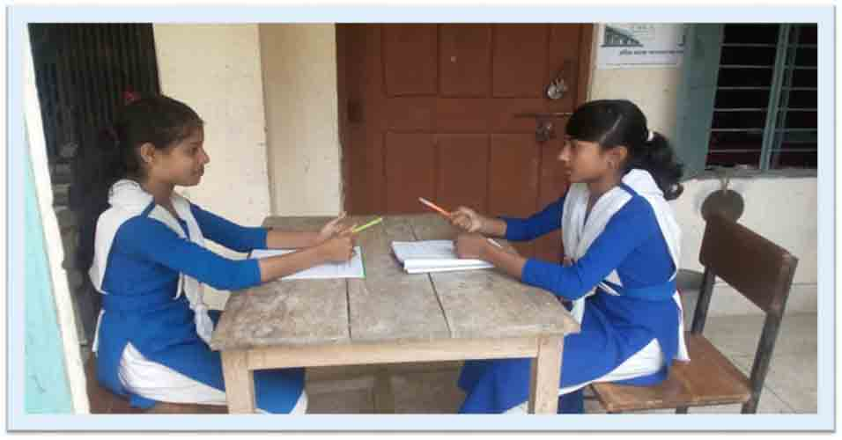
Sumana : Hello Sharmin, how’re you?
Sharmin : Not so well.

Slide 17
Sumana : But why?
Sharmin : My living place is very much polluted.

Slide 18
Sumana : Do you mean environment pollution?
Sharmin : Right you are.

Slide 19
Sumana : What’re the causes of it?
Sharmin : Mainly three causes.

Slide 20
Sumana : The first one?.
Sharmin : Water pollution using pesticide, throwing garbage and toxic chemicals into water,.

Slide 21
Sumana : The second one ?
Sharmin: Air pollution for black smoke of vehicles, mills and factories and brick fields.

Slide 22
Sumana: The third one?.
Sharmin : Sound pollution from hydrolic horn , loud sound from factories and airplane.

Slide 23
Sumana : How can we reduce it?
Sharmin : By solving the above problems and avoiding cutting trees rather planting more trees..

Slide 24
Sumana : Thank you for your valuable information.
Sharmin : You too.

Slide 25
Group work 15 min.
Each group develop a dialogue on
“ Environment pollution.”

Slide 26
FEEDBACK 5 min.
Answer the following questions-
What is Environment pollution?
Is it man made, yes or not ?
What are the causes of Environment pollution?
What should we do to reduce Environment pollution?

Slide 27
Homework
Develop a dialogue about
Global warming.

Slide 28
Advice
“Save The Environment”

Slide 29
THANKS ALL

