Slide 1
Welcome to all are students

Slide 2
Introduce
Teacher
lesson
Md. Saidul hoque
Assistant teacher
Enayetpur Alim Madrash
Senbag, Noakhali.
English for Today
Dakhil class-7
Time—45 minute
Date-23/11/2019

Slide 3
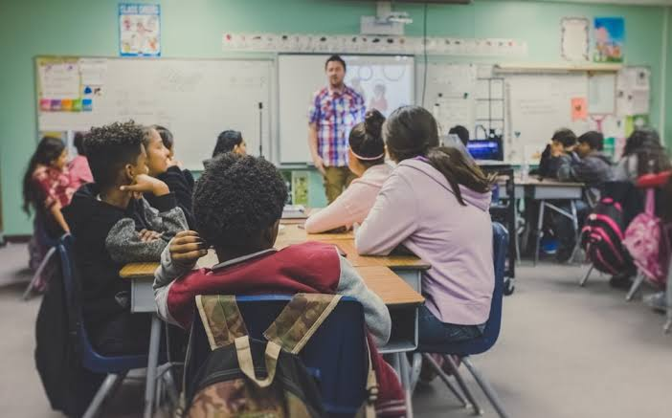
1.Who can you see in the picture?
2.What are they doing?
Thanks, So what can we discuss now?

Slide 4
Todays lesson
A teacher (2)

Slide 5
Learning outcome
After we have studied this lesson, students will be able to---
1.If you choose a job or a job of your own, 100% can be done with sincerity.
2.The success of the desired work is found in quick succession.
3.Do not impose your will on others.

Slide 6
Words: Company
Meanings in English: business, Meanings in Bangla: ব্যবসা

Slide 7
Words: Vacant
Meanings: not filled or occupied; available to be used.
Synonyms
Empty
Unfiled
Unoccupied

Slide 8
Words: Status
English meanings: High rank or social position.
Bangla meaning: মর্যাদা

Slide 9
Word: in-laws
Meanings: relatives marriage especially husband’s or wife’s family members.
Bangla meaning: বৈবাহিক সূত্রে
আত্নীয়।

Slide 10
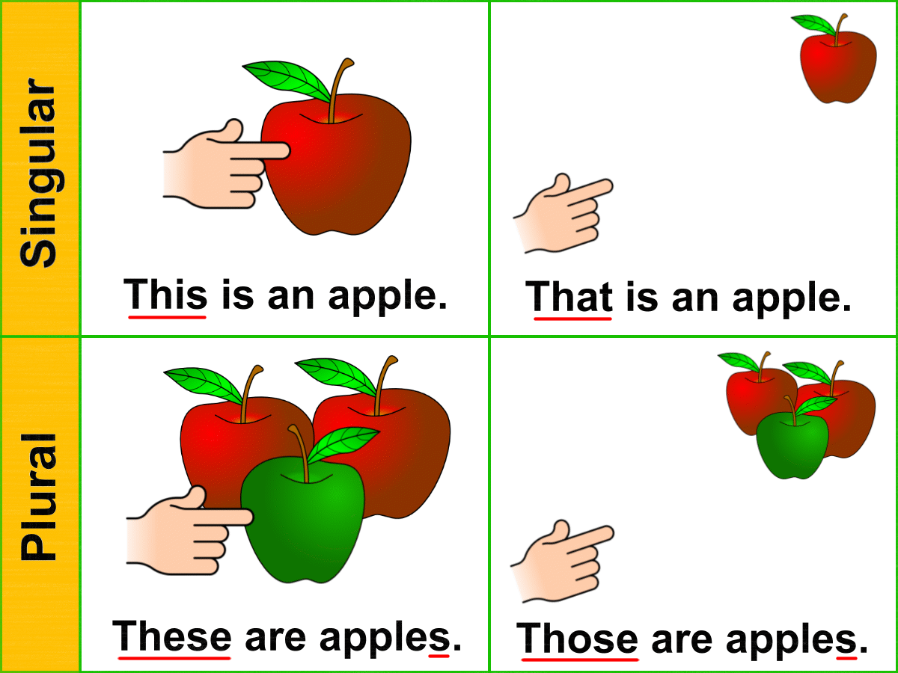
Words: demonstrative
English meaning: to show something by doing.
Bangla meaning: প্রদর্শন করা।

Slide 11
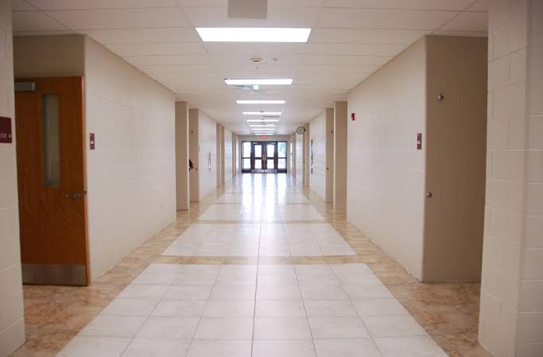
Word: corridor
English meaning: A long narrow passage in a building.
Bangla meaning: দরদালান।

Slide 12
Word: academic
English meaning: connected with study, education
Bangla meaning: শিক্ষা ও পড়াশুনার সাথে সম্পৃক্ত।

Slide 13
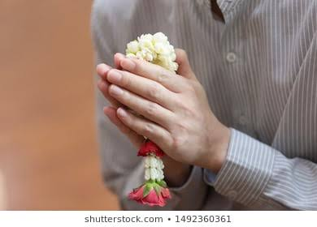
Word: Admire
English meaning: to show respect.
Bangla meaning: সম্মান প্রদর্শন করা।

Slide 14
Word: inspire
English meaning: to encourage somebody to do something well.
Bangla meaning: কাউকে কিছুকরার জন্য উৎসাহিত করা।

Slide 15
Groups work
Click to here for answer
Match the words with their meaning.
words | Meaning
a. Company | A long narrow passage in a building
b. Vacant | Relative by marriage especially husband`s or wife`s family members
c. Status | Emty
d. In-laws | Business
e. Corridor | High rank or social position
f. Academic | To show respect
g. Admire | Connected with study, education
e
d
b
a
c
g
f

Slide 16
Pairs work
Complete the passage with words from the box. A word can be used more than one time
help | passengers | pilot | wants | want
peaceful | aim | crash | useful | become
A father is taking to his daughter about her(1) aim in life. The girl(2) wants to be a pilot. But the father(3) wants her to(4) become a doctor. He says that the job of a (5) pilot is risky. Often there may be a plane (6) crash that may kill all the(7) passengers Of the plane. So the father does not (8) want her to be a pilot. On the other hand, the life of a doctor is (9) peaceful He/she can (10) help the suffering people and be a very (11) useful person in society.
aim
wants
wants
become
pilot
crash
passengers
want
peaceful
help
useful
Here to click of answer.

Slide 17
Evaluation
Read the completed passage in 15 slide above. Ask and answer the following question in pairs.
Question:1. what do you want to be?
2. why do you want to be a doctor?

Slide 18
House work
Question: 1. Make a list of things that shahana does as a teacher.

Slide 19
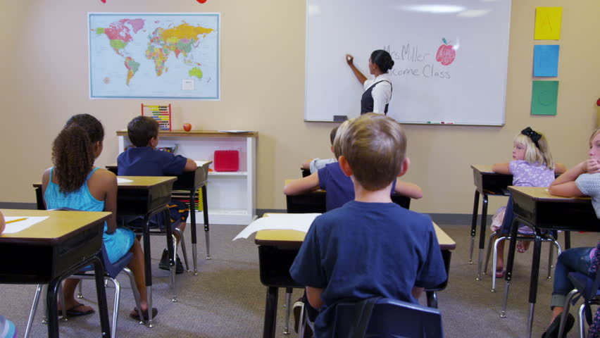
Thanks all are my dear students

Slide 20
We would like to express our cordial gratitude to the Ministry of Education, Directorate of Secondary & Higher Education, NCTB, A2i and the panel of honorable editors ( Md. Jahangir Hasan, Assistant Professor (English) TTC, Rangpur, Ranjit Poddar, Associate Professor (English) TTC, Dhaka, and Urmila Khaled, Assistant Professor (English) TTC, Dhaka, to enrich the contents.
Acknowledgement

