Slide 1
Welcome

Slide 2
Introduction
Teachers Info
Abul kucher
Assistant Teacher, ICT
Bishowanathpur Salameia
Hossaina Dhakil Madrasha
Class Info
Class : Six
Subject: English 1st Paper
Lesson: ?
Time: 50 minutes

Slide 3
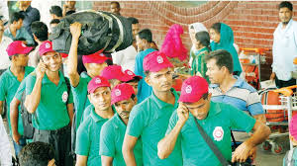
Let’s see the picture
What are you see in this picture?

Slide 4
Lesson Title
Our wage earners
Notes:
Title of the lesson: Nakshi Kantha

Slide 5
After this lesson, student will be able to :
Understand text by silent reading.
Participate in short dialogues and conversations on familiar topics.
Notes:
Title of the lesson: Nakshi Kantha

Slide 6
Read the passage silently

Slide 7
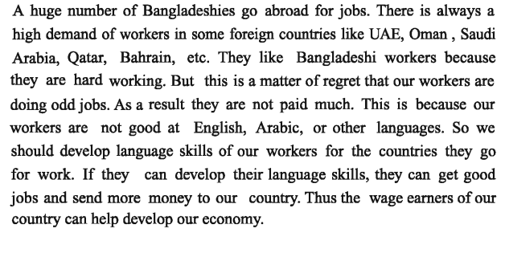
Silent Reading
Notes:
Title of the lesson: Nakshi Kantha

Slide 8
Let’s see the key words of the passage

Slide 9
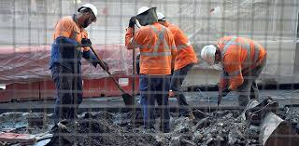
Key Words
worker
a person who does a specified type of work or who works in a specified way.
Notes:
Title of the lesson: Nakshi Kantha

Slide 10
Key Words
languge
the method of human communication, either spoken or written.
Notes:
Title of the lesson: Nakshi Kantha

Slide 11
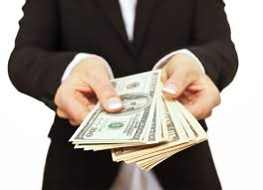
Key Words
Wage earner
a person who works for wages.
Notes:
Title of the lesson: Nakshi Kantha

Slide 12
Individual Work
Complete the following sentences with the clues given.
worker
regret
wage
Abroad
Good at
1 A huge number of Bangladeshi go ----------------for jobs.
2 They like Bangladeshi ---------- because of hard working.
3 But it is matter of ----------- that our worker doing odd job.
4 The Bangladesh are not ---------- foreign languge.
5 Thes the ------------ earners of our country can help develop our economy.
Notes:
Title of the lesson: Nakshi Kantha

Slide 13
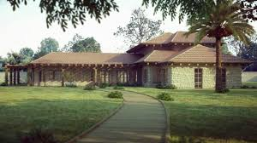
Home Work
Write 5 sentence
“How we can develop our language skill”.
Notes:
Title of the lesson: Nakshi Kantha

Slide 14
Thank you
Notes:
Title of the lesson: Nakshi Kantha

