Slide 1
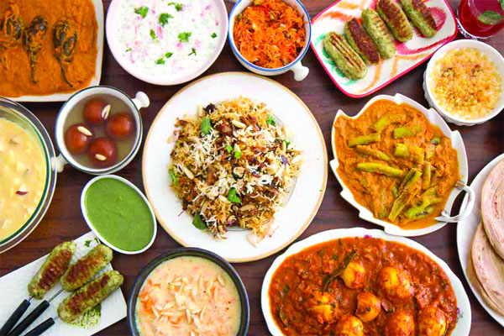


Slide 2

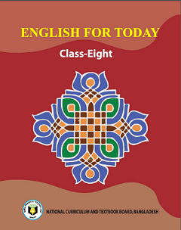
Introduction
Md. Shamsuddawha
Asst. Teacher (English)
Gangore High School
Niamatpur, Naogaon.
shamshzoha@gmail.com
Subject: English 1st Paper
Class: Eight
Unite: One
Duration: 50 Min.
Date: 03/08/2019

Slide 3
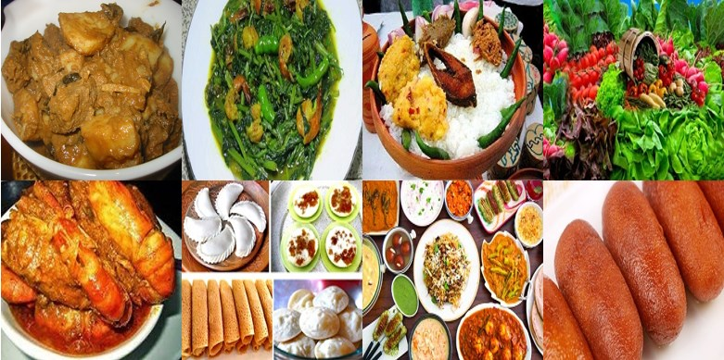
Look at the picture
Can you guess about today’s lesson?
What do you see in the picture?
Picture of Bangladeshi foods.

Slide 4
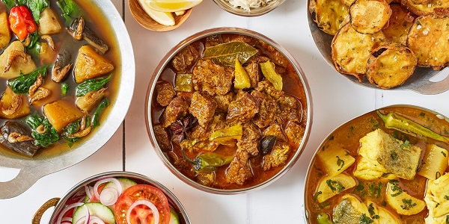
Bangladeshi cuisine

Slide 5
Learning outcomes
After end of the lesson students will be able to …………
infer meaning of the text through silent reading
ask and answer the question
write the main ideas of the text.

Slide 6
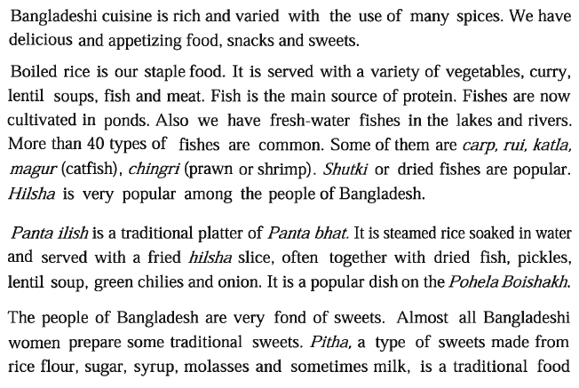
Dear students, open your text book, at page 08 and read the text silently. Try to understand the text and find out the unknown words. After finishing the text we will know about the new words.

Slide 7
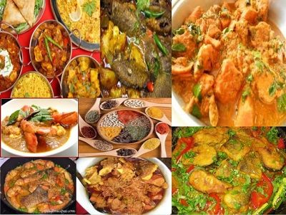
Individual work
Time
04 Min.
Cuisine
a style of cooking
The book is the definite guide to Bangladeshi cuisine.

Slide 8
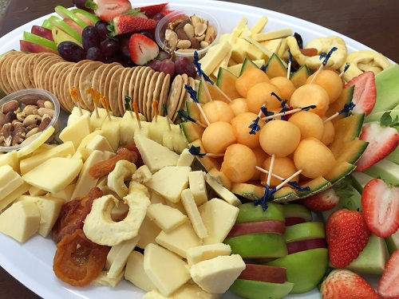
platter
a large plate used for serving food
The platter looks very nice.

Slide 9
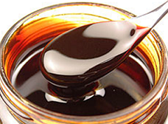
a thick, dark sweet liquid made from sugar plants/ syrup.
molasses
He poured milk and molasses into a bowl.

Slide 10

entire
whole or complete
His behavior disturbed the entire classroom.

Slide 11
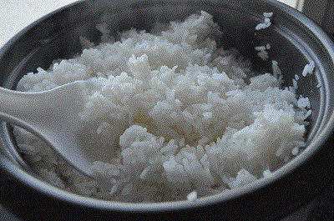
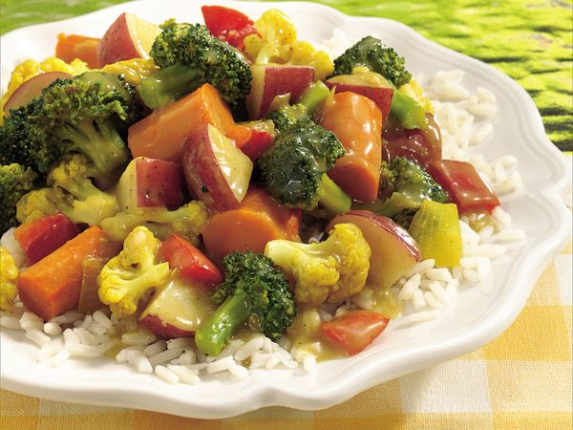
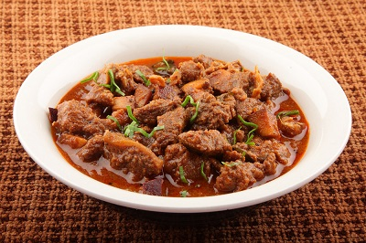
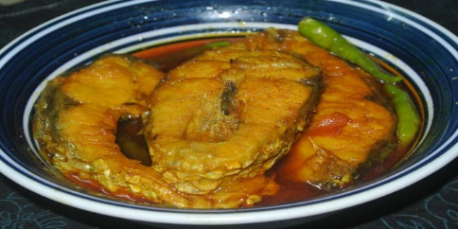
Let’s know about Bangladeshi foods
Rice
Vegetables
Meat
Fish
Boiled rice is our staple food. It is served with a variety of vegetables,
curry, lentil soups, fish and meat.

Slide 12
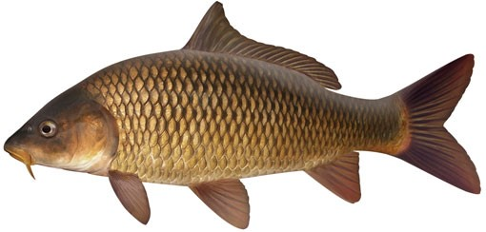
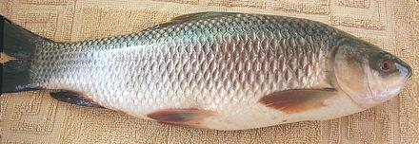
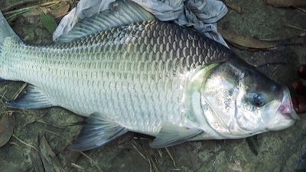
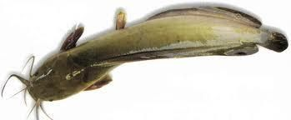
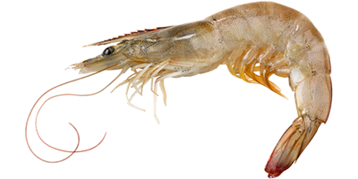
Carp
Rui
Katla
Magur
Chingri
Fish is the main source of protein. Fishes are now cultivated in ponds. Also we have fresh water fishes in the lakes and rivers. More than 40 types of fishes are common. Some of them are carp, rui, katla, magur(catfish), chingri(prawn or shrimp).

Slide 13
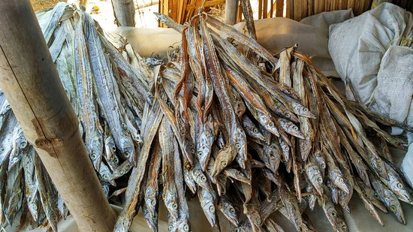
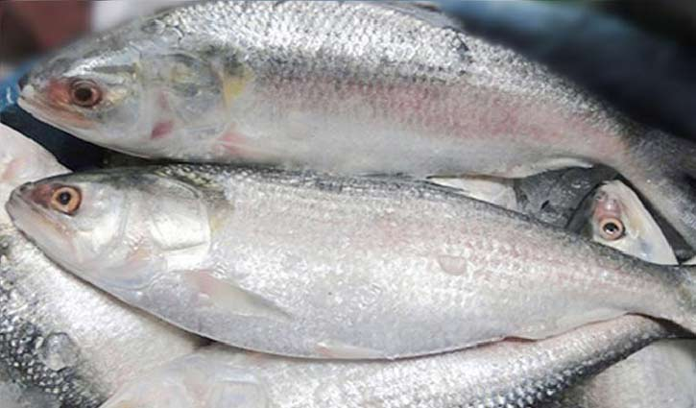
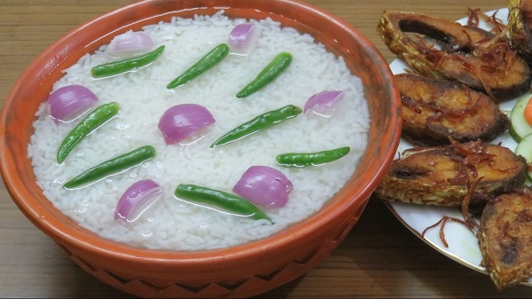
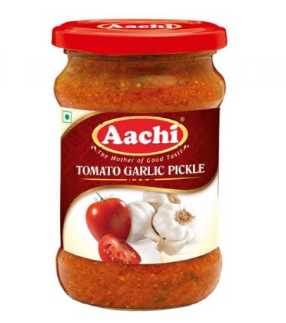
Shutki
Hilsha fish
Panta bhat with fried
hilsa slice
Pickles
Shukti or dried fishes are popular. Hilsha is very popular among the people of
Bangladesh. Panta ilish is a traditional platter of panta bhat. It is steamed rice soaked
in water and served with a fried hilsha slice often together with dried fish, pickles,
lentil soup, green chillies and onion.

Slide 14
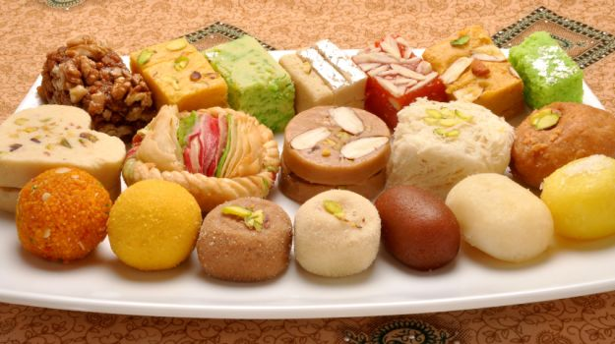
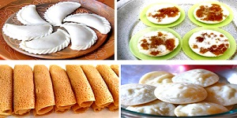
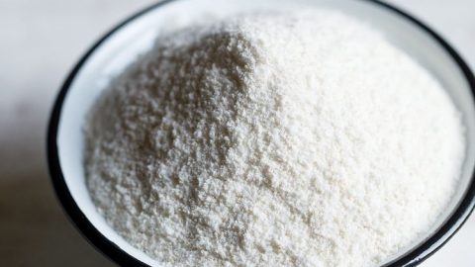
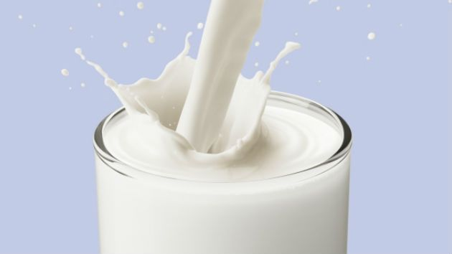
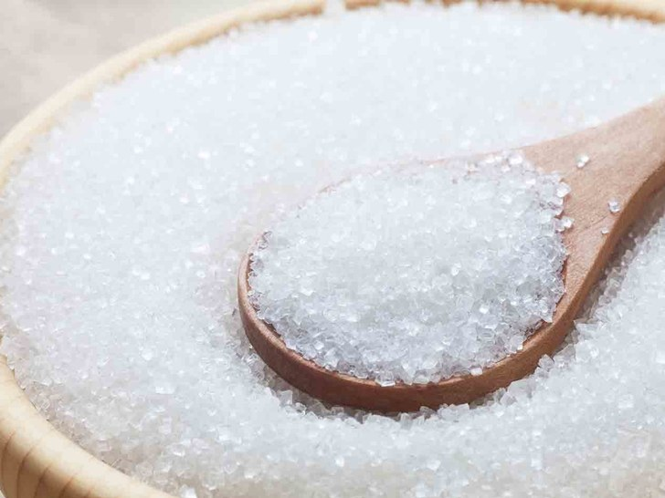
Sweets
Pitha
Rice flour
Milk
The people of Bangladesh are very fond of sweets. Almost all
Bangladeshi women prepare some traditional sweets. Pitha, a
type of sweets made from rice flour, sugar, syrup, molasses and
sometimes milk, is a traditional food loved by the entire
population. During winter Pitha Utsab, meaning pitha festival, is
organized by different groups of people. Sweets are distributed
Among close relatives when there is good news like births,
weddings, promotions, etc.
Sugar

Slide 15
Pair work
Time
06 Min.
Answer the following questions.
1. What has made Bangladeshi food so special?
2. Where do we get fishes from?
3. What are our staple foods?
4. Why are sweets an important part of our life?

Slide 16
Group work
Time
10 Min.
Open your textbook at page 08 and read the text carefully.
Now, write the main ideas of the text with your own words.

Slide 17
Evaluation
True or false? If false, give the correct information.
Sweets of Bangladesh are mostly milk based.
We get protein mostly from vegetables.
The people of Bangladesh are very fond of sweets.
On Pohela Boishakh, the traditional food is steamed rice
with rui, katla, chingri.
True
2. Correct Ans. We get protein mostly from fish.
False
True
4. On Pohela Boishakh, the traditional food is steamed rice
with panta ilish.
False

Slide 18

Home work
Why are there differences between the food eaten by the urban and the food
eaten by the rural people. Describe it.

Slide 19
