Slide 1
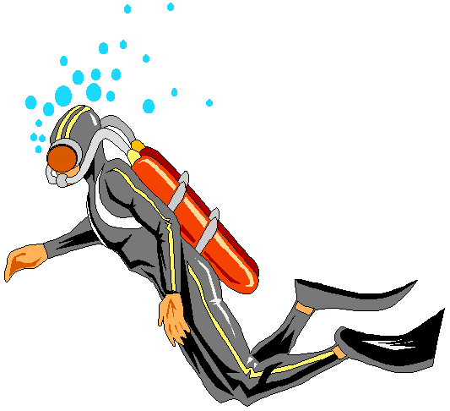


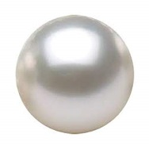

Slide 2


INTRODUCTION
Md. Shamsuddawha
Asst. Teacher (English)
Gangore High School
Niamatpur, Naogaon.
shamshzoha@gmail.com
Subject: English 1st Paper
Class: Eight
Unite: Seven
Duration: 50 Min.
Date: 28/07/2019

Slide 3
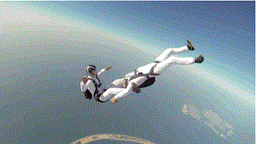
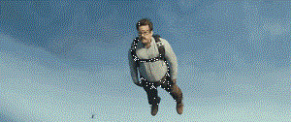
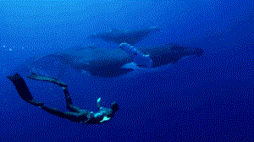
Look at the pictures
They are diving in the sky and under water.
Can you tell what are they called?
They are called diver.
What are they doing?

Slide 4
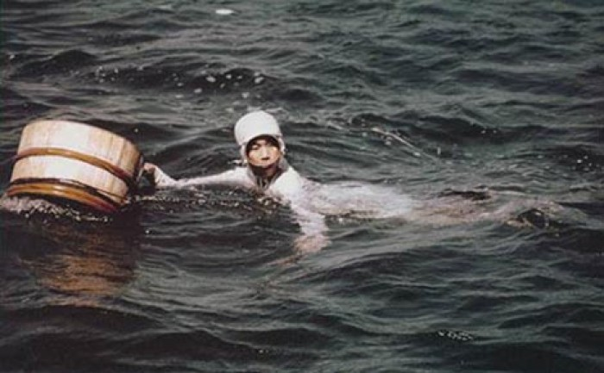
So, today’s topic is……..
The Ama divers

Slide 5
Learning Outcomes
After end of the lesson students will be able to …………
understand the text through silent reading
tell the meaning of the new words
ask and answer the question
write about Ama divers.

Slide 6

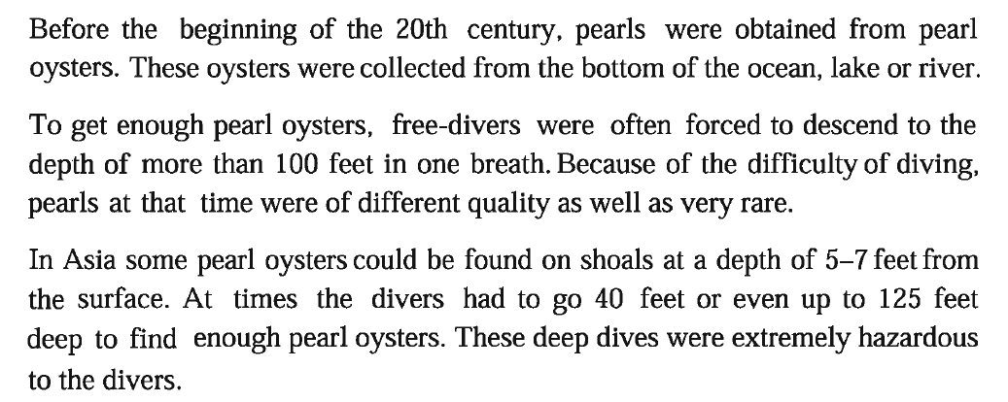
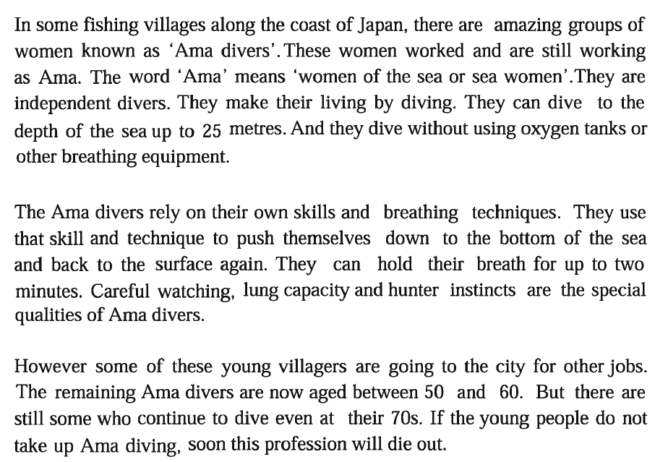
Dear students, open your text book, at page 80 and read the
text silently. Try to understand the text and find out the unknown
words. After finishing the text we will know about the new words.

Slide 7

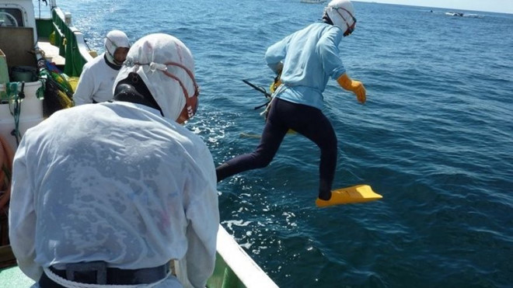
Time
05 Min.
Individual Work
Key Words
Main word
Meaning
diver
someone who dives.
He is a proficient pearl diver.

Slide 8

Main word
Meaning
not common or frequent, very unusual
rare
He has a collection of rare pearls.

Slide 9
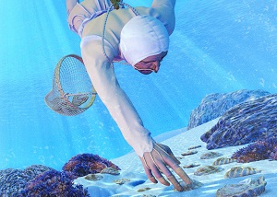
Main word
Meaning
descend
to go or come down
The Ama divers are descending to the depth of the sea.

Slide 10

Main word
Meaning
to depend on or
trust someone or something
rely
Many working women rely on relatives for childcare.

Slide 11
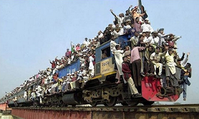
Main word
Meaning
hazardous
dangerous, risky
You should always avoid hazardous thing.

Slide 12
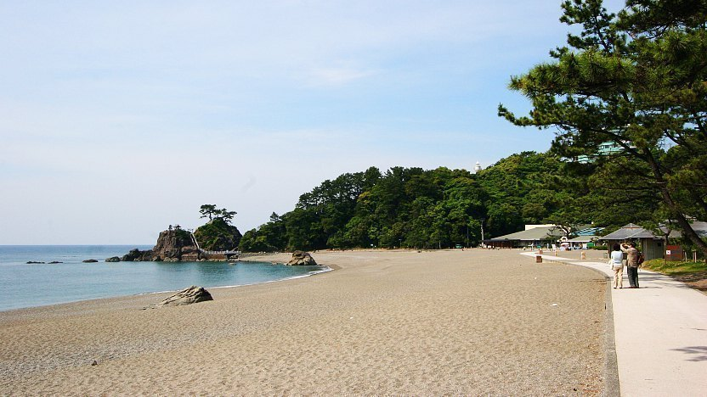
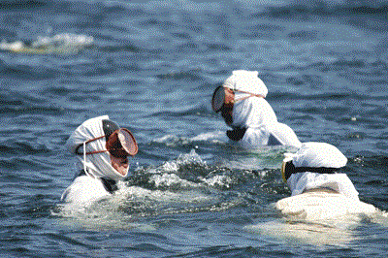
Let’s get some information about the Ama divers
In some fishing villages along the coast of Japan, there are amazing
groups of women known as ‘Ama divers’. These women worked and
are still working as Ama.

Slide 13
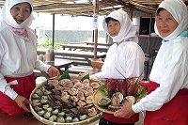
The word 'Ama' means 'women of the sea or sea women'.
They are independent divers. They make their living by diving.

Slide 14
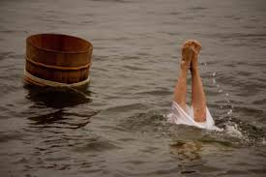
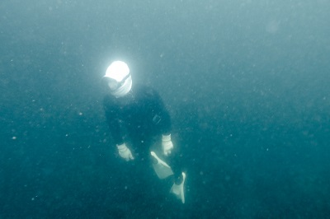
They can dive to the depth of the sea up to 25 meters. And they dive
without using oxygen tanks or other breathing equipment.

Slide 15
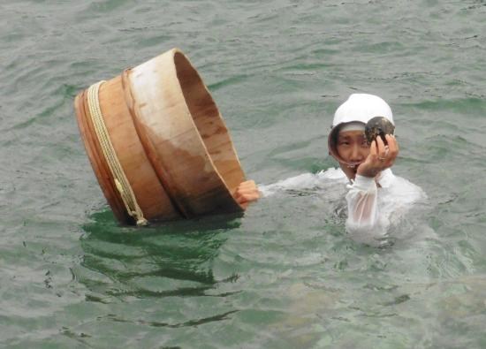
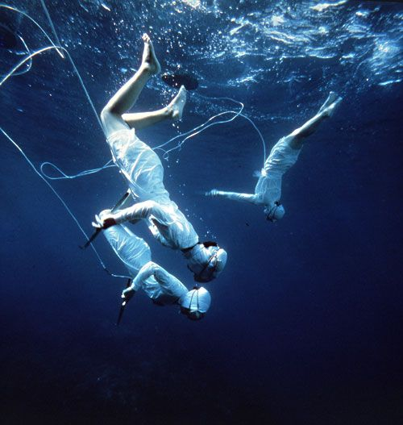
The Ama divers rely on their own skills and breathing techniques. They use
that skill and technique to push themselves down to the bottom of the sea and
back to the surface again. They can hold their breath for up to two minutes.

Slide 16
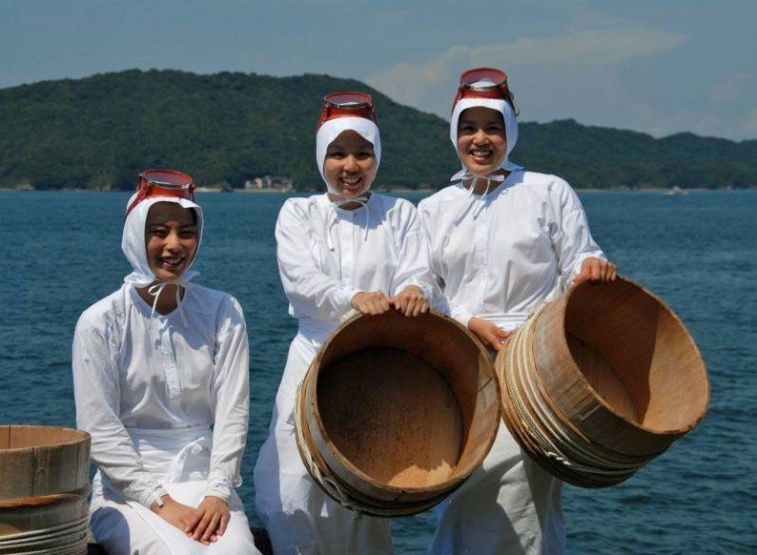
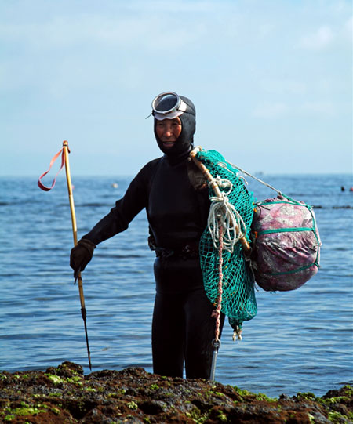
Careful watching, lung capacity and hunter instincts are the special
qualities of Ama divers.

Slide 17
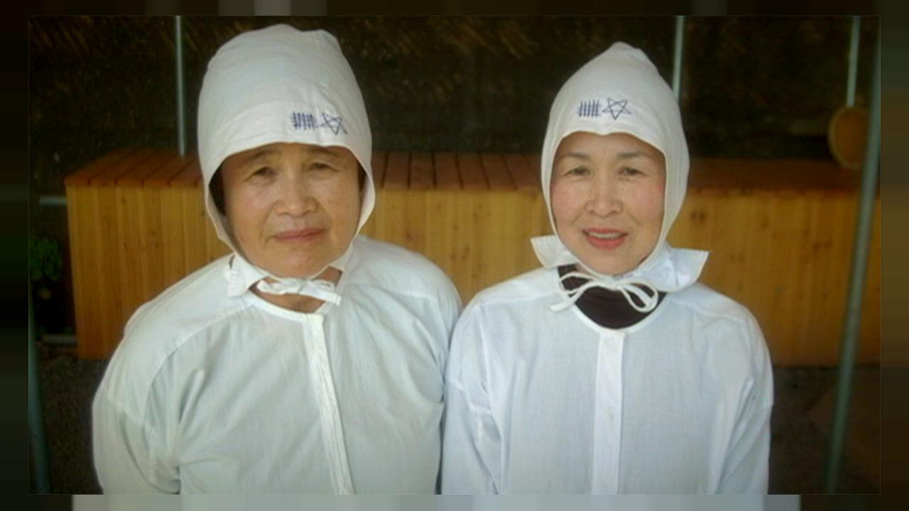
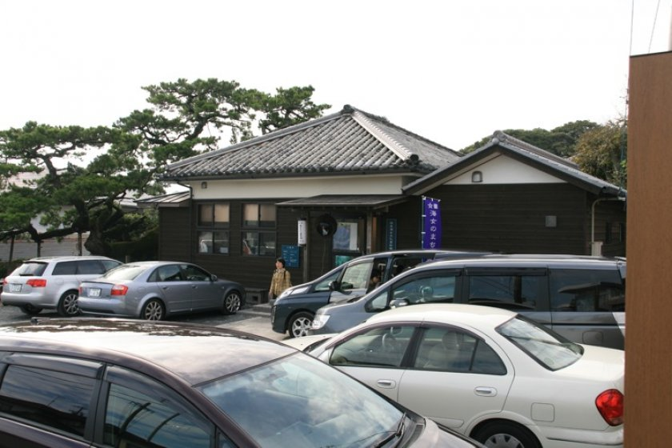
Some of these young villagers are going to the city for other jobs. But there
are still some who continue to dive even at their 70s. If the young people do
not take up Ama diving, soon this profession will die out.

Slide 18

Time
08 Min.
Pair Work
Discuss in pairs and answer the following questions.
Why are the Ama divers amazing?
How deep can the Ama divers go down into the sea?
What techniques and skills do the Ama divers use in diving?
Why do you think are the young villagers going on the city?

Slide 19
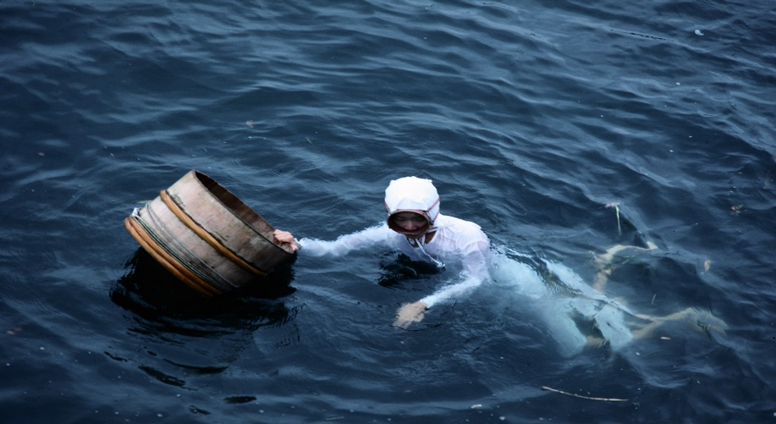
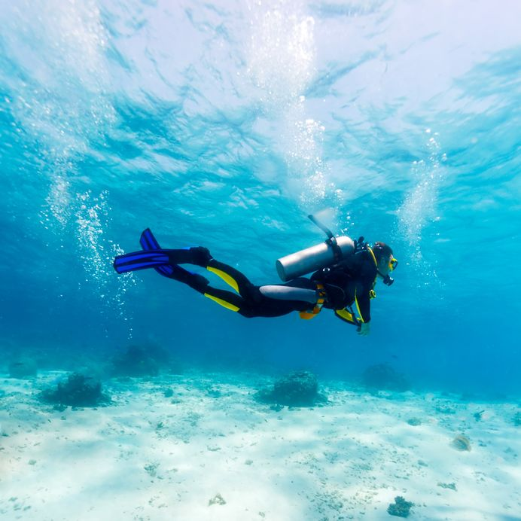
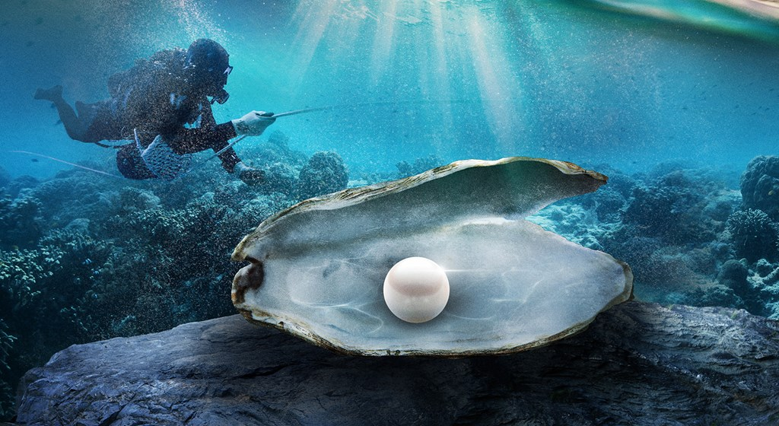
Look at the pictures.
Diving into sea
Searching pearls

Slide 20
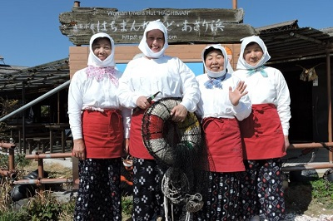
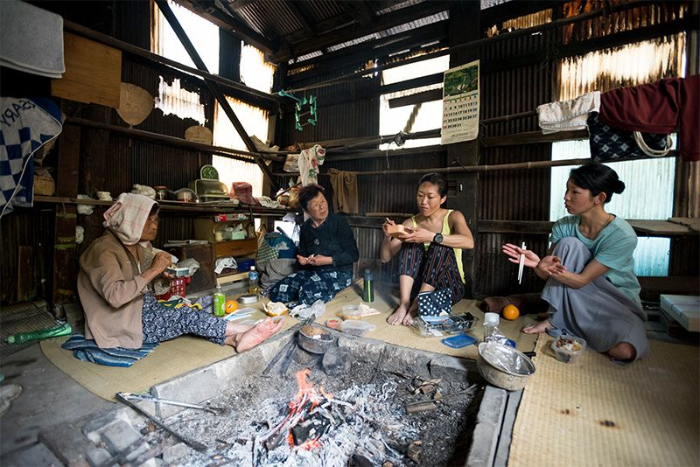
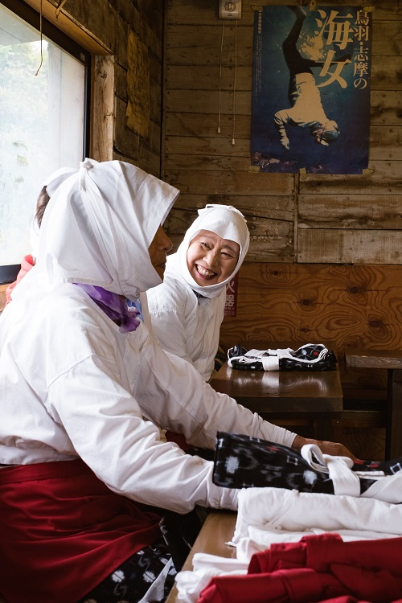
Working in group
Searching pearls

Slide 21

Time
08 Min.
Group Work
Write eight sentences about the Ama divers of Japan.

Slide 22

Write a paragraph on about Ama divers.

Slide 23

