Slide 1
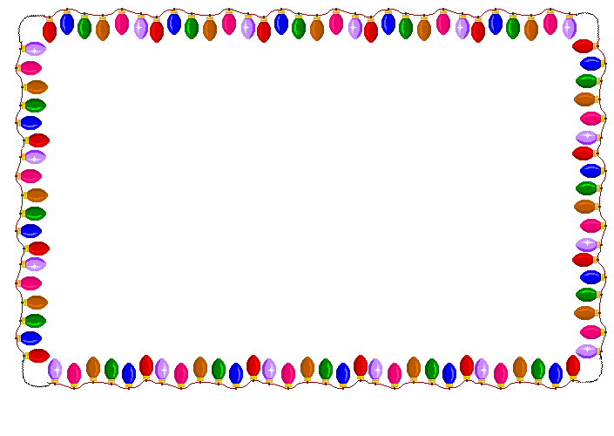

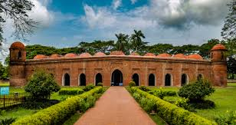
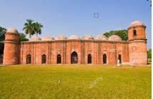

To this session

Slide 2




TEACHER’S INTRODUCTION
MD. SHAMSUDDAWHA
ASST. TEACHER (ENGLISH)
GANGORE HIGH SCHOOL
NIAMATPUR, NAOGAON
CELL NO. 01717-516353
E-MAIL: shamshzoha@gmail.com

Slide 3
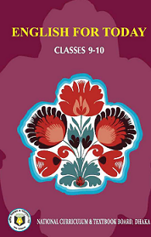
LESSON INTRODUCTION
ENGLISH FIRST PAPER
CLASS: NINE - TEN
UNIT: EIGHT
DURATION: 50 MIN.
DATE: 25-07-2019

Slide 4

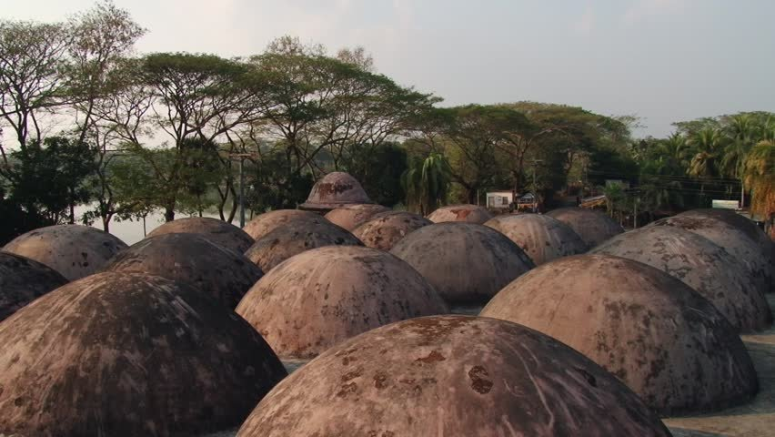
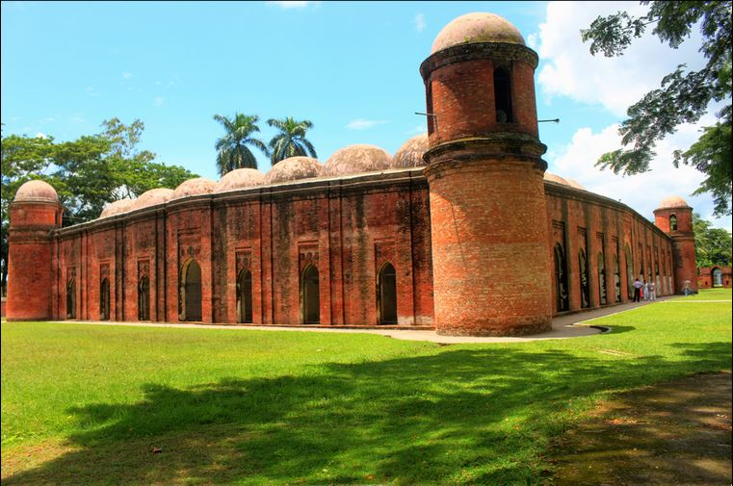
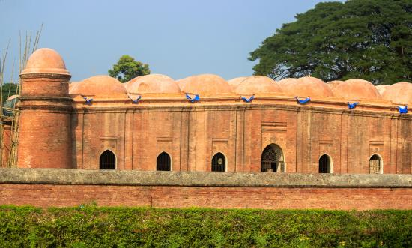
Look at the pictures
Can you tell me the name of the building?
It is called Shat Gambuj Mosque.
What do you see in the picture?
This is an ancient building.
Can you guess what would be our today’s topics?

Slide 5
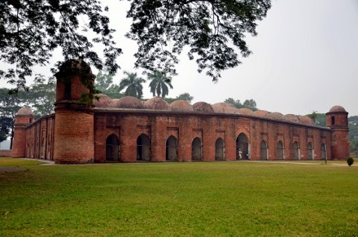
Our today’s topics is.……………………
The Shat Gambuj Mosque

Slide 6
Learning Outcomes
After end of the lesson students will be able to ….
read and understand the text through silent reading
ask and answer the questions
infer the meaning from the text
Write a short paragraph.

Slide 7

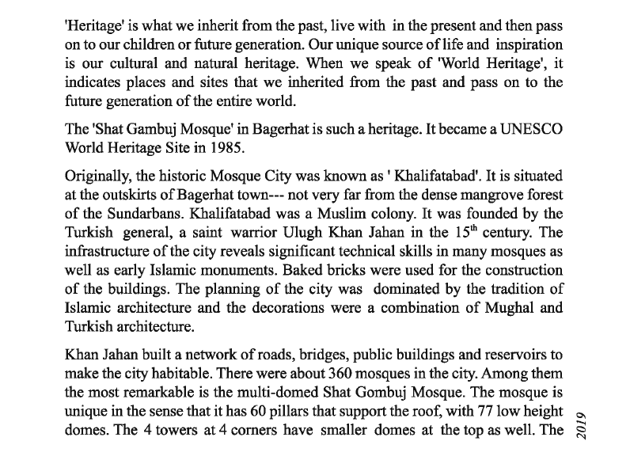
Dear students, open page at 110 of your text book. Now read the text silently and try to find out the new words.

Slide 8
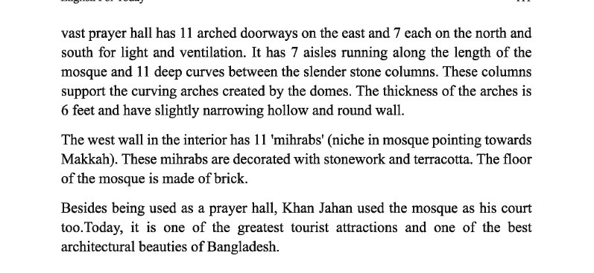

Slide 9


05
Min
Individual Work
Key words
Dome
a rounded roof on a building or a room
The dome was supported by white marble columns.

Slide 10
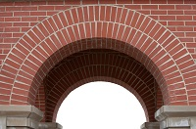
Arch
curve/semicircle
Marble Arch is a famous London landmark.

Slide 11
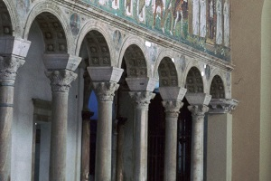
Slender
thin/slim
The building is made with slender stone columns.

Slide 12
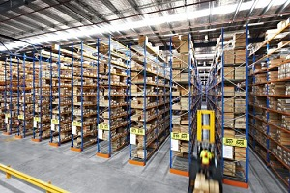
Aisle
Path/narrow way
We can see lots of aisles in the picture.

Slide 13
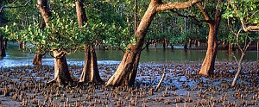
Mangrove
Coastal tree/tree grows on river bank
Sunderban is one of the biggest mangrove forests.

Slide 14
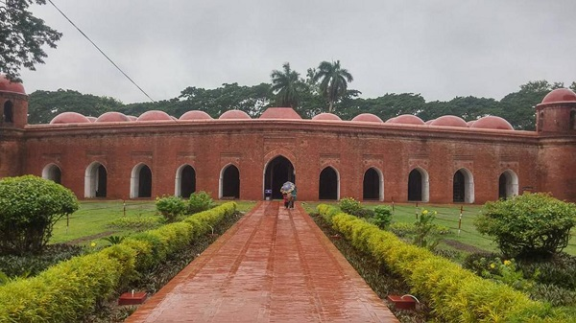
The Shat Gambuj Mosque in Bagerhat is such a heritage. It became a UNESCO world Heritage Site in 1985. Originally, the historic Mosque City was known as ‘Khalifatabad’. It is situated at the outskirts of Bagerhat town … not very far from the dense mangrove
forest of the sundarbans. Khalifatabad was a Muslim colony. It was founded by the Turkish general, a saint warrior Ulugh Khan Jahan in the 15th century.

Slide 15
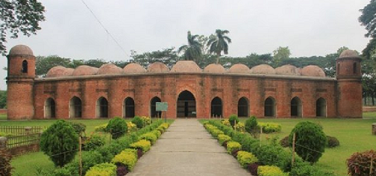
4 towers 4
Smaller
domes
Let’s have a look outside & inside the mosque.
77 low
domes
11 arched
doorways

Slide 16

7 Arched doorways each on north
and south for light and ventilation

Slide 17
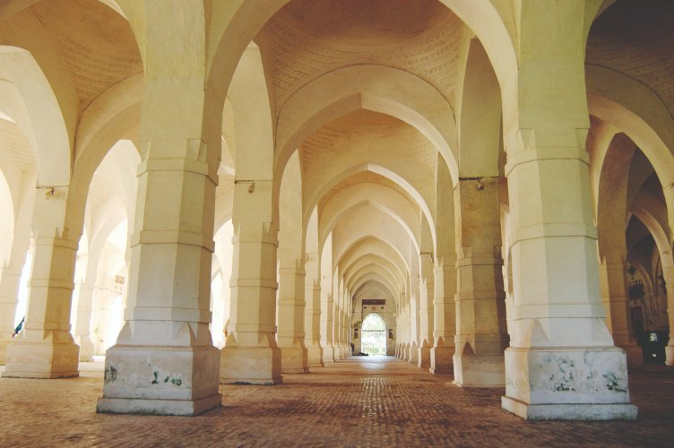
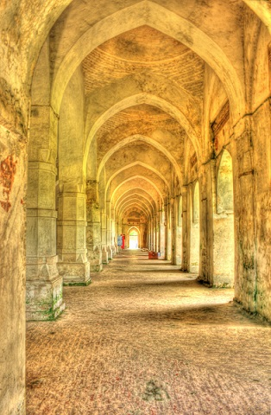
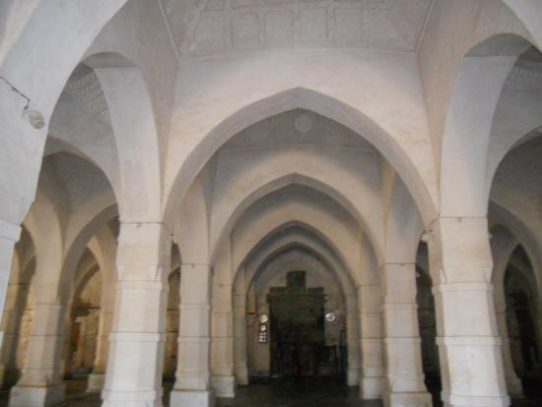
Inside the mosque
The west wall in the interior has 11 mirhabs which are pointed towards Makkah.

Slide 18
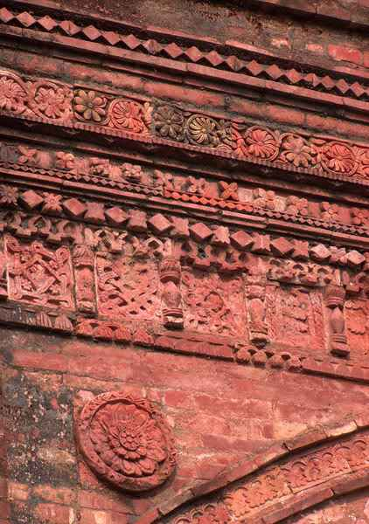
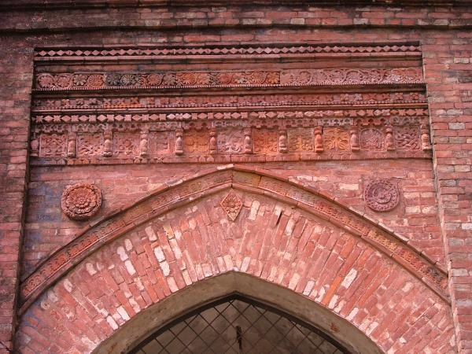
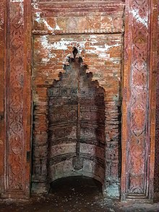
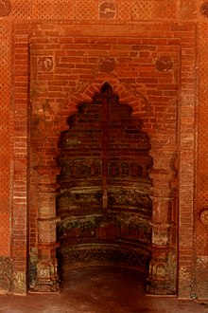
The mirhabs are decorated with stonework and
terracotta. The floor of the mosque is made of brick.

Slide 19

08
Min
Write answer to the following questions.
1. Who was Khan Jahan Ali?
2. Where does the Shat Gambuj Mosque stand?
3. When was a Muslim colony founded?
4. How was the interior western wall decorated?

Slide 20
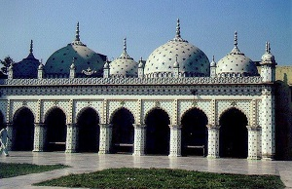
Let’s get information about the Star Mosque.
Star Mosque
Style:
Mughal
Domes:
5
Location: Abul Khairat Road, Dhaka.
Built by Mirza Ghulam Pir – a respectable Zamindar of Dhaka.
Built time: Early 18th century.

Slide 21
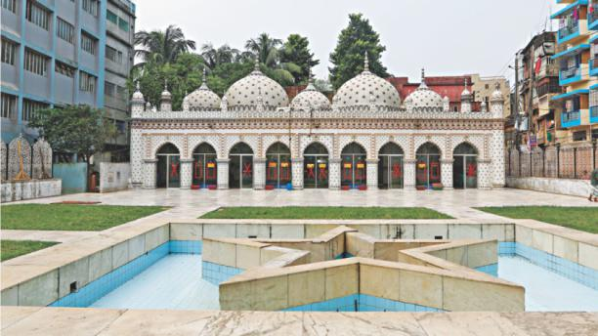
Decoration: different sizes of stars on dome and outside wall.
Materials used for decoration: chinaware and white cement.
Interior of the mosque: mosaic floor, floral tiles on the wall.

Slide 22

12
Min
Write a paragraph on about “Star Mosque” using information given above.

Slide 23

Do you have any building like Shat Gambuj Mosque or Star Mosque
in your area?
Write a short composition on about that building.

Slide 24
