Slide 1


Slide 2
Introduction
Md. Shamsuddawha
Asst. Teacher(English)
Gangore High School
Niamatpur, Naogaon.
shamshzoha@gmail.com
Subject: English 1st Paper
Class: Nine-Ten
Unite: Six
Duration: 50 Min.
Date: 13/07/2019

Slide 3
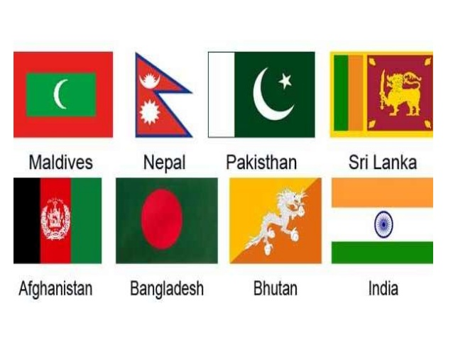
Look at the picture
They are our neighboring countries.

Slide 4
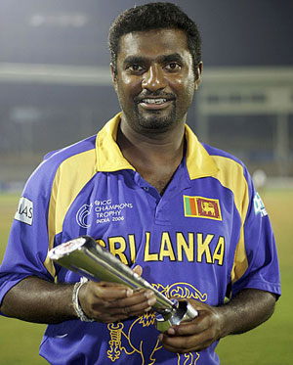
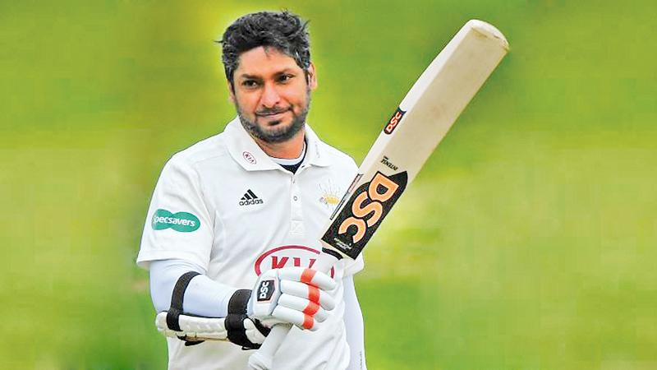
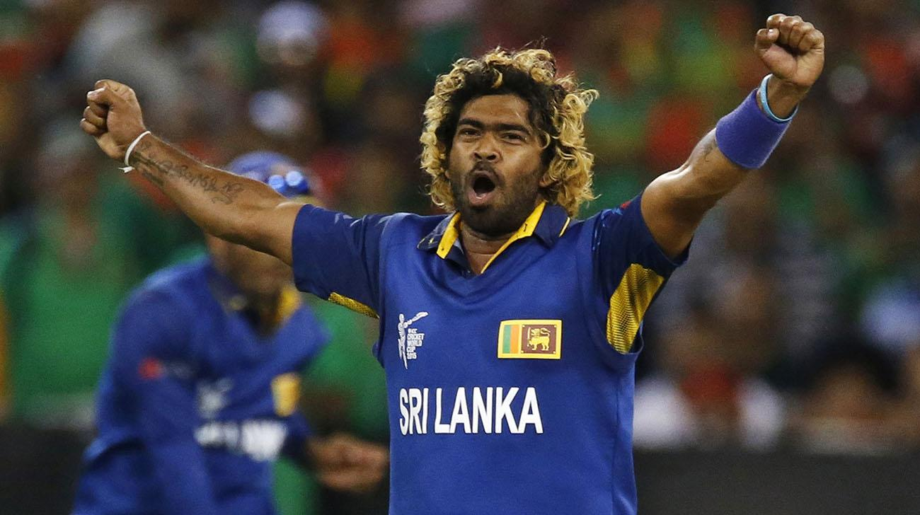
Can you tell their name?
Muttiah Muralitharan
Kumar Sangakkara
Lasith Malinga
They are all Sri Lankan famous cricketers.

Slide 5

So, today’s lesson is about …….
Our Neighbors

Slide 6
Learning outcomes
After completing this lesson, students will be able to …..
read and understand the text
ask and answer questions
write a paragraph on about an interesting place.

Slide 7
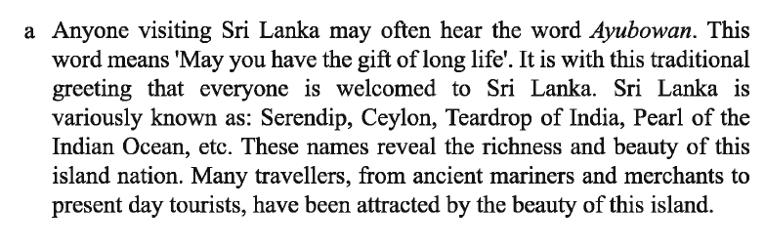
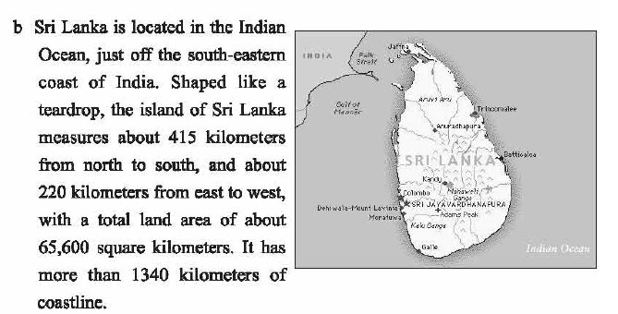
Open the page at 76 and read the text silently.

Slide 8

Individual Work
04
minute
Key Words
Ayubowan
It means, “May you have the gift of long life.”

Slide 9
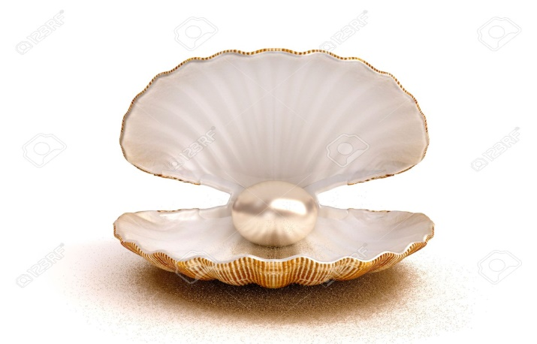
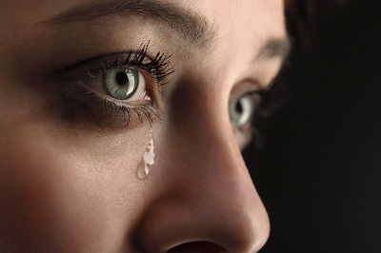
Pearl is a hard object that
grows in a shell.
Pearl
Queen Elizabeth likes to wear crown made of pearl.
A drop of water that comes
from eye in sorrow.
Teardrop
The nickname of Sri Lanka is teardrop of India.

Slide 10
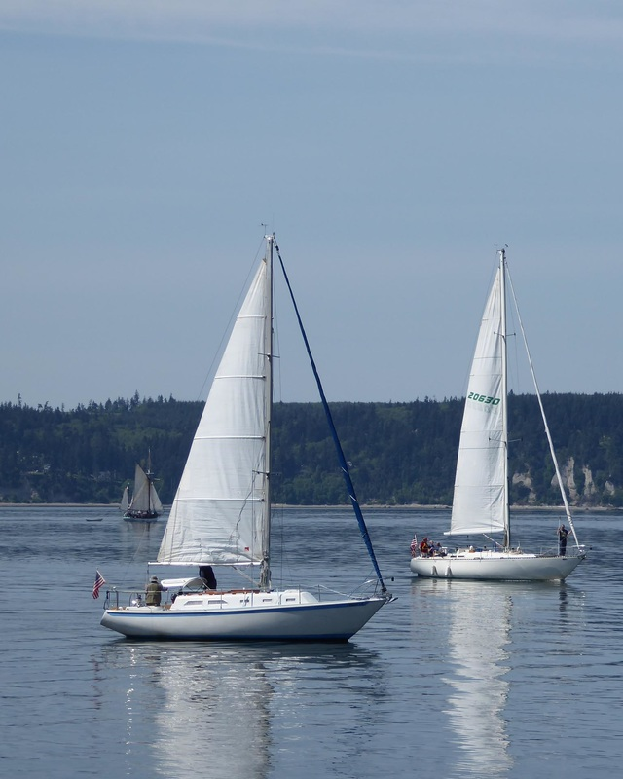
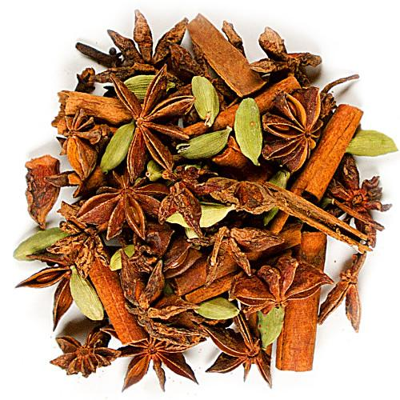
the action of sailing in a ship
or boat
Sailing
Sailing, fishing and bird watching are just some of the ways to
spend a relaxing day.
a substance made from a plant,
used to give a special flavor
to food.
Spice
Spices make our carry delicious.

Slide 11
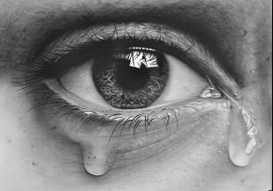
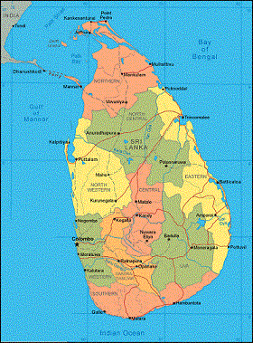
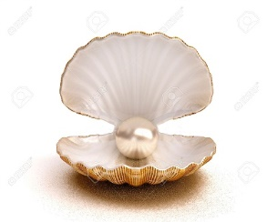
The nick names of Sri Lanka.
Pearl of the Indian
Ocean
Teardrop of India
Serendip

Slide 12
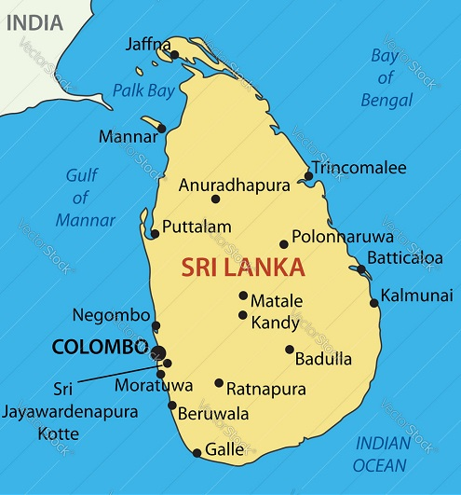
Land area of Sri Lanka
Sri Lanka measures
about 415 kilometres
from north to south.
22o kilometres from
east to west and total
land area of about
65,600 square kilometres.

Slide 13
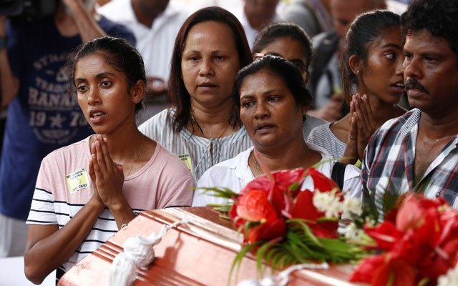
Population of Sri Lanka
There are about 20 millions people in Sri Lanka. Sri Lanka
is a multi – religious, multi – racial and multi – lingual country.

Slide 14
Religion based population

Slide 15

Pair Work
06
minute
Answer the following questions?
Which country is called the teardrop of The Indian Ocean?
How many religious group live in Sri Lanka?
In which Hindu epic mentioned about Sri Lanka?

Slide 16
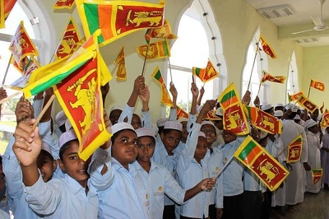
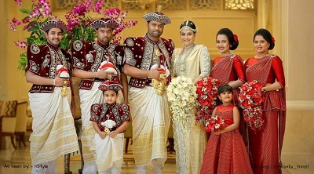
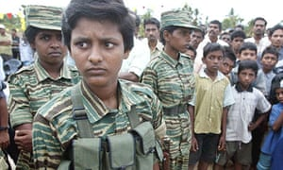
Ethnic groups in Sri Lanka
There are four major ethnic groups in
Sri Lanka. They are the Sinhalese,
Sri Lankan Tamils, Indian Tamils and
Sri Lankan Moors or Muslims.

Slide 17
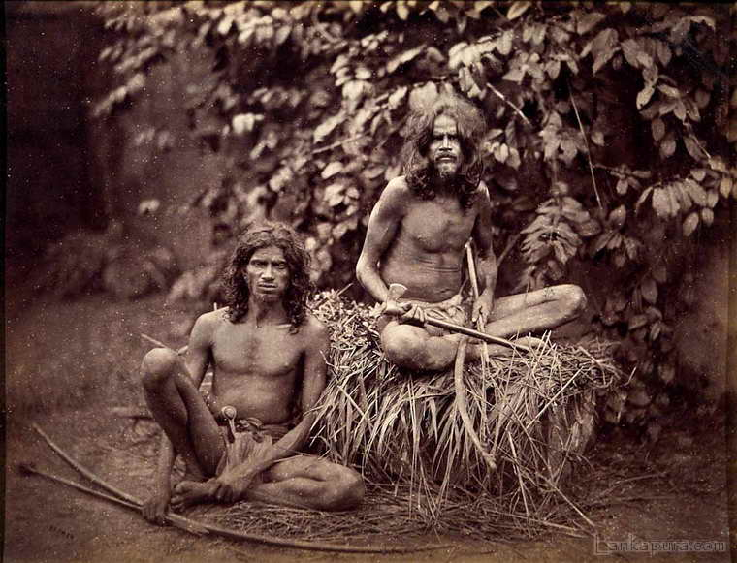
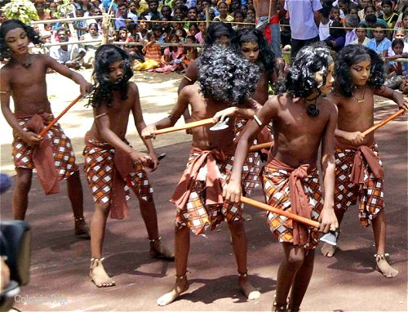
They is a fifth ethnic group named Veddhas, original
inhabitants of Sri Lanka.

Slide 18
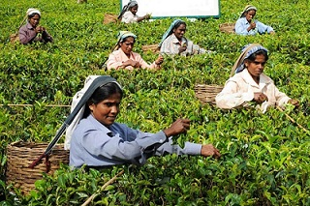
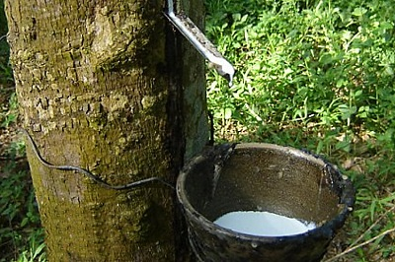
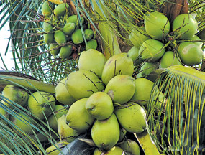
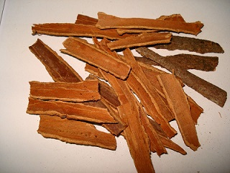
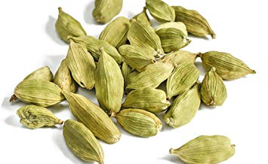
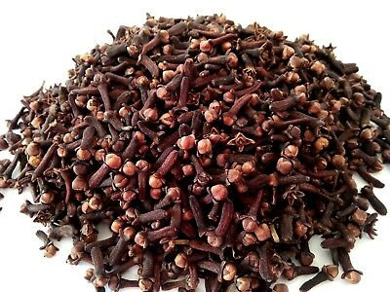
Economy of Sri Lanka
Sri Lankan economy has traditionally been based on agriculture. The emphasis is on exporting crops such as tea, rubber, coconuts. Sri Lanka is the largest tea exporter of the World. The country is also a major producer and supplier of a variety of spices such as cinnamon, cardamom, pepper, cloves and nutmeg.

Slide 19


10
minute
Group Work
Write a paragraph on about Sri Lankan Population and Economy.

Slide 20

Home Work
Suppose your pen friend is from Sri Lanka. He wants to
know about your country.
Now, write a letter to your pen friend describing Bangladeshi
population and economy.

Slide 21



