Slide 1

welcome

Slide 2
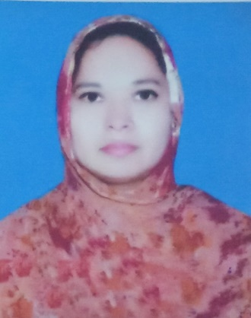
introduction
Musa. Rahima Akther
Asst. Teacher
Khulna Engineering University School
Class: Nine
Sub: English 1st Paper
Time: 50 minutes

Slide 3

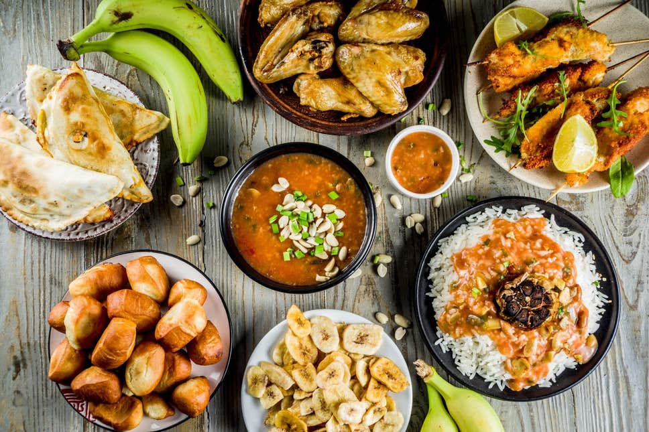
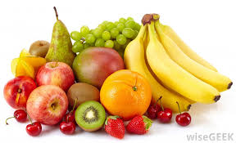
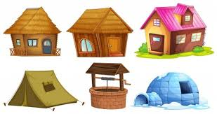
What do we see in the pictures?
Foods
shelter

Slide 4
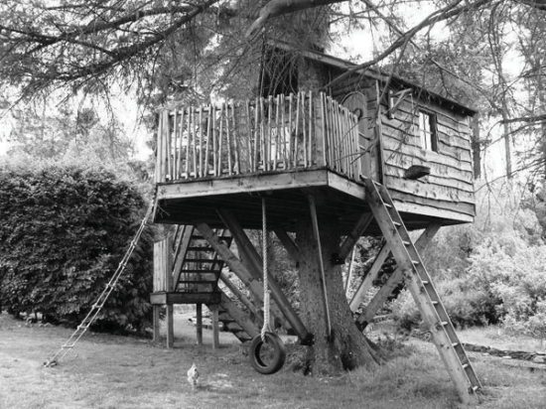
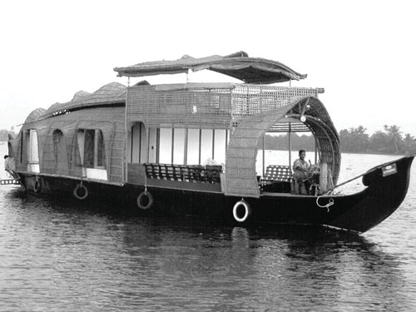
Look at the pictures and answer these questions.
What do the people do in a tree or a boat?
Why do they do so?
1. May people live in trees and boats using them as house.
2. They have done so due to acute scarcity of land for habitation.

Slide 5
Today’s lesson is--
“Our food and shelter”
Unit-4 Lesson-3

Slide 6
Learning outcomes-
At the end of the lesson students will be able to
Look at the pictures and ask and answer questions;
discuss about population problems;
Read and tick the best answer;
Make a list of things;

Slide 7
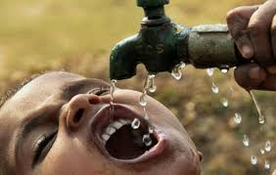
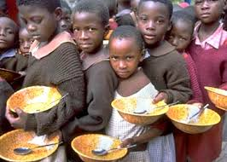
New words
scarcity
shortage
want
The scarcity of water
The scarcity of food

Slide 8
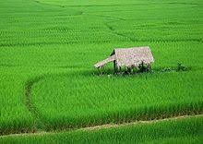
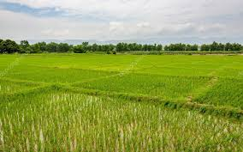
New words
arable
Cultivable land
Suitable for growing crops
Arable land

Slide 9
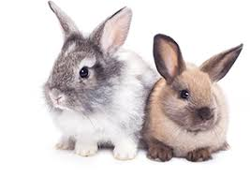
Pair work
Discuss in pairs-
1. What will be our problems if our population becomes double the size it is now?
Scarcity of food, scarcity of shelter, scarcity of employment, serious climate change etc. ,

Slide 10
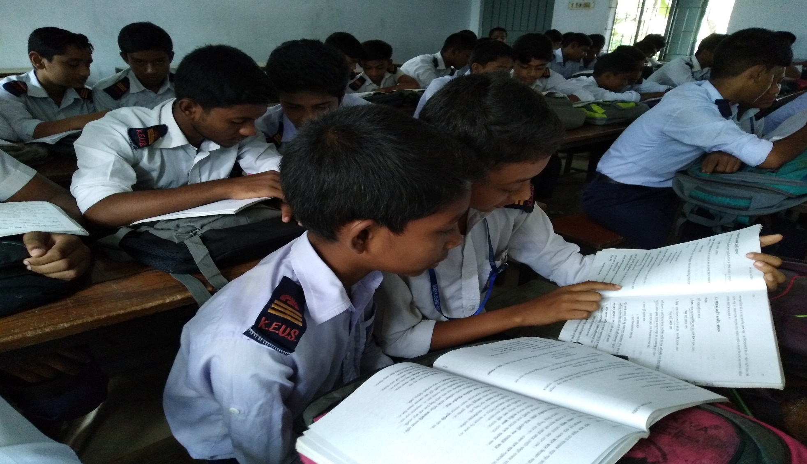
Read the text silently and answer the questions

Slide 11

Tick the best answer.
1 The rate of increase in food production cannot keep pace with the rate of population growth.
The sentence means that the food production
a is as much as needed.
b is less than what is needed.
c is more than what is needed.
d is sufficient for the population.
2 how can our housing problem add to our food problem?
a After making houses, farmers do not have enough time to work in the field.
b After making houses, farmers do not have enough money to buy food.
c If you do not have a house, you cannot store your food.
d For making too many houses, people are using the crop land.
3 What makes our land shrink day by day mentioned in line no. 13?
a Families are growing larger in size.
b Houses and factories are being built on it.
c Smaller families need smaller houses.
d Land grabbers are occupying portions of our land.
4 Many people may have to live on trees, because
a they would like tree houses.
b making houses on trees is less expensive.
c they may not find land to make houses.
d tree houses are safer during floods.

Slide 12
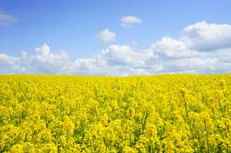
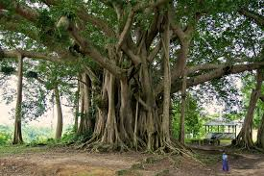
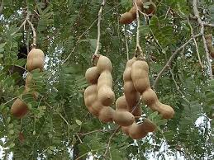
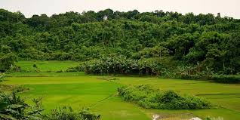
1. Make a list of things Ms Choudhury saw as a child in the village.
Green paddy fields
Yellow mustard fields
A tall tamarind tree
Banyan tree
wood

Slide 13
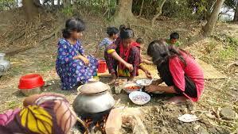
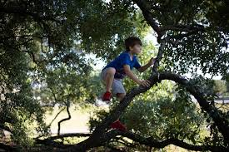
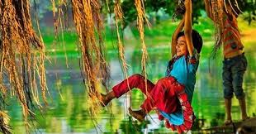
Why do you think she liked them?
From the text we know that she liked them as she tells her students in the class that her childhood days were delightful and in the description of her childhood she expresses her fondness to those things.

Slide 14
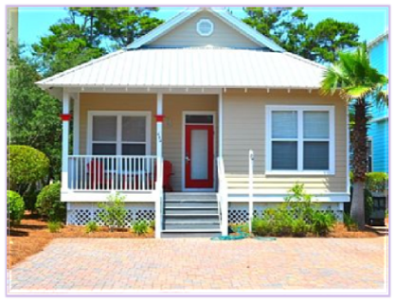
Home work
Write a composition about your village or locality. describe the change in the things you have noticed over the years, such as houses, fields, trees etc.

Slide 15
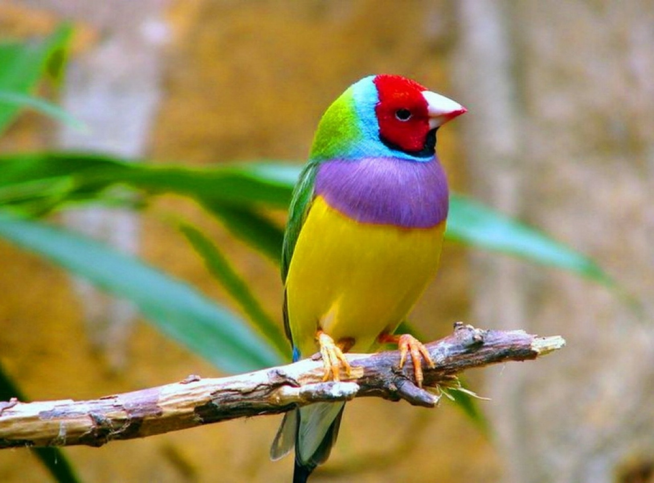
Thank you

