Slide 1
Welcome to my MMC

Slide 2

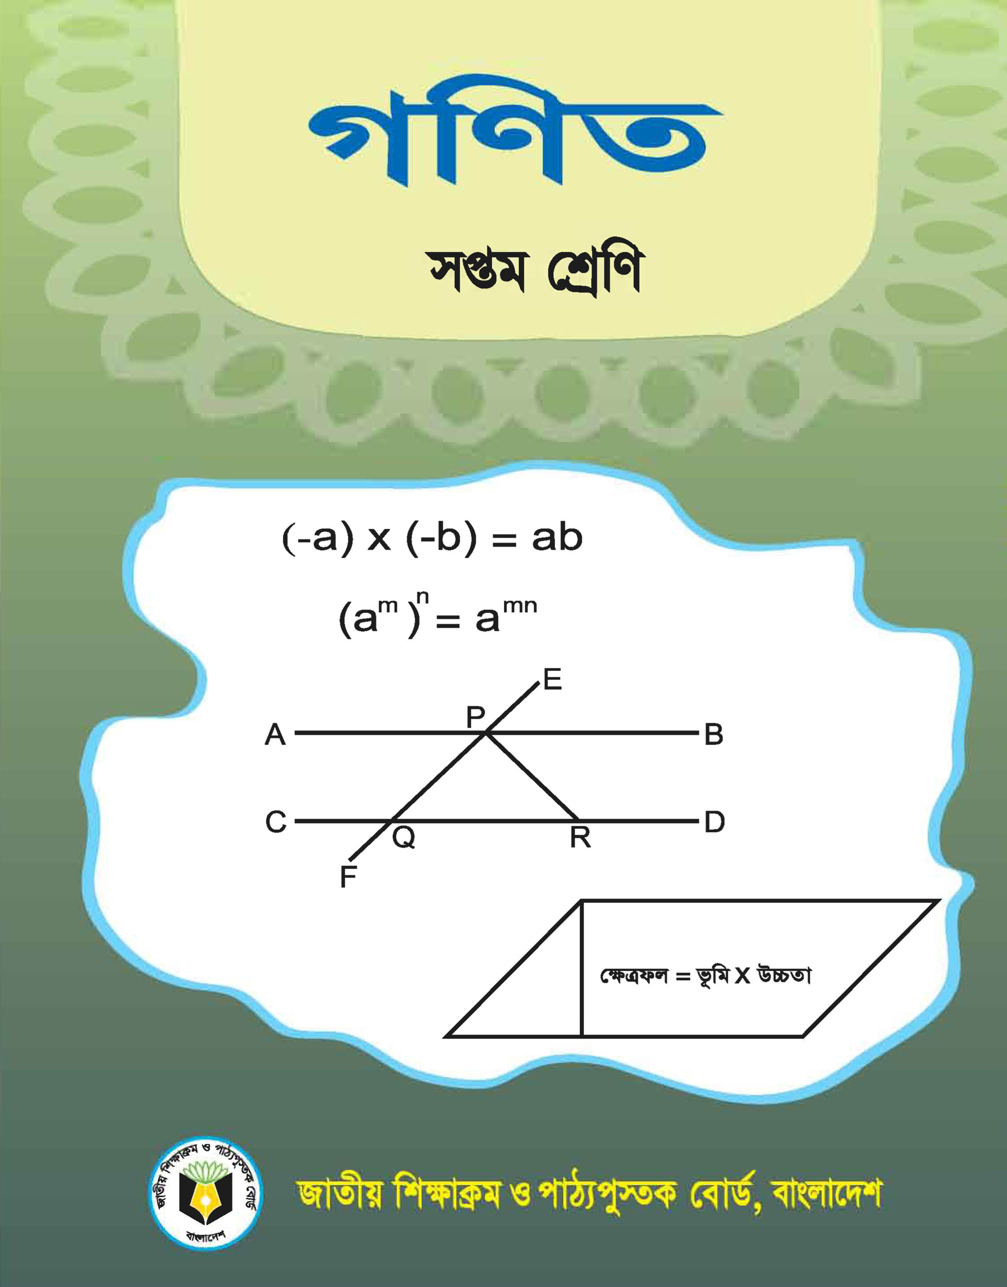
Identity
Teacher’s Identity
Lesson Introduction
Class : Seven
Section : A
Sub : English
Section : A
Date : 00/00/0000
Jahangir Alam
Assistant Headmaster
Dighulia Shahid Mizanur Rahman High School, Tangail.
E-mail: Jahangir.icttang@gmail.com
Cell : 01710500769.

Slide 3


Walking is good for health.
Reading the Quran is a good habit.
Here reading is formed from the word read by adding ing and used as the subject of a verb and wroks of a noun.
Do you know, here reading (read + ing) what kinds of verb or parts of speech ?
It’s called a Gerund.

Slide 4
Lesson Declaration
Our todays Lesson is ...
Gerund

Slide 5
Lesson Outcomes
By the end of the lesson students will have
learnt what Gerund is.
learnt the difference between Participle and Gerund.
learnt the uses of Gerund & Infinitive instead.
used appropriate gerundial form of verbs.

Slide 6

Definition of Gerund
A Gerund is that form of the verb which ends in –ing, and has the force of a Noun and a Verb.
The Gerund has the force of a Noun and a Verb: it is a Verbal Noun.
Functions of Gerund :
a) As the subject of a verb :
(i) Reading is our favorite pastime.
(ii) Learning is a continuous process.

Slide 7

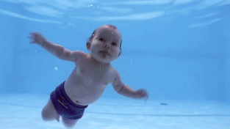
Functions of Gerund :
b) As the object of a verb :
Stop writing.
He learns drawing.
c) As the object of preposition:
He is fond of swimming
I am thinking of going there.

Slide 8
Individual Work
Open your English Grammar book page no. 26
Read the passage carefully :
Ask and answer with your partner :
How many verbs with+ ing are there in the passage ? Find out them.
Do all the verbs having ‘ing’ work as gerunds or participles ? If not identify and show them separately.
Are there infinitives in the passage ? Find out them.

Slide 9

Pair Work
Replace infinitives of the following sentences by gerund.
i,. To tell a lie is a great sin.
I like to eat vegetables.
His hobby is to travel.
To walk is good for health.
He started to learn English.
It is bad to find fault with others.
To plant a sapling is everybody’s responsibility.

Slide 10
Group Work
Complete the following sentences by using appropriate gerundial form of verbs :
You cannot learn English without (a) ...... the four language skills. (b) ...... is the first skill you should practice. The second one is (c) ...... The third one is (d) ...... while the fourth skill is (e) ...... Unless you practice the skills, you cannot succeed in (f) ...... any foreign language.
Answer : (a) practising, (b) listening, (c) speaking, (d) reading, (e) writing, (f) learning,

Slide 11
HOME WORK
Write the functions of Gerund.

Slide 12
Thank you.

