Slide 1
Welcome to all
Email:dhalder785@gmail.com

Slide 2
Identification
Dulal Halder
Assistant Teacher
Kumna Govt.primary School
Chhatak,Sunamgonj
Email:dhalder785@gmail.com
Class:Four
Subject:English ForToday
Unit:39
Lesson::1
Heading:Occupation
Email:dhalder785@gmail.com

Slide 3
How are you?Do you like song?Lets sing a song.
Email:dhalder785@gmail.com

Slide 4
Learning outcome:
Students will be able to---
1.4.1-read word phrases and sentence in the text.
6.2.1-talk about people, objects,events etc
3.1.1-to write,words,phrases and sentence using non-cursive capital and small letters.
Email:dhalder785@gmail.com

Slide 5
What can you see in the picture?
Email:dhalder785@gmail.com

Slide 6
What can you see in the picture?
Email:dhalder785@gmail.com

Slide 7
How many people are there in your family? What do they do?
Job or profession is the same meaning of occupation.
Occupation especially as a means of earning a living.
Email:dhalder785@gmail.com

Slide 8
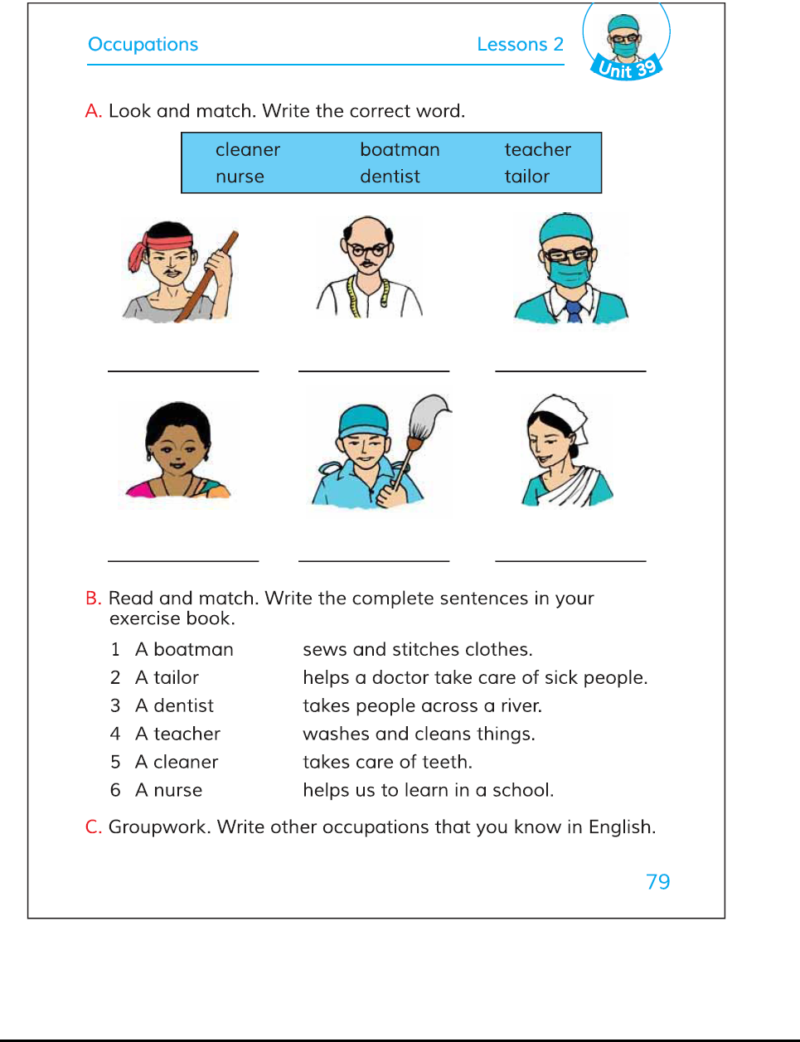
Take your book and open at page-79
Email:dhalder785@gmail.com

Slide 9
Do you know what are they?
boatman
tailor
dentist
teacher
cleaner
nurse
Email:dhalder785@gmail.com

Slide 10
What do they do?
Email:dhalder785@gmail.com

Slide 11
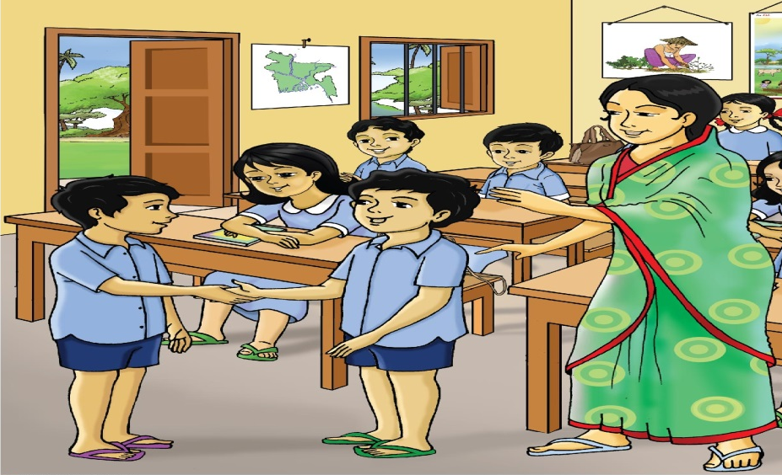
Pair work
1st St: What is he doing?
2ndSt:He takes care of teeth.
Email:dhalder785@gmail.com

Slide 12
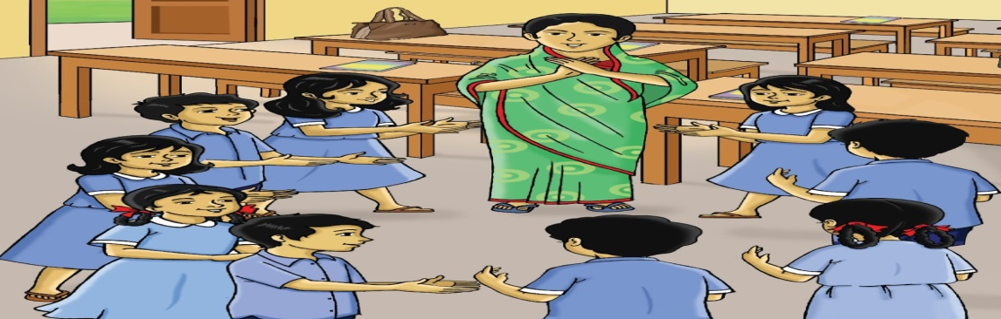
Group work
What do they do? boatman,tailor,dentist,
teacher,cleaner,nurse.
Email:dhalder785@gmail.com

Slide 13
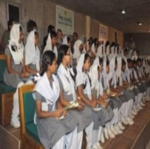
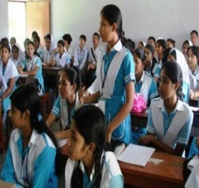
EVALUATION
?
Write the correct word to see the pictures.
Email:dhalder785@gmail.com

Slide 14
Write other occupations that you know in English.
1) ____2 ____3 ____4 ____
Home work
Email:dhalder785@gmail.com

Slide 15
Email:dhalder785@gmail.com

