Slide 1
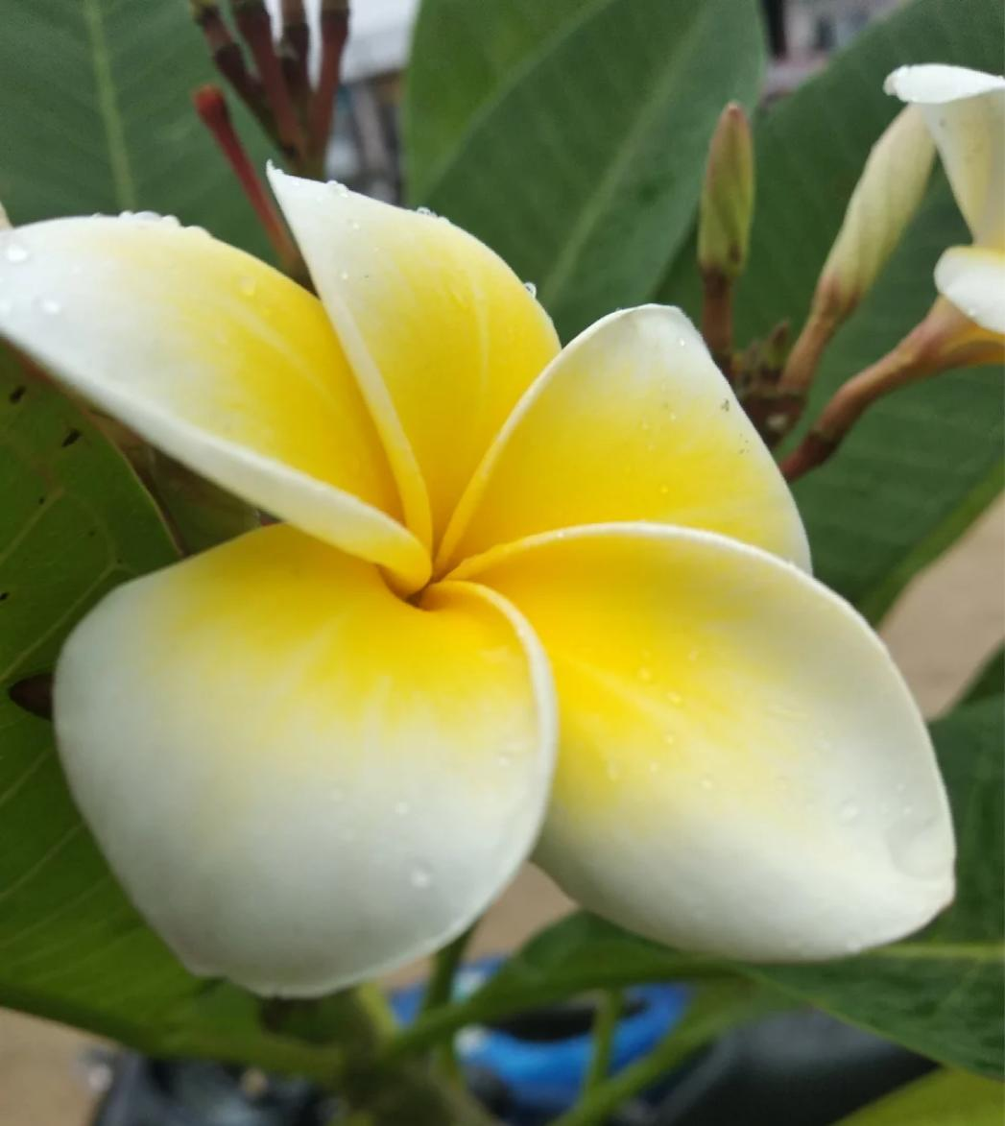
Welcome everybody

Slide 2
Teacher’s Information
Md. Rabiul Mowla
Assistant teacher
Mogdhara Adorshopara govt. primary school

Slide 3
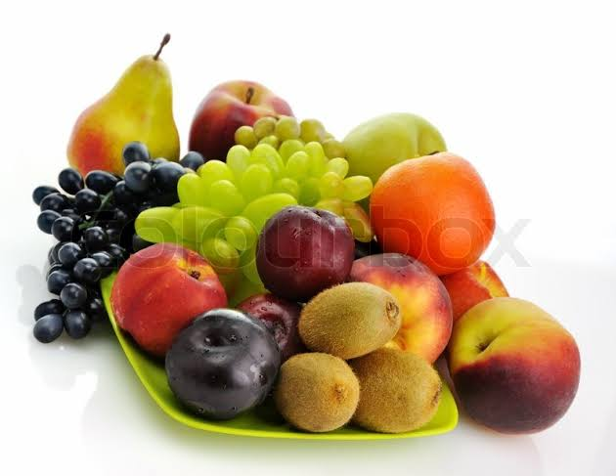
What is this?
Food

Slide 4
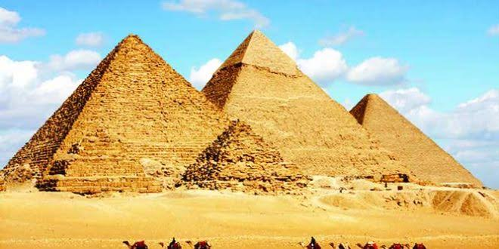
Can you guess it?
Pyramid

Slide 5
Food
Pyramid

Slide 6
Today’s Lesson
Class-Five
Eat healthy (The FooD Pyramid)
Unit-6
Lesson 2-7

Slide 8
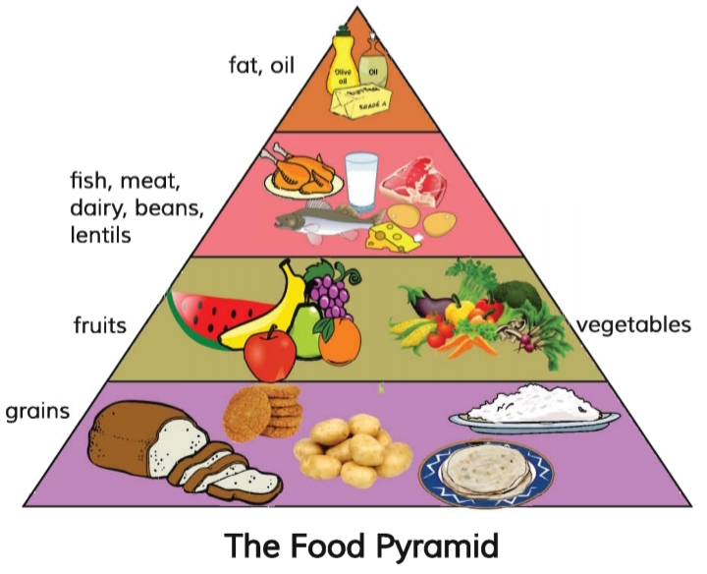

Slide 9
Vocabulary
Word | Meaning
Vitamin | ভিটামিন
Energy | শক্তি
Sugar | চিনি
Lentil | ডাল
Beans | শিম
Eye | চোখ
Teeth | দাঁতগুলো
Bone | হাড়

Slide 10
What food is good food?
Sometime the food we like to eat isn’t the healthiest for us. The food pyramid helps us to understand the different food groups and it tells us how much of each food group we should eat.

Slide 11
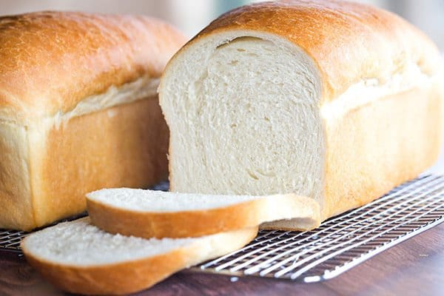
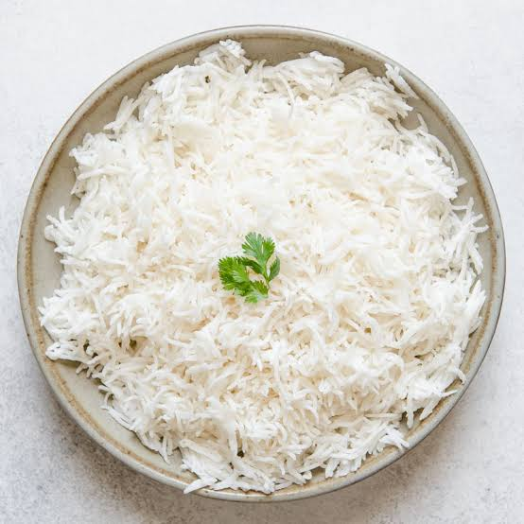
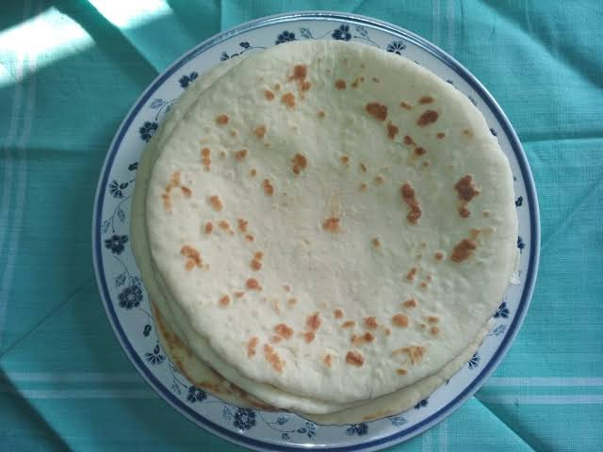
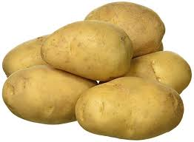
What foods do you see at the bottom of the food pyramid? These are the things made from grains.For example, rice, ruti and bread. Potatoes are not grains,but they are similar.Grains give us energy.
Rice
Bread
Potato
Ruti

Slide 12
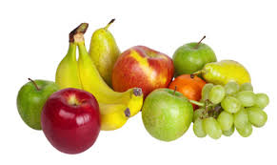
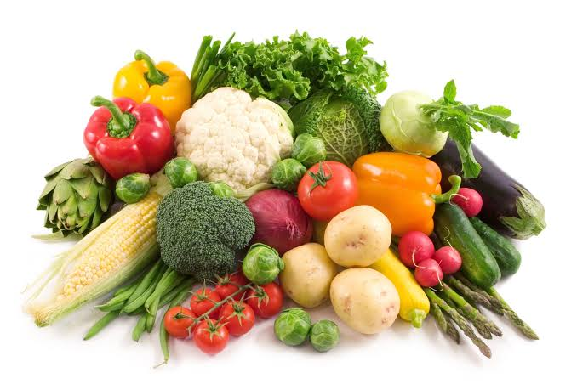
Fruits and vegetables are in the next level of the pyramid. These are also very important for us.They have vitamins. They help our eyes and health.
Vegetables
Fruits

Slide 13
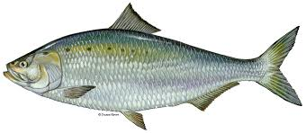
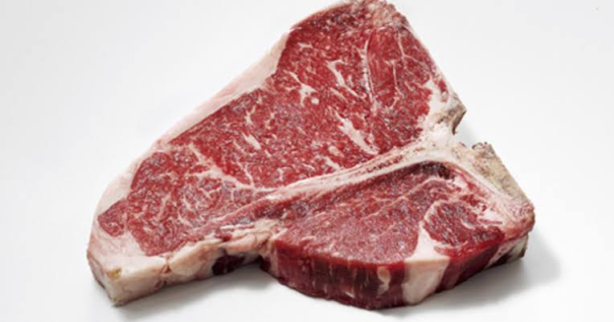
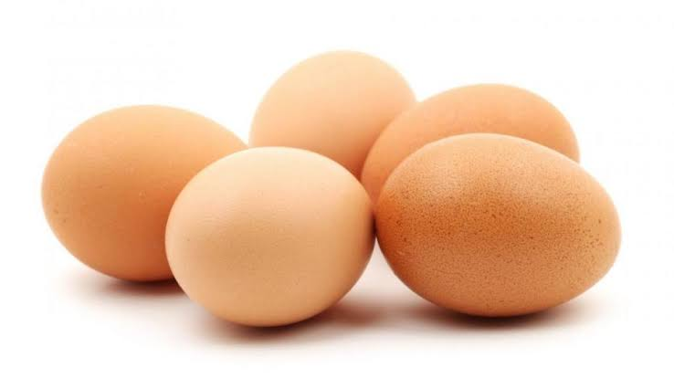
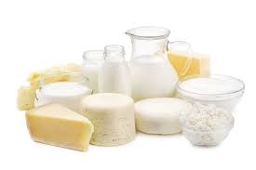
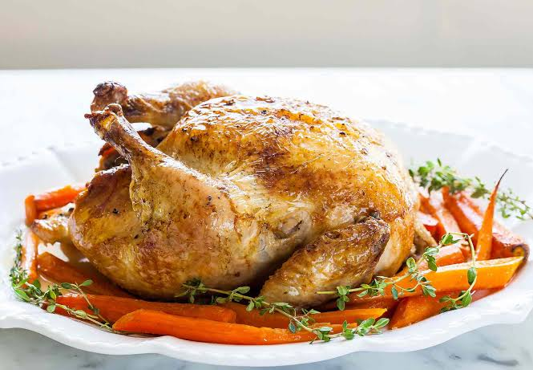
On the next level, there are fish,meat,dairy products,egg,beans and lentils.Meat,fish and chicken have protein. Beans and lentils do too!
Fish
Meat
Egg
Dairy
Chicken

Slide 14
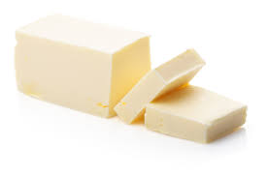
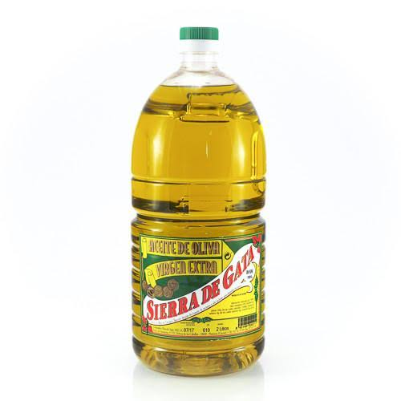
Fat and oil are at the top of the Food Pyramid. These make food delicious, but our body does not need very much them.
Oil
Fat

Slide 15
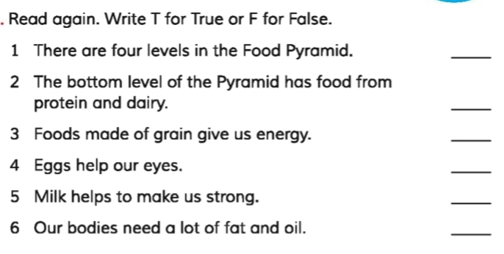
Evaluation
T
F
T
F
T
F

Slide 16
Pair work
1. Which foods are made from grains?
2. Which food gives us energy?
3. Which foods have vitamins?
4. Which foods help our eyes and health?

Slide 17
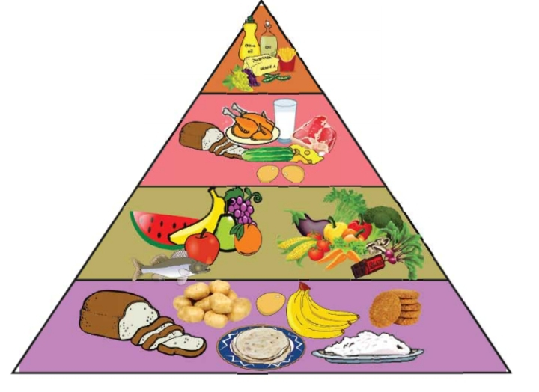
Group work
Find the mistakes in the food pyramid

Slide 18
Homework
Look at the shape of the Food Pyramid.
How much of each food group we should eat.

Slide 19
Thank you

