Slide 1
Well come Students

Slide 2
Presented by
Nasima begum
Assistant Teacher.
Dhaisar Govt.Primary School.
Rajnagar,Moulvibazar.

Slide 3
Lesson Introducing
Class: Four Unite: 11
Sagar and His Family.
Time:40 minute

Slide 4
Learning outcomes
Listening3.2.1 :Student will be able to understand questions about family and friend.
Speaking:1.1.1 repeat after the teacher and say words , pharse and sentence with proper sounds stress and intonation
Reading : 1.4.1 student will be able to read word ,and phrese and sentence in the text with with proper pronunciation stress and intonation
Writing 10.2 : To write a short composition about oneself,family and other similar topics
.

Slide 5
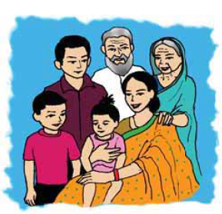
Lets see a picture
INPUT

Slide 6
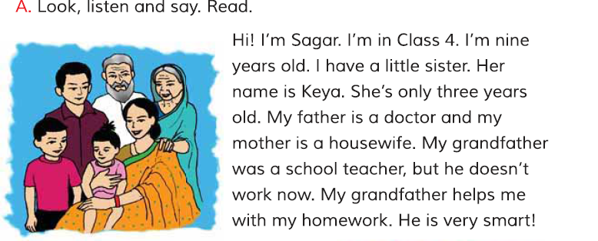
Title declaration:
Sagors Family

Slide 7
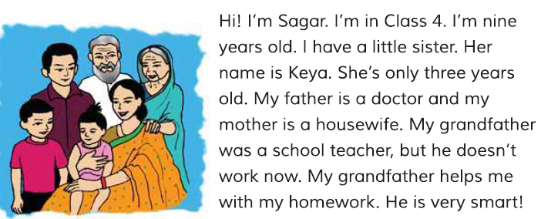
Teacher activities

Slide 8
Students activities
PRACTICE

Slide 9
Group work
Group:1.Find out the words
Student
Sister
Grandfather
Housewife

Slide 10
Group:2. Make Sentence.
I am a students.
He is my grandfather.
His mother is housewife.

Slide 11
Task
1.Who is sagor ?
1.Who is sagor ?
Ans : Sagor is a student.
2. How old is he ?
Ans:He is nine years old.

Slide 12
Home work
Write five sentence about Sagor.

Slide 13
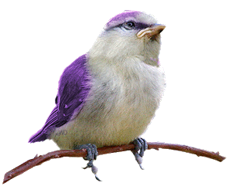
Thank you

