Slide 1
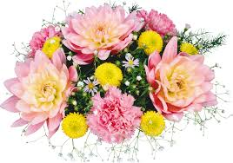
Welcome

Slide 2
Identity
MD.SADEKUL ISLAM
BBA, MBA, MSLMIS
Assistant Teacher Librarian
Laupara Sagar Saikot Secondary School
Laupara, Taltali,Barguna
Sadekul.islam565@gmail.com
Class : Ten
Subject : English For Today
Unit : Five
Lesson : Three

Slide 3
Let us enjoy a video

Slide 4
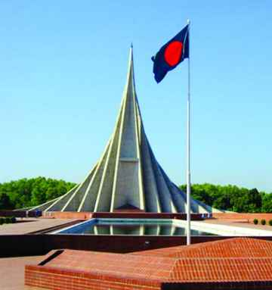
What can you see in the picture?

Slide 5
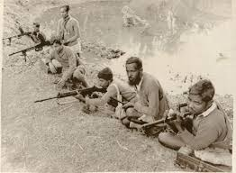
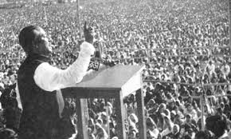
Look at the pictures
The speech of Shiekh Muzibur Rahman
Freedom Fighters

Slide 6
Learning Outcomes
After studied this lesson, we will be able to---
1. Talk about Independence day.
2.Understand new words.
3. Writing a Paragraph.

Slide 7
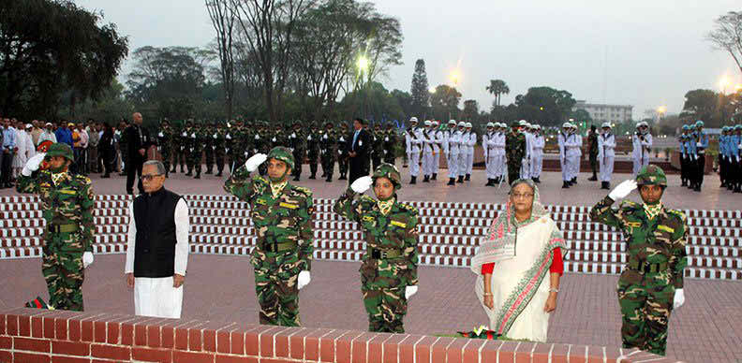
Early in the morning the president and the prime minister on behalf of the nation place floral wreath at the at the national mausoleum at Savar.

Slide 8
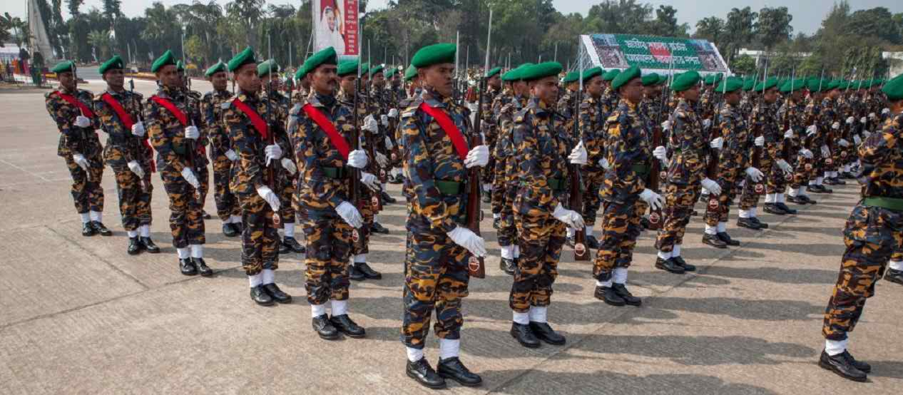
People witness dressed parade of defense forces.

Slide 9
Individual Work
1. What the country witness at the National parade ground this day ?
2. How is 26 march celebrated every year in the country?
3. What is remembered on this day?
4. Who take part in the national parade ground?

Slide 10
Key Words
Word | Meaning
Festival | A day or period of celebration.
Struggle | Fight
Freeom Fighter | A person who fought for the independence of the country.
Fervour | A strong feeling of excitement.
Alike | In a similar way.
Spectator | a person who is watching an event.
Display | Acts of performing skills.
Illuminate | To decorate a building with bright lights.

Slide 11
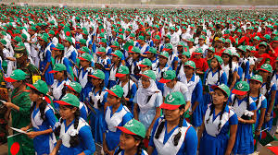
In Bangabondhu Stadium, Bangladesh scouts, girls guide and students take part in various display.

Slide 12
Group Work
How should we observe the Independence Day?

Slide 13
Evaluation
1 . Our biggest festival is …
Pahela Baishakh . b)Victory day.
c )Independence day . d) 21st February
2 .The celebration of Independence day begins with ……..
a) Procession b)gunshots.
c) Placing wreaths at national memorial. d) The display of parade by defense foresees.
3. The Independence day is celebrated with-----
Due solemnity and fervor b) zeal and fatality
d) Emoiton and pride d) fame and fratility
4.The National Masuleum of Bangladesh is---------
Shahbag b) Gazipur
c) Mymensingh d) Savar

Slide 14
Home Work
Write a paragraph about Independence Day

Slide 15
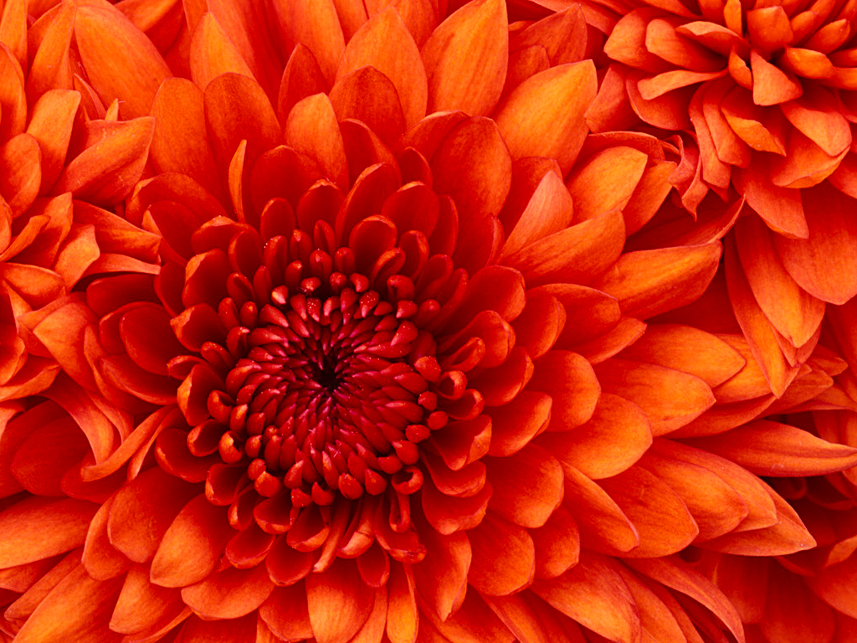
Allah Hafez

