Slide 1
WELCOME

Slide 2
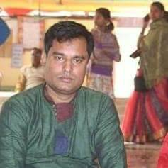
Presented by
Uttam Chandra Samadder
Head Teacher
Kachipara government primary school
Bauphal,Patuakhali.

Slide 3
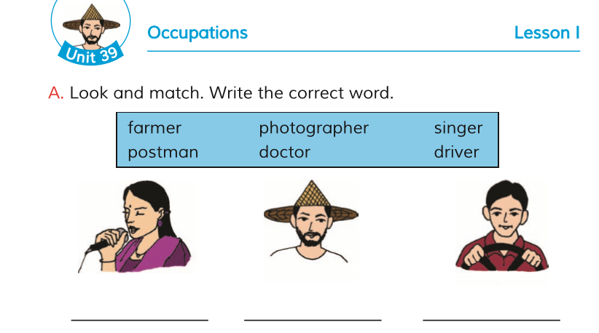
Class-Four
Subject-English
Unit-39,lesson 2
Occupations

Slide 4
Learning outcome:
Student will be able to
1.read Instruction and carry them out
2. Make sentences with new words.

Slide 5
Let us sing an Eia action song

Slide 6
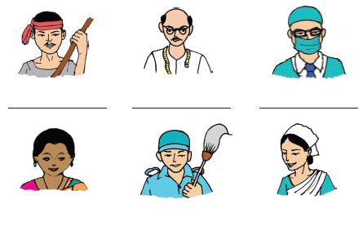
Close your eyes.do you want to see picture?

Slide 7
Open your eye
And see pictures

Slide 9
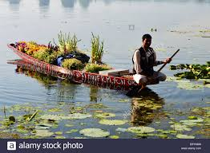

Slide 10
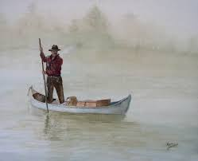
Boatman

Slide 11
Boatman
Takes people across a river

Slide 12
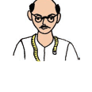

Slide 13
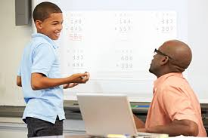

Slide 14
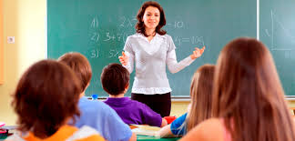
Teacher

Slide 15
Teacher
Helps us to learn in a school

Slide 18
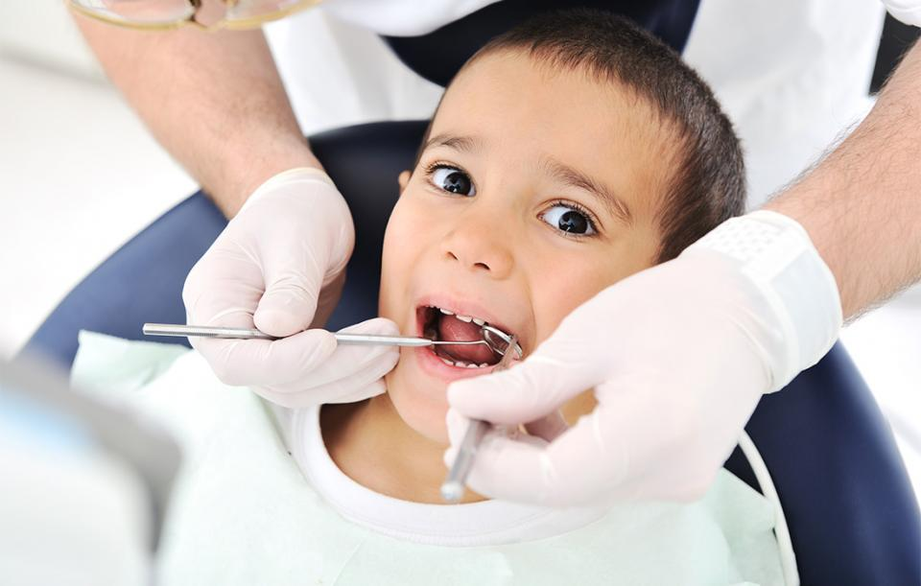
Dentist

Slide 19
Dentist
Takes care of teeth

Slide 21
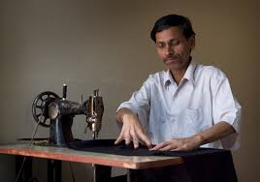

Slide 22
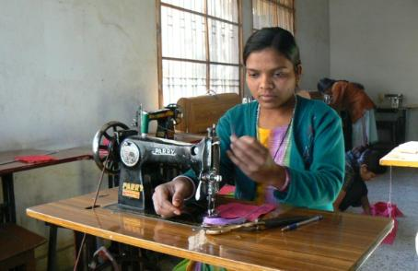
Tailor

Slide 23
Tailor
Sews and stitches cloths.

Slide 25
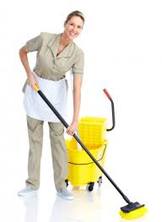

Slide 26
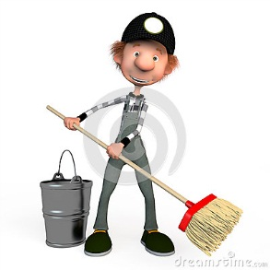
Cleaner

Slide 27
Cleaner
Washes and cleans things

Slide 30
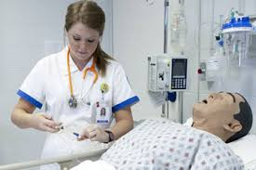
Nurse

Slide 31
Nurse
Helps a doctor take care
Of sick people

Slide 32
Act with the ss as farmer,doctor,postman,photographer,
Driver and singer

Slide 33
Playing a missing word game
In group

Slide 34
Playing a missing word game
In group

Slide 35
Make different sentences with given 6 words
Like…….
Karim is a boatman.
Rahim is a teacher.
Toli is a dentist.
Joya is a tailor.
Halal is a cleaner.
Arpita is a nurse.

Slide 36
Fill in the gap
In pair
He is a ……..
Suma is a ……

Slide 37
Match word and picture
single

Slide 38
Write other occupations
That you know in english
In group

