Slide 1
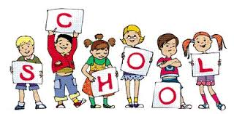
A Handout of Articles
For weak learners
Notes:
Teacher's Professionalism Development in Bangladesh:
The time it is to think over the development of teacher's professionalism in Bangladesh context,when the continuous increased budget in education sector is getting the first priority, the economic status of both govtment and nongovtment schools and colleges is on the track running, it is obviously natural that we should lay emphasis on the issue.

Slide 2
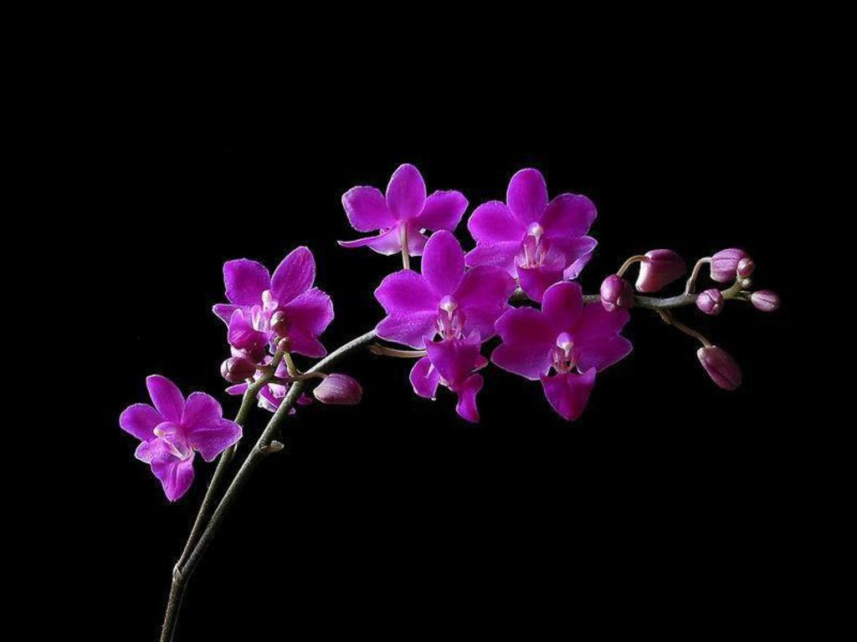
welcome

Slide 3
Teacher’s Identity
MILAN SHIKDER
Assistant Head teacher
HAZI ABDUL MALEK GIRLS’ HIGH SCHOOL

Slide 4
The Articles
The Maghs build their houses on high platforms, about six to eight feet above the ground, so that their houses do not become damp. The reason to build houses on high platforms is also to protect them from the different types of insects and animals. Moreover they can use the empty space below their houses to keep things such as agricultural tools and-looms. Timber or bamboo posts support the platforms. The walls are made of bamboo, slates and the roof is thatched. These THE are one kind of article

Slide 5
Once upon a time there lived a girl named Jesmin. She had a brother named Murad. He is a student of a famous school. His school’s name is Kamolgang Primary School. His headmaster is a very active person. Eevery day he went a fishing in a pond. One day he caught a large fish with his rod. When he was going school saw a one eyed beggar with a bag in his hand. He gave a one taka note and an apple to the beggar . The beggar had a knife . Jesmin does not like begging. She wants to be an MBBS doctor.
Here All A/AN are another articles.

Slide 6
Kinds of articles
There are two kinds of articles.
1. Definite article (the)
2. Indefinite articles (a, an) .
Both kinds of articles are used before nouns.

Slide 7
The main uses of the definite article are given
Definite Article “THE” is used before

Slide 8
Before Three things
Part of things
1. I will eat the yellow part of the eggs.
2. I ate the small portion of the cake.
Only one thing
Bangladesh is near the Bay of Bengal. The sky is blue,
The sun rises in the east. The moon shines at night.

Slide 9
Definite thing
1.The boy is very naughty.
2. Our class teacher dislikes the naughty boy.
3. The book you wanted is out of print.

Slide 10
P
O
D
Part of things
Only one things
Definite things

Slide 11
Before Three Nouns
Before Collective noun
The class is making noise, The army is active
Before Uncountable noun
The iron, the sugar, The water of this sea is blue, The gold of this ring is pure.

Slide 12
Singular common noun
The cow lives on grass, The bird fly in the sky, The bamboo is a kind of grass. The cat loves comport, The bird can fly in the sky, The Swedish are meritorious.
C
U
S

Slide 13
Before Three “R”
Road
Race
Radio

Slide 14
This is the Arakan road
The Muslims are pious
I heard the radio news

Slide 15
Before Two “S”
Superlative
Special class
He is the best boy in the class,
The crow is the ugliest bird,
This is the most important note.
The rich are not happy, The poor are born to suffer,
The poor deserve our sympathy

Slide 16
Before Two “C”
Comparative
Cardinal number
The sooner the better, The sooner you do it the better
The 1st boy, The 2^{n d} girl, George the fifth was a ruler

Slide 17
P
O
D
C
U
S
R
R
R
S
S
C
C

Slide 18
Definite Article “THE” is NOT used before

Slide 19
Before Three Nouns
Material noun
Please give me the ( X) water.
Abstract noun
I like his the ( X) kindness.

Slide 20
Proper noun
I know the( X) Kamal

Slide 21
The is not used before season
I will use hot water in the( X) winter.
The is not used before Game.
Cricket is my favorite game. the( X)

Slide 22
The is not used before Prepositional phrase
I call him by the name. the( X)
The is not used before Television
I watch the television . the( X)

Slide 23
The is not used before Festival
We celebrated Eid Ul Azha. the( X)
The is not used before Language
Bangla is our mother tongue.( not the Bangla).

Slide 24
The is not used before At
I will go to bed at night .( not at the night)
The is not used before Complement of transitive verb
We made him Captain ; Not the captain

Slide 25
The is not used before God
God helps those who help themselves.
The is not used before Meals
Meals ( We have meals at 10p.m.)
We have our meals at 10 p.m.
The is not used before Place
Dhaka is an old city.

Slide 26
The is not used before Man
Man is mortal (Not the man)
The is not used before Pair
I love my parents . (not the parents)

Slide 27
So ‘The’ is not used before
M
A
P
S
G
P
T
F
L
A
C
G
M
P
M
P

Slide 28
A” is used before
Certain person
A Mr. Rahman came here.
O = “wa” pronunciation
I see a one eyed man.

Slide 29
U = you sound
He is a university student.
Before Determinatives
a few ,a lot of, a little.

Slide 30
Before Unit
A dozen , a hundred, thousand
Consonant & consonant sound
A cow is eating grass, A tiger is a ferocious animal

Slide 31
An” is used before
S tress second syllable*
He lives in an hotel , an historical , an heritage
Un sound “H”
He is an honest man , I am waiting for an hour.

Slide 32
Vowel & vowel sound
an apple, an M.A. He is an idiot, Give me an orange.
So A/An ‘ is used before
U
D
U
c
C
O
S
U
V

Slide 33
A or An is used before
Same thing
Birds of a feather flock together.
Unknown person
A Mr. Chowdhury wrote this book.

Slide 34
What (exclamatory)
What a nice bird it is!
Before Profession
He is an engineer, He is a businessman .

Slide 35
Before Each /per
He earns 100 taka a (per/each ) day.
Before Like
I think you are a Rabindranath. an Uttam Shen
S
U
W
P
E
L

Slide 36
So A or An’ is used Before
C
O
U
D
U
C
S
U
V
S
U
W
P
E
L

Slide 37
EXCERCISES-01
This is –----- unique picture
2. He is ------- honors graduate(an)
3. – ----virtues are happy
4. He is –----B.A.
5. I met -----–one eyed man on –----- road.
6. The king has –----- heir
7. She ate –---- apple
8. ------–horse is ----- graceful animal.
9. I have --- ----uncle called Fazlu
10. I read –----- daily Azady
an
an
the
a

Slide 38
(a)----camel is not the animal of our(b)-----country. It is (c)----ugly animal. But it is (d)---very useful animal. There is (e)---hump on its back. It is very useful to(f) ---Arabs.(g)-----Arabs move from one place to another place on its back. It is called (h)---ship of desert.(i)---camel is very docile .It is not ferocious(j)—animal.

Slide 39
Illiteracy is (a)--- great problem in our country. It is(b) ---great obstacle to (c)---way of (d)---progress and there many reasons behind it. Poverty is (e)--- main cause of this illiteracy in (f)--- our country. Due to poverty (g)---poor cannot send their children to (h)---school .So everybody should drive away (i)---poverty from (j)---society.

Slide 40
Thanks all

