Slide 1
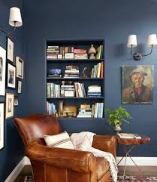

Slide 2
Learning Outcomes
After this lesson the Students will able to …
talk about the picture.
Write a paragraph on a reading room

Slide 3
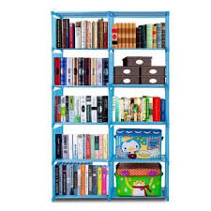
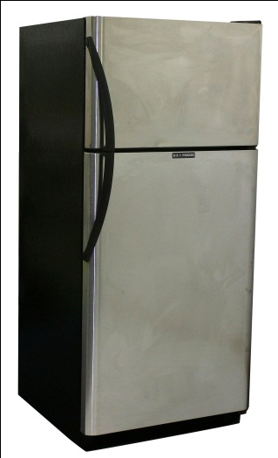
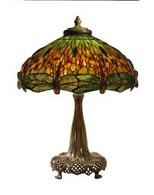
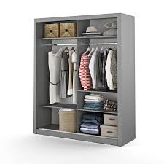
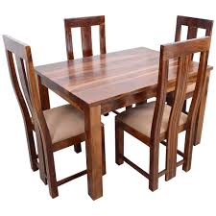
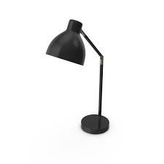
Look at the pictures and find out which things are usually needed in a reading room?
Bookshelf
Refrigerator
Table lamp
wardrobe
Tablechair
Table lamp

Slide 4
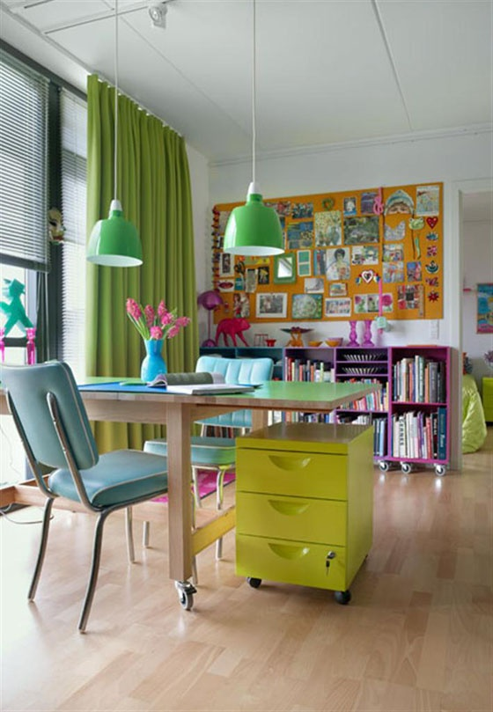
What do you see in the picture?
a) A bed room
b) A classroom
c) A reading room

Slide 5
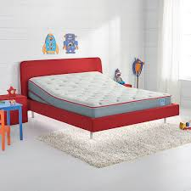
Look at the picture. This is Karim’s reading room. Now describe the picture. (Pair Work)

Slide 6
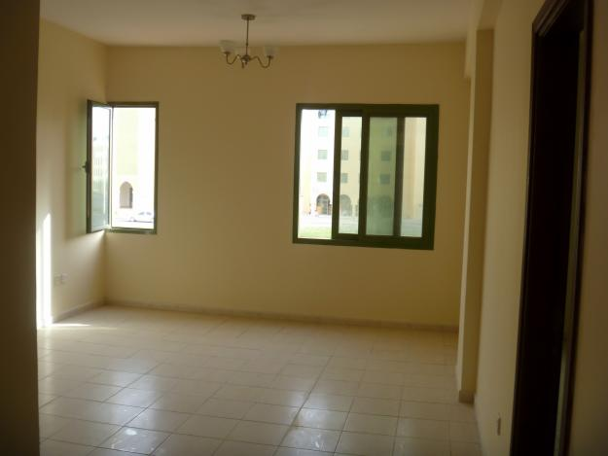
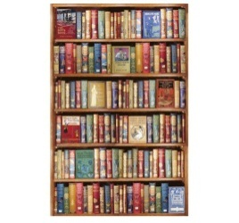
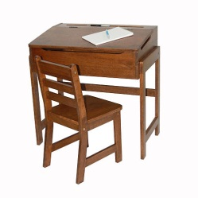
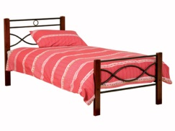
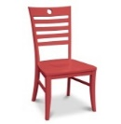
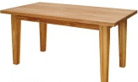
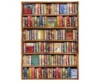
Re-write the following passage using the name of the pictures. (5 minutes)
Babul is a student. He has a reading room. It has two windows and one door. There are a , a and a . On the table there are a and a . Books are nicely arranged in the bookshelf. His reading room is very neat and clean. It also serves the purpose of his room.He loves his reading room very much.

Slide 7
Answering the following questions write a paragraph on “Your Reading Room”. (10 minutes)
1. What is a reading room?
2. What things are there in your reading room?
3. How iAs your reading room arranged?
4. How does it look?
5. How do you feel in your reading room?

Slide 8
HOME WORK
Write 6 sentences about Reading room

