Slide 1
Welcome to my MMC

Slide 2
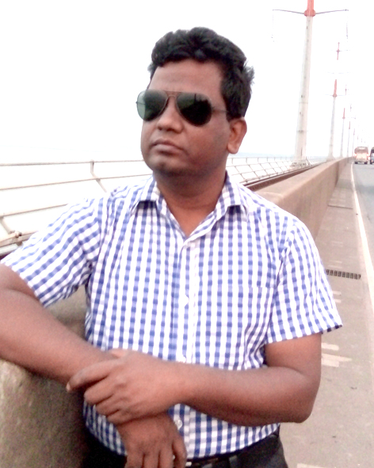
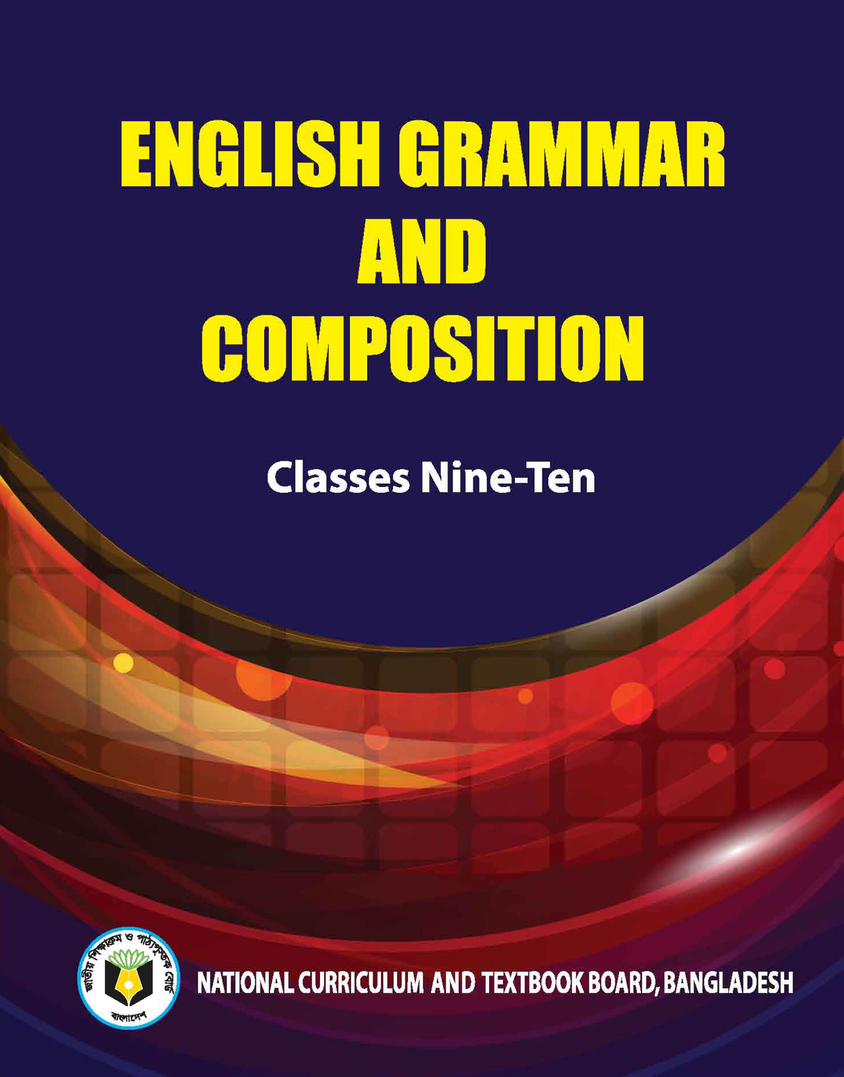
Identity
Teacher’s Identity
Lesson Introduction
Jahangir Alam
Assistant Headmaster
Dighulia Shahid Mizanur Rahman High School, Tangail.
E-mail: Jahangir.icttang@gmail.com
Cell : 01710500769.
Class : IX-X
Section : A
Sub : English Second Paper
Topic : Completing Sentence

Slide 3
we lived.
This is the house where _________
What kind of sentence is this?
Completing sentence
Let us discuss about completing sentence.

Slide 4
Be continued after part – 3.

Slide 5
Completing item - 22
How to complete a sentence with ‘relative pronouns/words’
who, which, what, that, when, while, where, why, whom, whose, how.
I built.
This is house that ______
Formation : Given item with relative/word + relevant clause.
Notes:
So………… that (এত... যে)

Slide 6
Activities (Check your answers)
I saw the sky which ____________
There was a plane that ______________
The plane was on the runway what ______________
When the plane was taking off ,
looked blue.
was taking off.
was launching.
I was enjoying very much.

Slide 7
Completing item - 23
Use of ‘without + gerund’
Formation: Given without + gerund + subject (personal) + can not/could not + verb + extension.
you cannot make a good health.
Without reading attentively __________
Without taking physical exercise _____
Without respecting others _______
Without take medicine ________
Activities

Slide 8
Completing item - 24
Use of ‘if conditional (1st conditional)’
If + Present + Future/Future modal
If + Sub + V1 +, + Sub + will + V1
If you come, _________
I will go.
First conditional describes a particular situation not in general/ not habitual.
Activities
If you study regularly ____
If you play well ____

Slide 9
Completing item - 25
Use of ‘if conditional (2nd conditional)’
If + Past simple + Past modal
If + Sub + V2 +, + Sub + would + V1
If you came, ___________
I would go.
Second conditional is used to talk about something in the present which is impossible, because it's not true.
Activities
If you studied regularly ____
If you played well ____

Slide 10
Completing item - 26
Use of ‘if conditional (3rd conditional)’
If + Past perfect + Future perfect in the past
If + Sub + had + V3 +, + Sub + would have + V3
If you had come, __________________
I would have gone.
It talks about the past. It's used to describe a situation that didn't happen, and to imagine the result of this situation.
Activities
If you studied regularly ____
If you played well ____

Slide 11
Completing item - 27
Use of ‘if conditional (Zero conditional-Universal truth)’
Zero conditional = If + Present + Present
If + Sub + V1 +, + Sub + V1
If people eat balance diet, ____________
they keep fit.
If you are ill, __________________
you go to doctor.

Slide 12
Completing item - 28
Use of ‘would that/ wish’
I wish, ____________
I were a bird
I wish, ____________
I were there.
I wish, ______________________
I could have been there.

