Slide 1
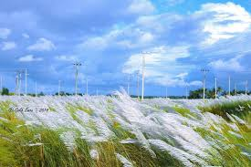
Welcome

Slide 2
Introduction
Teachers Info
Abul kucher
Assistant Teacher, ICT
Bishowanathpur Salameia
Hossaina Dhakil Madrasha
Class Info
Class : Seven
Subject: English 1st Paper
Lesson: ?
Time: 50 minutes

Slide 3
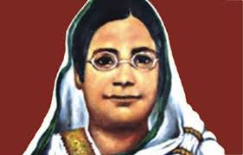
Let’s see the picture
What are you see in this picture?
Who is she?

Slide 4
Let’s see a video
Notes:
Elicitation

Slide 5
Lesson Title
Great women to remember
Notes:
Title of the lesson: Nakshi Kantha

Slide 6
After this lesson, student will be able to :
Talk about people .
Understand text by silent reading.
Write answers to question.
Notes:
Title of the lesson: Nakshi Kantha

Slide 7
Read the passage silently

Slide 8
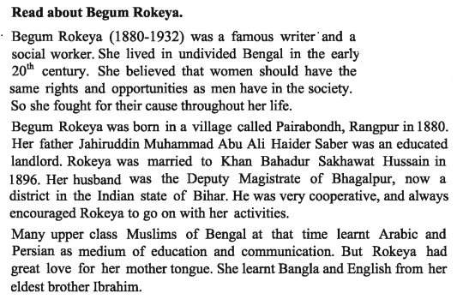
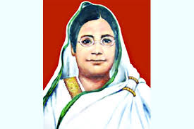
Silent Reading
Notes:
Title of the lesson: Nakshi Kantha

Slide 9
Let’s see the key words of the passage

Slide 10
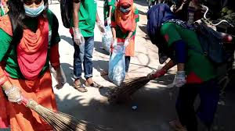
Key Words
Social worker
"Social workers work with individuals and families to help improve outcomes in their lives.
Notes:
Title of the lesson: Nakshi Kantha

Slide 11
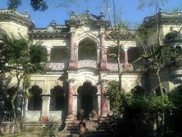
Key Words
Landlord
A landlord is the owner of a house, apartment, land.
Notes:
Title of the lesson: Nakshi Kantha

Slide 12
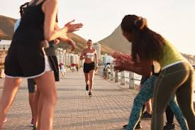
Key Words
Encourage
give support, confidence, or hope to (someone).
Notes:
Title of the lesson: Nakshi Kantha

Slide 13
Answers the question.
1.Where Begum Rokeya was born?
2.What did she fight for?
3.Why did Rokeya learn Bangla and English?
Notes:
Title of the lesson: Nakshi Kantha

Slide 14
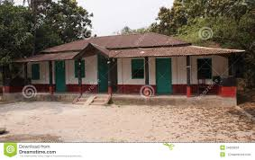
Home Work
Write 5 sentence
“ The roles of Begum Rokeya in the awakening of women”.
Notes:
Title of the lesson: Nakshi Kantha

Slide 15
Thank you
Notes:
Title of the lesson: Nakshi Kantha

