Slide 1


Welcome

Slide 2

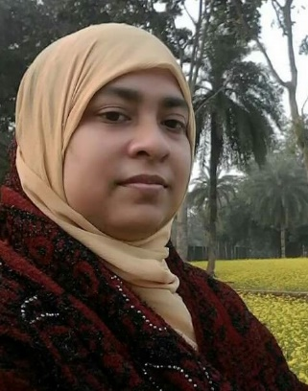
Introduction
Sherina Khatun
Assistant Teacher(ICT)
Baniargati Mohila Model Dakhil Madrasah
Jashore Sadar, Jashore.
Email: sherinkhatun4@gmail.com

Slide 3

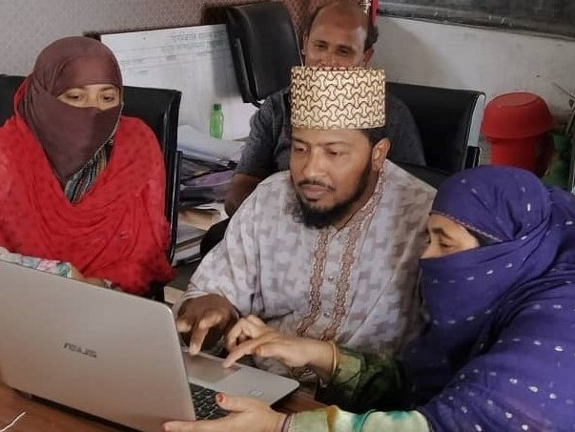
Working alone looks bored
Working together looks happy

Slide 4

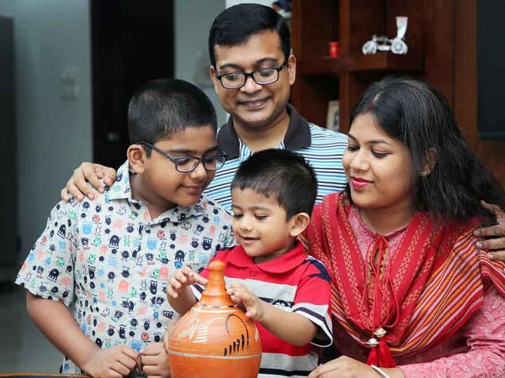
Which picture do you unlike?
Living alone
Living with family

Slide 5
Our Today’s lesson is--------
Our Today’s lesson is--------
Can you Live alone?
Unit: one, lesson: one.
Time: Forty Five.
Can you Live alone?
Unit: one, lesson: one.
Time: Forty Five.

Slide 6
Learning Outcomes
After we have studied the lesson, students will be able to
Ask and answer questions.
Narrate incidents.
Listen and understand others.
Read and understand the text through silent reading.

Slide 7
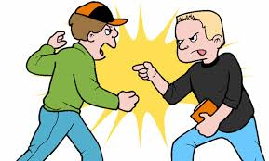
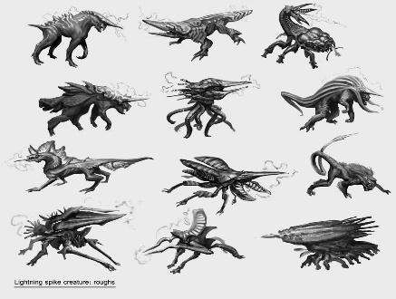

Vocabulary
QQuarrel
Clash
Creature
aAnimal
Forest
Jungle

Slide 8



Vocabulary
WWood
Timber
Grass
Straw
Blanket
Partial

Slide 9
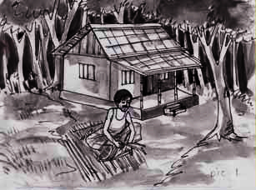
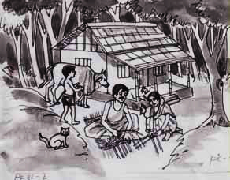
A Look at the pictures and discuss in pairs the following questions.
1 Can you live alone in a house?
2 Make a list of the problems you think you will have if you live alone in a
house, e.g. having accidents, cooking, etc.

Slide 10
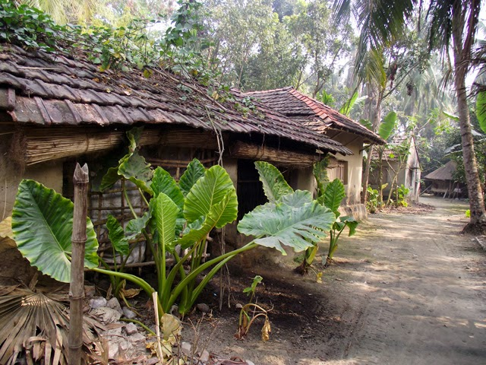
Long ago, a young man who lived in a village

Slide 11
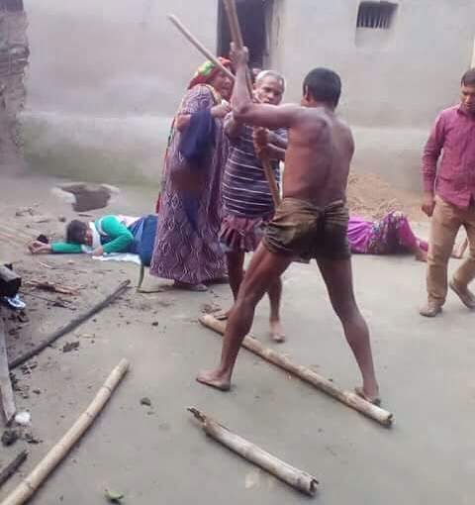
But his life is full of problems and sufferings, such as ill-fellings, Quarrels, jealousy, enmity –all were part of everyday life.

Slide 12

Jungle
So, he left his house and went to a jungle.

Slide 13
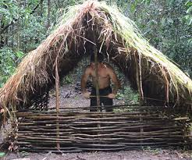
He made a hut with wood, bamboo and reeds

Slide 14
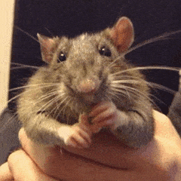
But one day he found some mice in his hut.The little creatures soon made holes in his blanket.

Slide 15
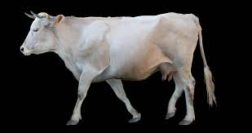

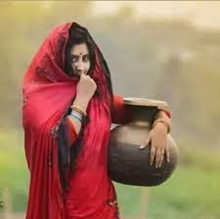
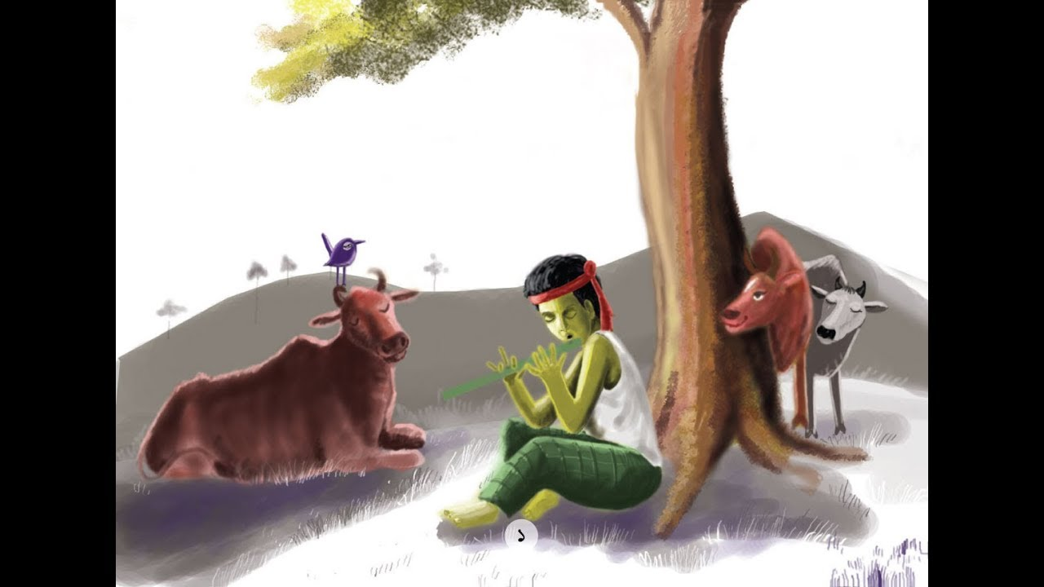
So, he brought a cat to kill the mice.
So, he brought a cow . The cow needed grass and hay.
The cat needed milk
So , he brought a cowboy
So , he took a wife to cook meals.
The cowboy needed food

Slide 16
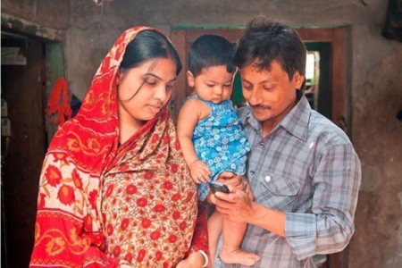
Then children where born to them , and the man found himself again in a family.
So, nobody can not live alone.

Slide 17
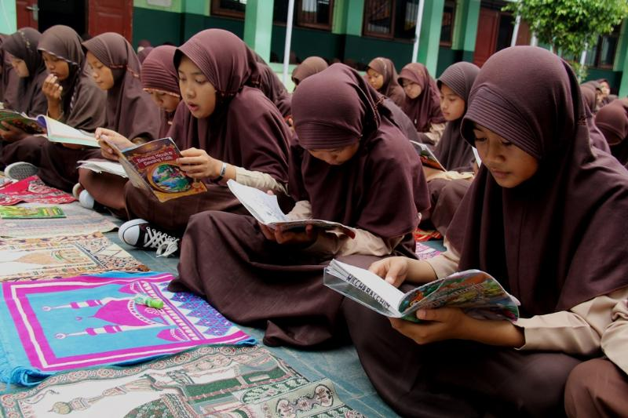
Silent Reading
B Read the story and answer the questions that follow.
Long ago, a young man found life in the family in his village full of problems and sufferings. Quarrels, ill-feelings, jealously, enmity - all were part of everyday life there. So he left his house and went to a jungle to live by himself. There he made a nice little hut with wood, bamboo and reeds. “Ah, how happy I am here!” said the man to himself. But one day he found some mice in his hut. The little creatures soon made holes in his blanket. So he brought a cat to kill the mice. The cat needed milk. So he brought a cow. The cow needed grass and hay. So he brought a cowboy. The cowboy needed food. So he took a wife to cook meals. Then children were born to them, and the man found himself again in a family. So nobody can live alone, unless they are either angels or devils. People need food, shelter, companions and cooperation. They need to help each other. And if they live in a family or community, their need can be fulfilled. Hence living in society can make people good and happy citizens.

Slide 18
Answer these questions. First discuss in pairs, then write the answers individually.
1.How was the life of the young man in the village?
2.Why did the young man make the hut with?
3. What do people need for living?
4. Who can live alone?
5. How was the relation among the village people?

Slide 19
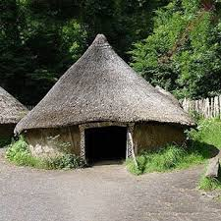
Home work
Write a letter to your friend describing about the village life.

Slide 20

All The Best
Allah Hafez

