Slide 1
Welcome to my MMC

Slide 2
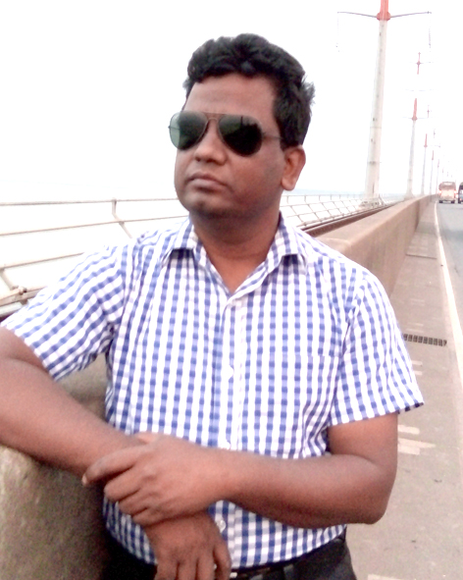
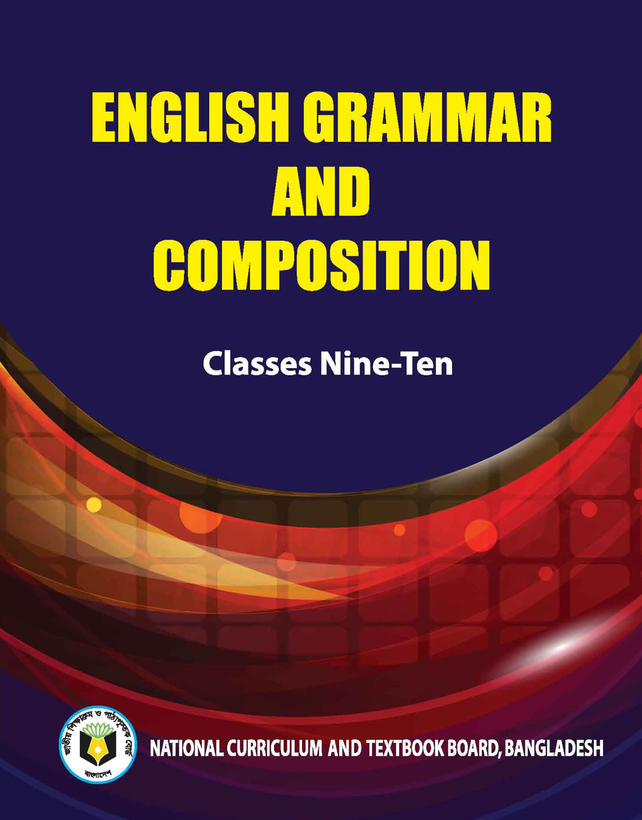
Identity
Teacher’s Identity
Lesson Introduction
Jahangir Alam
Assistant Headmaster
Dighulia Shahid Mizanur Rahman High School, Tangail.
E-mail: Jahangir.icttang@gmail.com
Cell : 01710500769.
Class : VI
Section : A
Sub : English Second Paper
Topic : Present Indefinite Tense

Slide 3
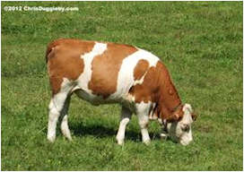
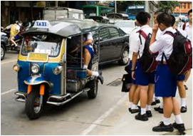
Mind set up :
Can you speak in English about the following pictures ?
The cow lives on grass.
The sun rises in the east.
They go to school everyday.
T. You are right. Thank a lot. Everybody claps for him
T. Can you say what kind of tense are those ?
S. Sir, They are present Indefinite tense.

Slide 4
Lesson declaration
So, we will discuss on-
Present Indefinite Tense

Slide 5
Lesson Outcomes
By the end of the lesson students will be able to
tell how many kinds of tenses ;
write the structure of Present Indefinite Tense ;
make correct sentence according to Present Indefinite Tense.

Slide 6
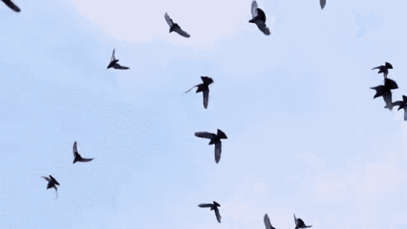
Present Indefinite Tense
Can anyone say the definition of Present Indefinite Tense.
Definition: Present Indefinite Tense denotes an action in the present time of habitual event, universal truth, historical events and near future.

Slide 7
Present Indefinite Tense
Can anyone say the structure of Present Indefinite Tense
Aff : Sub + V1 + obj.
Neg : Sub + do not/ does not + V1 + obj.
Intre : Do/ Does + Sub + V1 + obj ?
If subject is third person singular number then s/es will be add with principle verb.

Slide 8
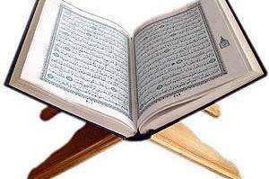
Present Indefinite Tense
If in the sentence there is everyday/ always/ regularly/ occasionally/ usually/ often/ sometimes/ generally , the sentence will be Present Indefinite tense.
Example : Mother reads the Quran everyday.
Regularly I pay my tuition fees. etc.

Slide 9
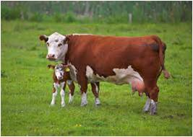
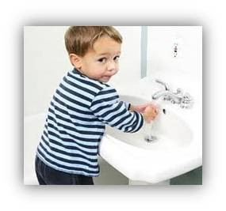
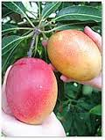
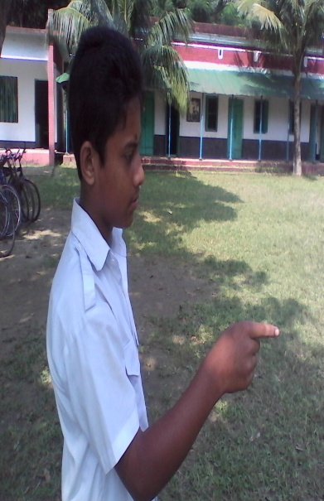
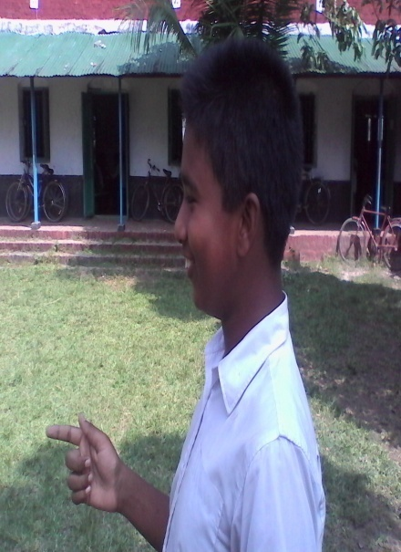
Pair work: Ask and answer - Follow the conversation
Yes, he does.
Do you like mango?
Yes, I do.
Mainly, what does the cow give us?
Mainly, The cow gives us milk?
Does he wash his hands before eating?
Now any two boys come to near my desk and make a dialogue using do/does or don`t/doesn`t.

Slide 10
Individual Work
Fill in the gaps with the right form of verbs that given in the box.
We (a) ___ to school everyday but Rana (b) ___ not to go school everyday. He (c) ___ football with his friends. (d) ____ you go to school everyday? What class does he (e) ____ in? Rahat (f) ___ in Dhaka with his family. Do you (g) ___ your school? Sabina (h) ___ a song. The sun (i) ___ in the east. A good teacher (j) ___ his class interesting.
Answers are as follows-
Do
plays
sings
read
does
rises
makes
love
lives
go

Slide 11
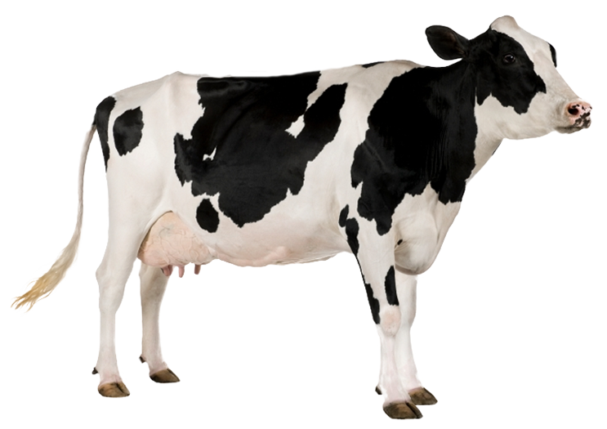
Group Work
Write three sentences (affirmative, negative and Interrogative) about the above picture according to the rules of Present Indefinite Tense.

Slide 12
Home Work
Write down five sentences that you and your sister do at your house. Using Present Indefinite Tense.

Slide 13
The End

Slide 17
Continue to next content

