Slide 1
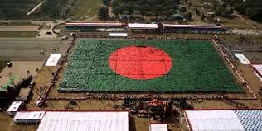
Notes:
…global causes.

Slide 2
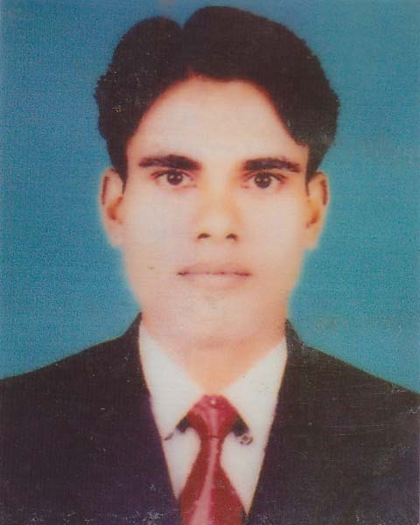
Khan Asaduzzaman Assistant Teacher Naldha Secondary School Fakirhat, Bagerhat.

Slide 3
Learning Outcome
By the end of the lesson, students should be able to -
Say about E-mail
talk about the form of E-mail
Speak about the process of writing E-mail
Write E-mail

Slide 4
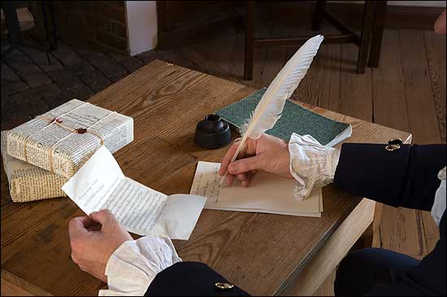
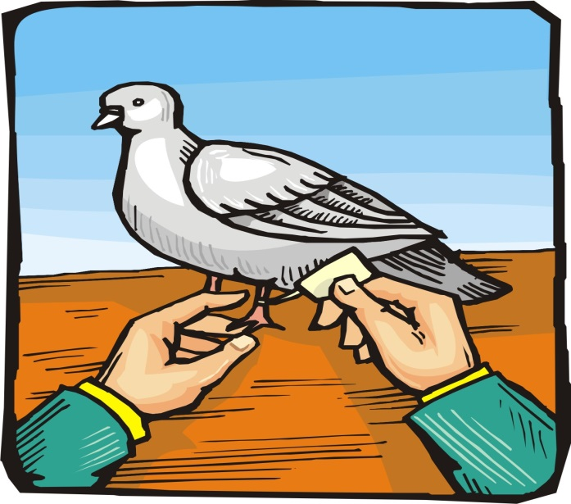
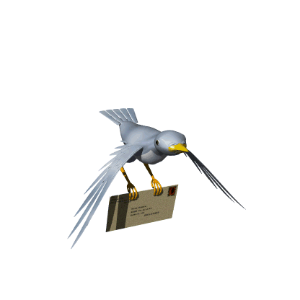
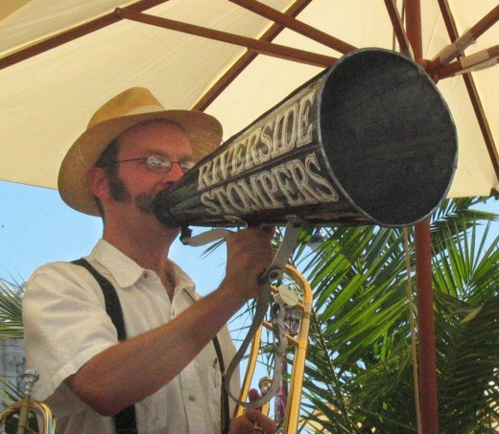
Some mode of communications in the ancient time
Notes:
In the past We use envelop to write letter and post it to post box . Post office collect it and send it by Runner.Next we use Mobile for sending message. But now use laptop , modem for sending letter or message through E-mail. So Today’s lesson E-mail writing.

Slide 5
Today’s lesson is on-

Slide 6
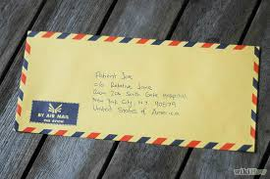
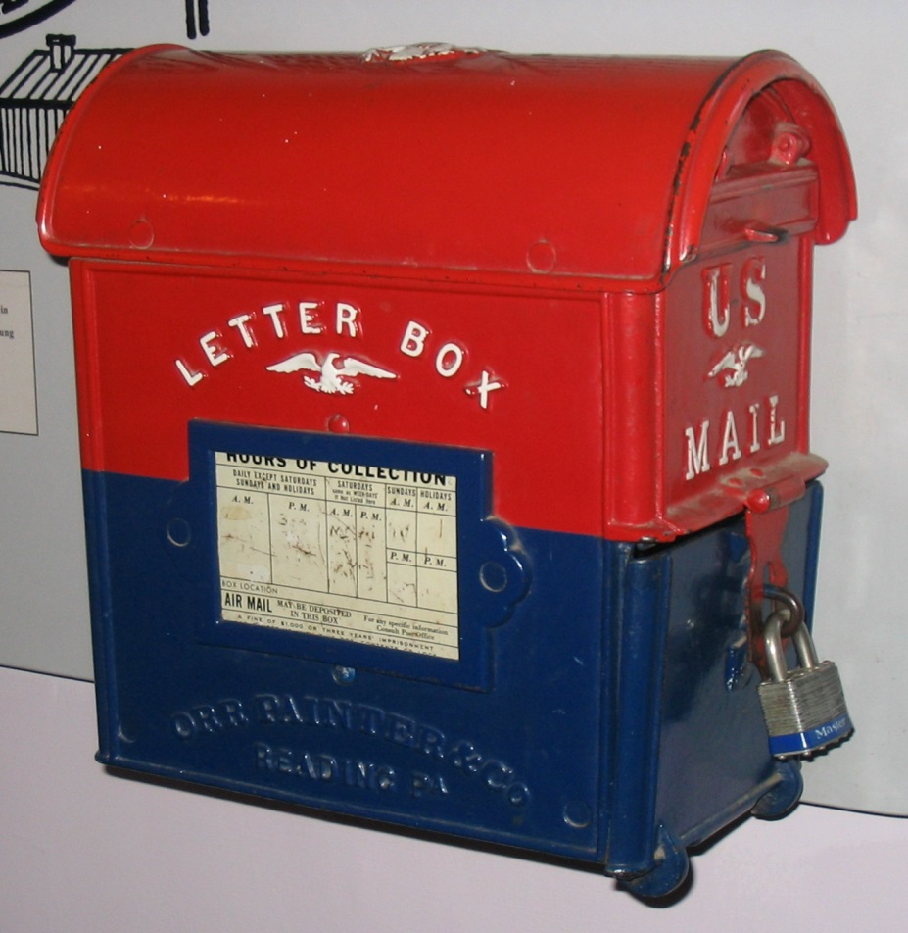
In the past, we used envelop to write letter and post it to post box . Post office collect it and send it according to its addresses.

Slide 7
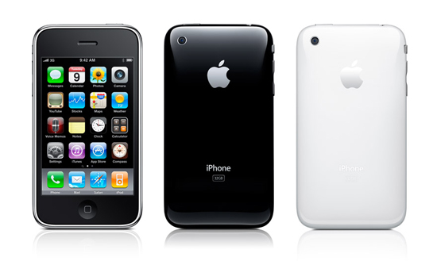
But now we use laptop, desktop or mobile phone for sending letter or message through E-mail.

Slide 8
What’s E-mail ?
Electronic Mail is popularly known as E-mail
It is an Electronic communication System.
It is a computer based messaging system.
We can send any messages or documents through it.

Slide 9
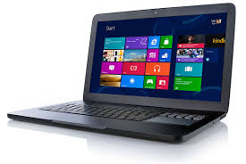
What do we need for E-mail ?
Computer
Notes:
Gmail.Hotmail.Yahoo.iCloud .They are free online e-mail service or search engine

Slide 10
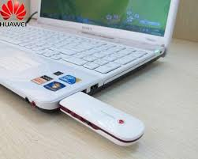
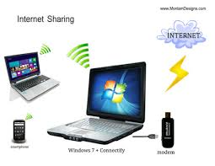
What do we need for E-mail ?
Internet Connection
Notes:
Gmail.Hotmail.Yahoo.iCloud .They are free online e-mail service or search engine

Slide 11
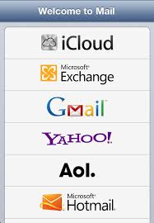
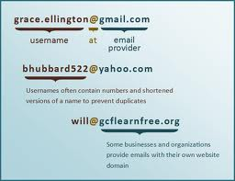
What do we need for E-mail ?
E-mail Account
Notes:
Gmail.Hotmail.Yahoo.iCloud .They are free online e-mail service or search engine

Slide 12
From :
Sender’s email address
asaduzzaman@yahoo.com.
To :
Receiver’s email address
abir1985@gmail.com
CC :
More receiver’s email Address
amir2000@hotmail.com.
BCC :
nafiza@gmail.com.
More receiver’s email address
Sent :
Sunday, 25. 01. 2015, 2pm.
Sent date and time
Name of the sub in short.
Sub :
Preparation for the exam.
Body of the E-mail in short.
Cc=Carbon Copy.
Bcc =Blind Carbon Copy

Slide 13
From : <abir> @gmail.com
To : <masud>@gmail.com
Cc :
Bcc :
Sent : Thursday, October 02 ,2019; 10:00pm
Subject : Request to return book
Dear Masud,
Hope you are having a nice time .It is a long time since you borrowed my book entitled " A book of English Grammar and Composition" .You have forgot to return it. My exam is knocking at the door. So I am badly in need of the book.
Please return the book to me without delay.
Best regards
Abir.

Slide 14
Group Work
Group A
Make An E-mail Structure
Group B
Write five
E-mail Addresses

Slide 15
Evaluation
*What is E-mail?
** What is gmail/Yahoo/Hotmail?
** In an E-mail What is written to “To”?
* In an E-mail What is written to “Subject”?
** In an E-mail What is written to “Cc”?
* In an E-mail What is written to “Sent”?
** Say an e-mail address ?

Slide 16
Home Work
Suppose You are Kamal/ zamia . Write an e-mail to your friend inviting him on your birthday party.

Slide 17
Thanks all

