Slide 1
Welcome to all
One day one word
Our todays word----Work

Slide 2
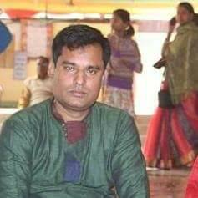
Presented by
Uttam Chandra Samadder
Head Teacher
Kachipara government primary school
Bauphal,Patuakhali.

Slide 3
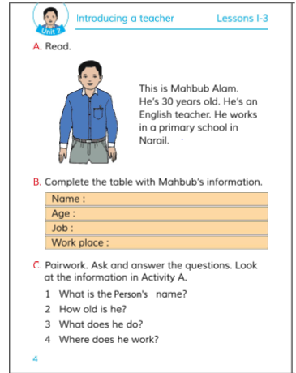
Subject-English
Class-Three
Lesson-1-3 Unit-2
Introducing a teacher.

Slide 4
Our todays word---
Work---vowel---ওয়ার্ক---কাজ করা।

Slide 5
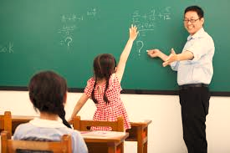
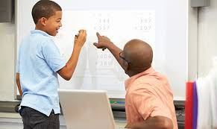
Look at the pictures

Slide 6
Our todays lesson
Introducing someone.

Slide 7
Learning outcomes
At the end of the lesson…
SS will be able to…………
10.1.1 Write short and simple paragraph by answering a set of questions.

Slide 8
Say after me
This is Mahabub Alam

Slide 9
This is Uttam Samadder.

Slide 10
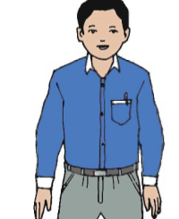
He’s 30 years old.
He’s 45 years old.

Slide 11
He is an English teacher.
He is an English teacher.

Slide 12
He works in a primary school in Narail.
He works in a primary school in Patuakhali.

Slide 13
Pair work
Read the topics in pair.

Slide 14
Complete the table with Mahabub’s information.
Name:
Age:
Job:
Work Place:
Pair
Work

Slide 15
Playing a missing word game.

Slide 16
Write a paragraph answering the questions
Pair/Single work.
1.What is the person’s name?
2.How old i8s he?
3.What does he do?
4.Where does he work?

Slide 17
Think about a person.
Draw a picture of the person.

Slide 18
Compleat the sentences….
This is ………………………..
He/she is ………………………
He/she is……………………….

