Slide 1

Welcome

Slide 2
Introduction
Teachers Info
Abul kucher
Assistant Teacher, ICT
Bishowanathpur Salameia
Hossaina Dhakil Madrasha
Class Info
Class : Six
Subject: English 1st Paper
Lesson: ?
Time: 50 minutes

Slide 3
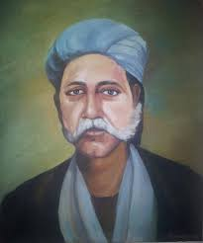
Let’s see the picture
Who is he?

Slide 4
Let’s See a Video
http://youtube.com/watch?v=q4ab8aYF4fc

Slide 5
Lesson Title
Hason Raja:The mystic bard of Bangladesh
Notes:
Title of the lesson: Nakshi Kantha

Slide 6
After this lesson, student will be able to :
Understand text by silent reading.
Read aloud with proper pronunciation, stress and intonation.
Notes:
Title of the lesson: Nakshi Kantha

Slide 7
Read the passage silently

Slide 8
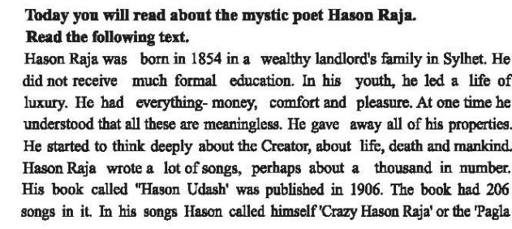
Silent Reading
Notes:
Title of the lesson: Nakshi Kantha

Slide 9
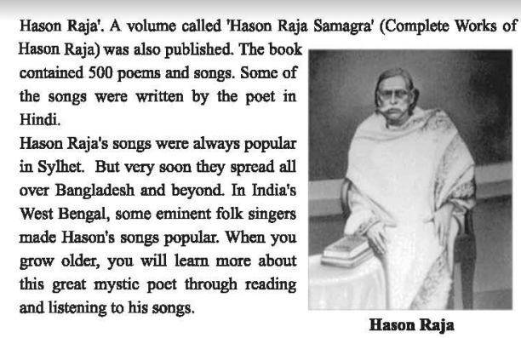
Silent Reading

Slide 10
Let’s see the key words of the passage

Slide 11
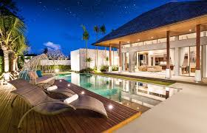
Key Words
luxury
a state of great comfort or elegance, especially when involving great expense
Notes:
Title of the lesson: Nakshi Kantha

Slide 12
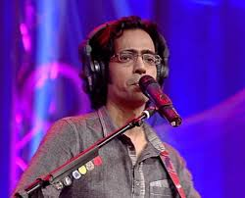
Key Words
song
A song is a musical composition intended to be sung by the human voice
Notes:
Title of the lesson: Nakshi Kantha

Slide 13
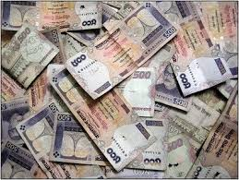
Key Words
Money
Money is any item or verifiable record that is generally accepted as payment for goods and services
Notes:
Title of the lesson: Nakshi Kantha

Slide 14
Individual Work
1.When was Hason raja born?
2.Where did he come from?
3.What was his childhood like?
4.What was the other name by which Hason Raja was known?
Notes:
Title of the lesson: Nakshi Kantha

Slide 15
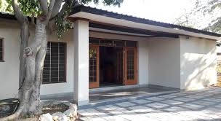
Home Work
Briefly described Why hason called him “Crazy hason Raja” .
Notes:
Title of the lesson: Nakshi Kantha

Slide 16

Thank you
Notes:
Title of the lesson: Nakshi Kantha

